Slide 1
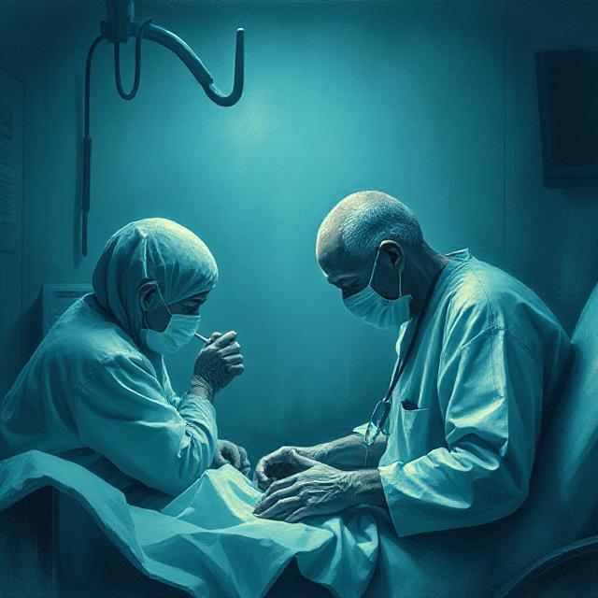
Immunothrapy for cancer
Mohadese baniasadi

Slide 2
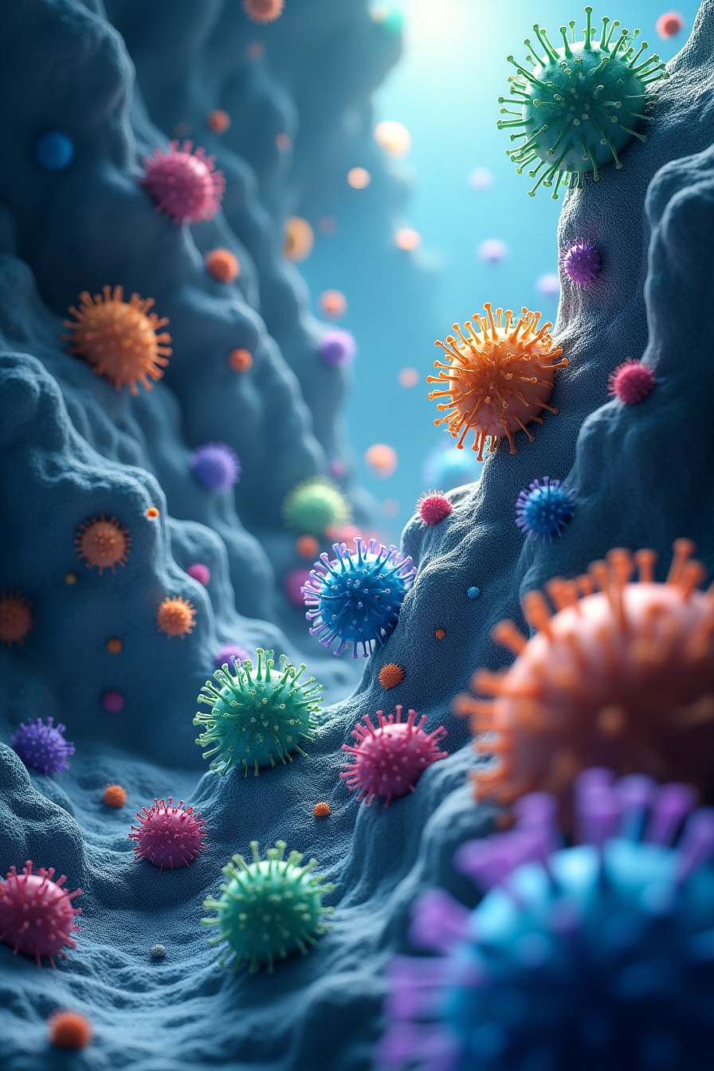
These vaccines are powerful immunotherapeutic platforms against cancer due to their high potency, specificity, versatility, rapid development, large-scale capability, low-cost manufacturing, and safety. Recent advances in mRNA vaccine design and delivery have accelerated the development and clinical application of mRNA cancer vaccines.
Cancer Vaccine Platforms: Various cancer vaccine platforms are discussed with an emphasis on nucleic acid vaccines.
Design and Optimization: Rational design and optimization strategies for mRNA cancer vaccine development are reviewed.
Delivery Systems: The review highlights available platforms for the delivery of mRNA vaccines, particularly focusing on lipid nanoparticles (LNPs)-based delivery systems.

Slide 3

mRNA Cancer Vaccines
Effectiveness in Melanoma
A vaccine encoding four tumor-associated antigens (TAA: NY-ESO-1, MAGE-A3, tyrosinase, and TPTE) has been effective in treating melanoma.
Personalized mRNA Vaccines
BioNTech and Moderna have developed personalized mRNA vaccines showing promising anti-tumor effects. Moderna's mRNA-4157 and BioNTech's BNT122 are in phase II clinical trials, targeting up to 34 and 20 neoantigens, respectively.

Slide 4

DNA Cancer Vaccines
Engineered DNAs
DNA vaccines encode for one or more TAAs, crossing the cell membrane of antigen-presenting cells (APCs) to start transcription, resulting in the presentation of antigens to stimulate an immune response.
Clinical Trials
DNA cancer vaccines like VGC-310 for HPV-related cervical cancer have shown promising results in clinical trials.

Slide 5
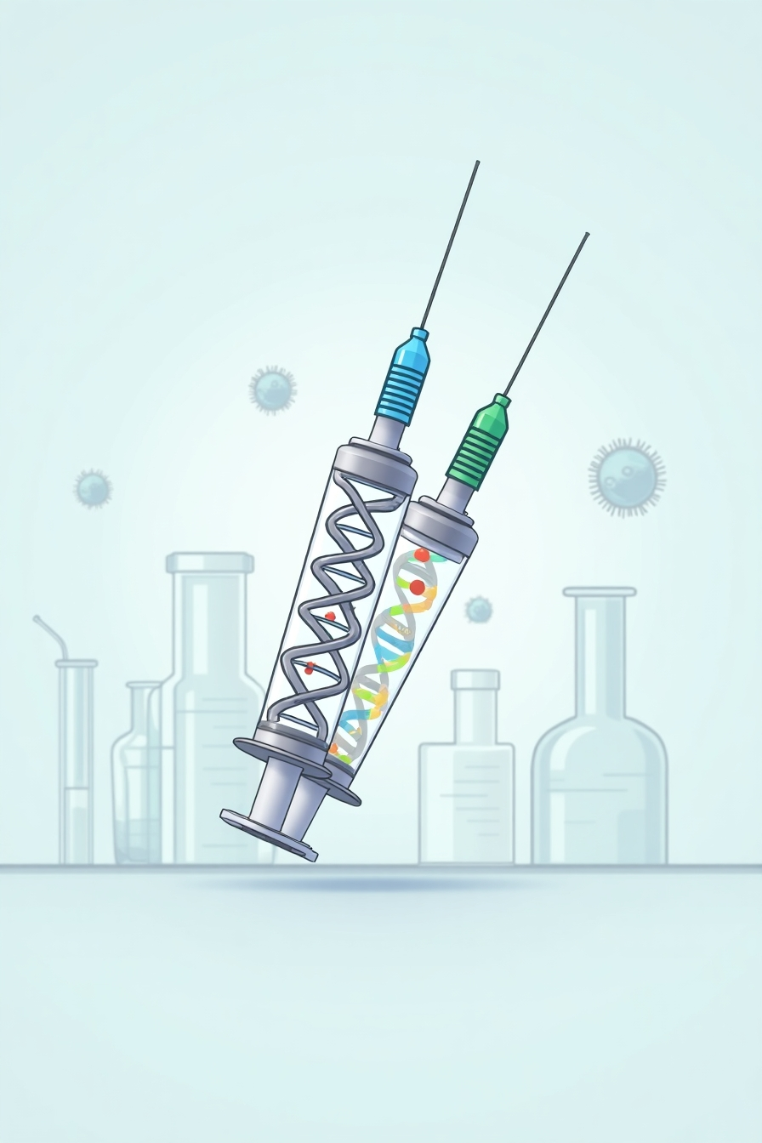
Targeting the Immune System
mRNA vaccines are engineered to encode TAAs and activate the innate immune response, allowing easy manipulation and modification of RNA. The COVID-19 pandemic has increased societal acceptance of mRNA vaccines.
Development and Deployment
Multiple mRNA cancer vaccines are in development, targeting tumor-infiltrating lymphocytes (TIL) and specific TAAs.
Comparison with mRNA Vaccines

Slide 6
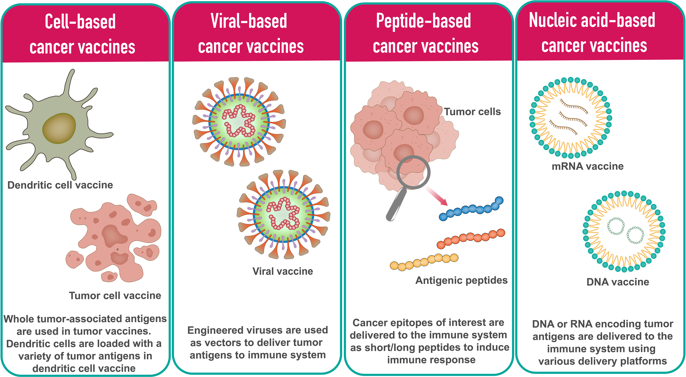
Figure 1
Cancer vaccine platform types

Slide 7
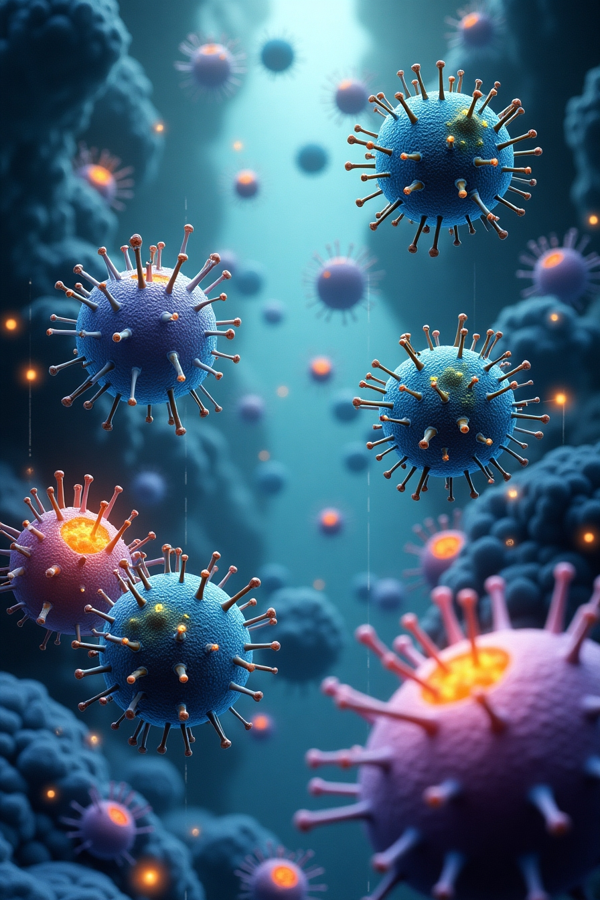
Cell-based Cancer Vaccines:
Tumor Cell Vaccines
Utilizes allogenic or autologous patient-derived tumor cells, which can be genetically modified to enhance immune response. Dendritic cells (DCs), being professional antigen-presenting cells (APCs), are used in DC-based vaccines by loading them with tumor antigens (DNA, RNA, peptides).
Clinical Trials
Tested in phase I, II, and III clinical trials.

Slide 8

Peptide-based Cancer Vaccines
Synthetic Peptides
Consist of highly immunogenic tumor-specific peptide antigens. These peptides are taken up by APCs and presented on the cell surface with HLA molecules to elicit an immune response.
Examples
HBV and HPV vaccines for liver and cervical cancers.

Slide 9
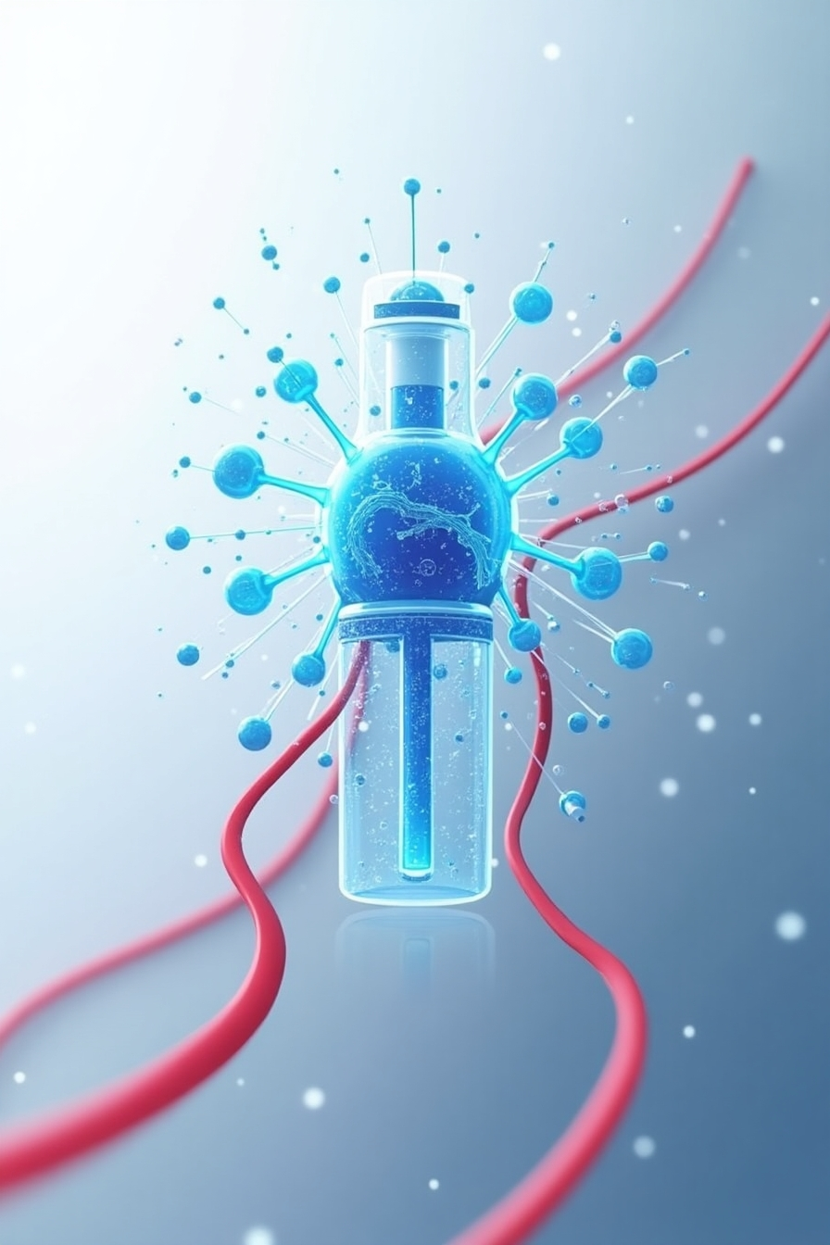
Engineered Viruses
Use viruses' genetic content to include sequences encoding TAAs. Common viral vectors include adenoviruses, poxviruses, and alphaviruses.
Oncolytic Viruses
Infect and kill tumor cells while promoting anti-tumor responses, e.g., T-VEC, a recombinant oncolytic herpes simplex virus.
Viral-based Cancer Vaccines

Slide 10
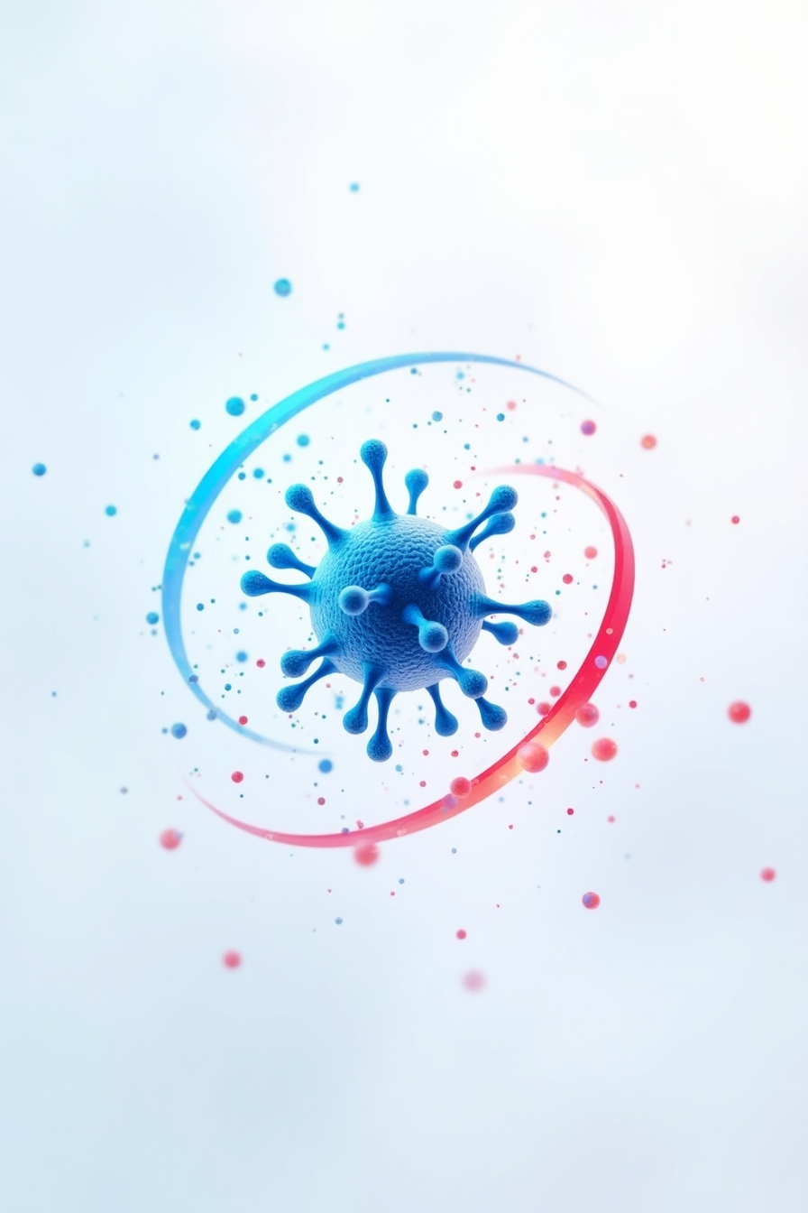
DNA and RNA Vaccines
Contain antigens encoded by DNA or RNA. DNA vaccines encode TAAs and move to the nucleus to start transcription, resulting in antigen presentation by APCs.
Challenges
Include poor immunogenicity and durability.
Nucleic Acid-based Cancer Vaccines

Slide 11
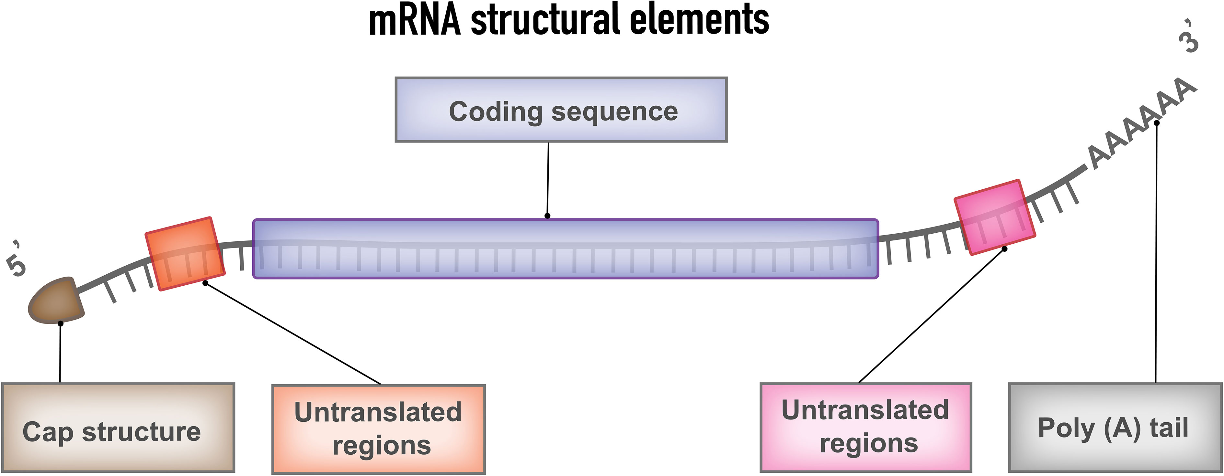
1. Structure of Typical mRNA
Comprises a cap, 5′-untranslated regions (UTR), 3′-UTRs, an open reading frame (ORF) encoding cancer antigens, and a poly(A) tail.
These components can be modified to enhance stability, translation efficiency, and immunogenicity.
Rational Design and Optimization of mRNA Cancer Vaccines

Slide 12
2.1 Coding Sequence
Codon Composition
Affects translation efficiency. Substituting rare codons with regular synonymous codons can reduce translation time and increase yield.
Nucleotide Modifications
Incorporating chemically modified nucleotides (e.g., 5-methylcytidine, 1-methylpseudouridine, and pseudouridine) decreases immunogenicity and improves translational efficacy.
2.2 Noncoding Region
5′- and 3′-UTRs
Critical for mRNA stability and translation. Optimizing these regions increases efficiency and half-life.
5′-Cap Structure
Essential for mRNA capping and enhances the initiation process.
Poly(A) Tail: Influences regulation of mRNA in cellular translation.
2. Design
and Optimization Approaches

Slide 13
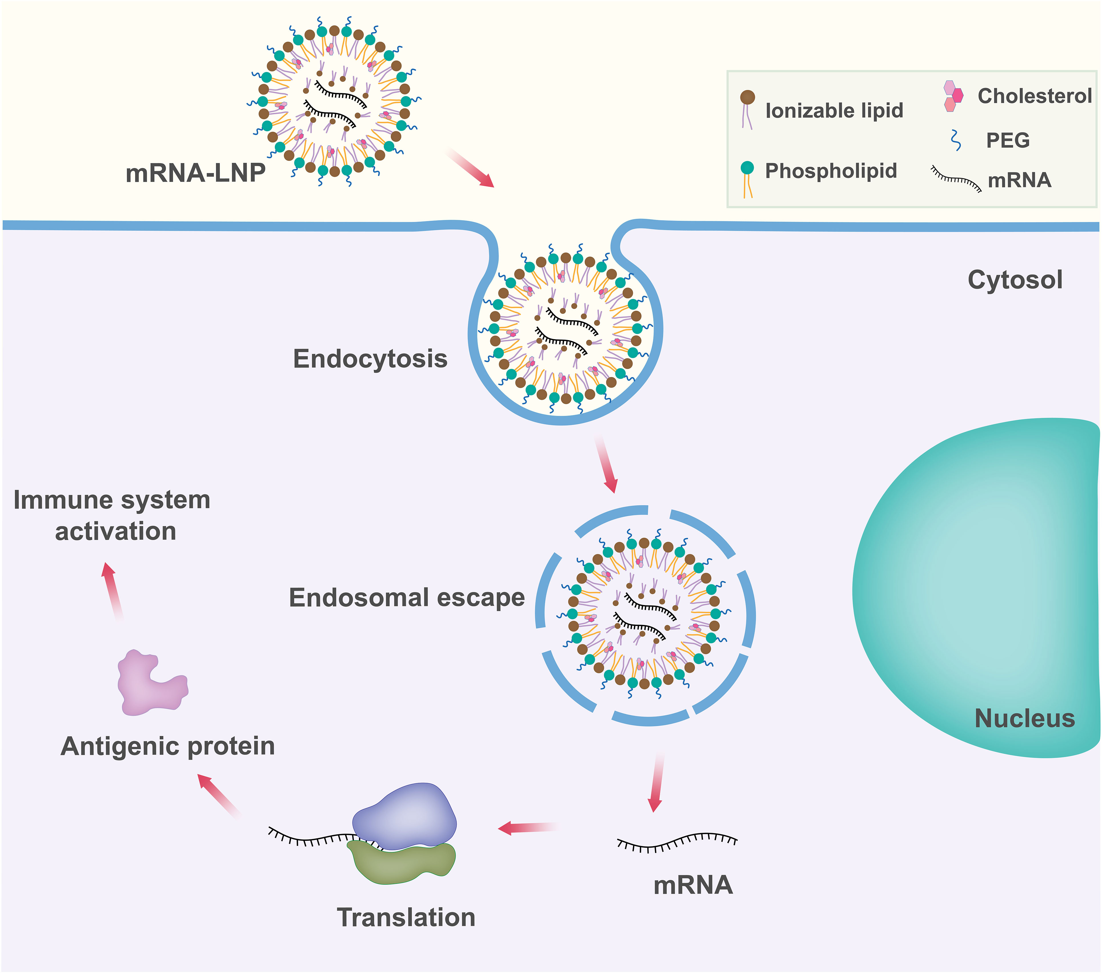
3.1 Ex vivo Loading of mRNA into DCs
Dendritic Cells (DCs)
Efficient APCs. mRNA is delivered to DCs, which are then activated to present tumor antigens and stimulate T cells against tumor cells.
3. Delivery Format Optimization

Slide 14
3.2 Direct Injection of mRNA with or without a Carrier
Naked mRNA Vaccines
Can be directly injected to induce antigen-specific immune responses. Limitations include a short extracellular half-life due to rapid degradation.
Viral Vector-Based Technologies
Used to deliver mRNA vaccines but limited by anti-vector immunity.
Lipid-based Nanocarriers (INPs)
Protect mRNA from degradation and efficiently deliver mRNA to target cells. These are typically ~100 nm and consist of lipid components that facilitate mRNA release into the cytoplasm.
Polyethylene Glycol (PEG) Lipids:
Comprise <5% of total formulation. They stabilize and diminish surface charge, inhibiting particle aggregation.

Slide 15
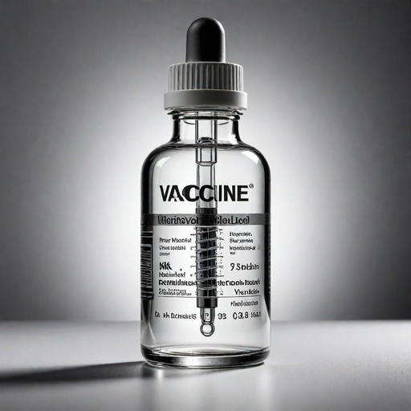
Route of Administration
Intramuscular and Intradermal Injections
Provide the highest level of immunity and longest duration of effect.
Intravenous Administration
Less preferred due to liver first-pass metabolism and less convenience.

Slide 16

Conclusion
The advantages of mRNA cancer vaccines, such as their ability to encode and express tumor-associated antigens (TAAs) and tumor-specific antigens (TSAs), induce both humoral and cellular immune responses, and offer rapid, flexible, and cost-effective production.The development of personalized mRNA cancer vaccines using next-generation sequencing (NGS) technology and computational approaches to predict HLA haplotype enrichment for rational vaccine design.The ongoing challenges and future directions, including improving the stability and in vivo delivery of mRNA vaccines, developing targeted delivery systems, and exploring combinations with other immunotherapies.
The promising future of mRNA cancer vaccines, driven by the technological revolution in this field and the potential for successful clinical translation, with the need for further development of personalized vaccines and clinical trials for different tumor types.

