Slide 1
WHO 2022 Classification of Lymphoid Neoplasms
Sirous jafari
MSC student in Hematology at kmu

Slide 2
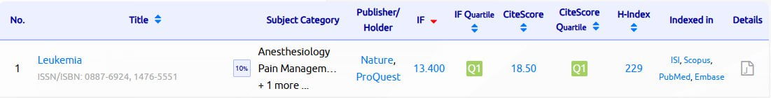

Slide 3
WHO Classification of Lymphoid Neoplasms (2022)
Comparison of WHO 2016 vs 2022
Focus: Molecular precision, simplified hierarchy, and integration of genetic data.

Slide 4
General Evolution
2016: Morphology and immunophenotype based.
2022: Molecular, genetic, and clinical integration.
Entities organized hierarchically; no provisional entities.

Slide 5
B-ALL Major Updates
Shift from cytogenetic to molecular classification.
BCR::ABL1-like ALL recognized officially.
New fusions added: DUX4, MEF2D, ZNF384, PAX5-related, TCF3::HLF.

Slide 6
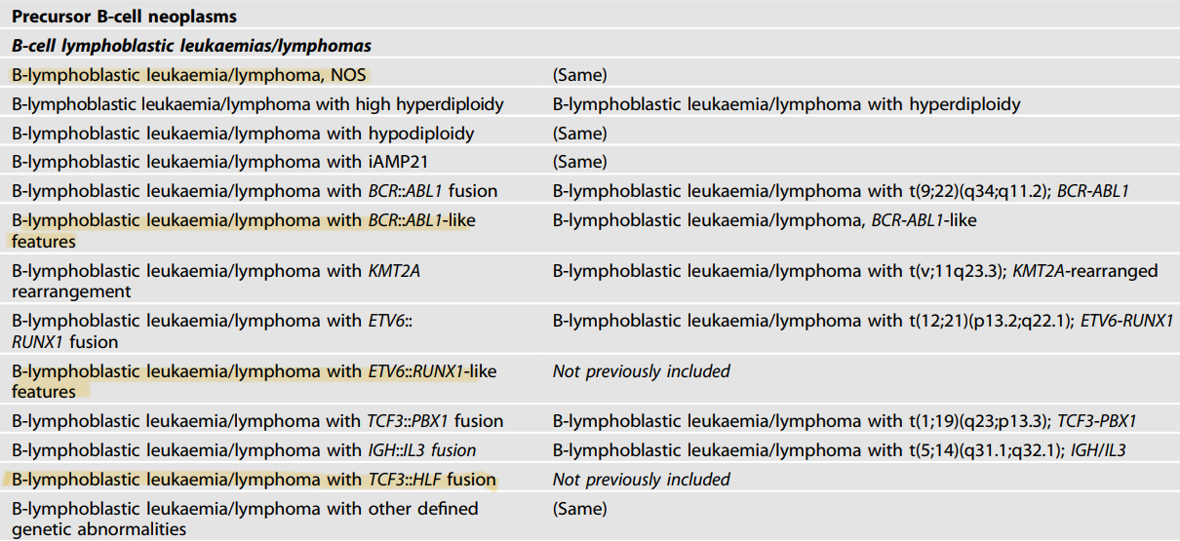

Slide 7
B-PLL and Splenic Neoplasms
B-PLL removed as independent entity (heterogeneous genetics).
New: SBLPN replaces HCL-variant and B-PLL overlap.
Classification now molecularly defined.

Slide 8
Marginal Zone Lymphoma (MZL)
2016: Classified by location (nodal, splenic, extranodal).
2022: Adds genetic criteria; new entity: Primary Cutaneous MZL.
Site-specific mutations recognized.

Slide 9
Follicular Lymphoma (FL)
2016: Single entity based on BCL2 translocation.
2022: Divided into classical, pediatric, duodenal types.
Grade 3B removed and reassigned to high-grade BCL.

Slide 10
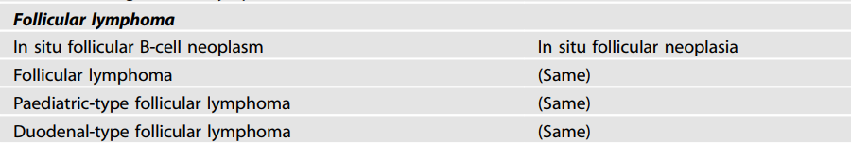

Slide 11
DLBCL (Diffuse Large B-Cell Lymphoma)
2016: GCB and ABC subtypes.
2022: Adds molecular subtypes (EZB, BN2, MCD, ST2, A53).
New forms: Fibrin-associated, Fluid overload–associated.

Slide 12
Lymphoplasmacytic Lymphoma (LPL)
2016: Single form associated with IgM.
2022: IgM and non-IgM forms recognized.
MYD88 and CXCR4 mutations key for diagnosis and therapy.

Slide 13
Precursor T-ALL/LBL
2016: Defined by morphology and cytogenetics.
2022: Adds molecular pathways (NOTCH1, JAK/STAT, BCL11B).
ETP-ALL officially recognized.

Slide 14
Indolent T-Lymphoblastic Proliferation (iT-LBP)
New benign/reactive lesion mimicking T-ALL.
Associated with Castleman or IgG4-related disease.
Non-neoplastic and limited proliferation.

Slide 15
Nodal TFH Cell Lymphomas
2016: AITL, FTCL, and provisional entity.
2022: Unified family 'Nodal TFH Cell Lymphomas'.
Defined by phenotype (PD-1, CXCL13) and mutations (TET2, RHOA).

Slide 16
EBV-related T/NK-cell Disorders
2016: Multiple separate entities.
2022: Integrated biological spectrum (indolent to aggressive).
Includes CAEBV (systemic/cutaneous), HV-like LPD, SMBA.

Slide 17
Classical and NLP Hodgkin Lymphoma
Definitions retained, no major structural change.
2022: Reinforced molecular origin from germinal center B cells.

Slide 18


Slide 19
Plasma Cell Neoplasms
Adds MGRS, cold agglutinin disease, and AESOP.
Broader recognition of paraprotein-associated disorders.

Slide 20
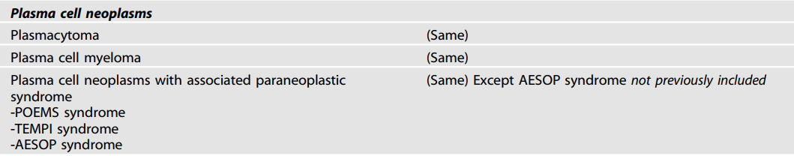

Slide 21
Spleen-Specific Tumours
2016: No spleen-specific section.
2022: New chapter for splenic entities.
Includes SBLPN, SDRPL, SMZL (with NOTCH2, KLF2).

Slide 22
Stromal and Dendritic Cell Tumours
Adds intranodal palisaded myofibroblastoma, splenic hamartoma.
EBV-positive inflammatory FDCS recognized.

Slide 23
Genetic Predisposition Syndromes
First inclusion: germline syndromes like ATM, NBN.
Clinical relevance for diagnosis, prevention, and counseling.

Slide 24
WHO Classification Philosophy
Goal: Global accessibility, reduce over-diagnosis.
Essential/Desirable criteria introduced for universal standardization.

Slide 25
tanks

