Slide 1
Efficient Generation of Mature Megakaryocytes and Functional Platelets from Human Embryonic Stem Cells
Presenter: Fatemeh Khademi
Supervisor: Dr. Mirzaei

Slide 2
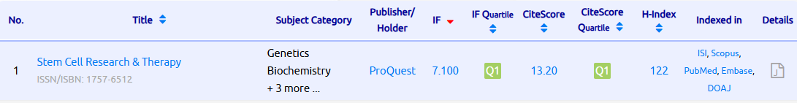
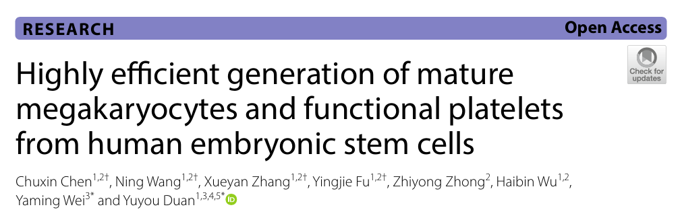

Slide 3

Table of Contents
02
04
01
03
05
method
DISCUSSION
Introduction
RESULTS
Conclusion

Slide 4
Introduction
Platelet transfusion is an essential therapy for bleeding disorders and hematologic malignancies.
Donor-derived platelets have major limitations: short shelf-life, immunologic incompatibility, and limited supply.
Producing platelets from pluripotent stem cells (PSCs) can overcome donor dependency.
However, previous systems were inefficient, animal-derived, or genetically manipulated

Slide 5
Introduction
Megakaryocytes (MKs) are large bone marrow cells responsible for platelet production.
Human embryonic stem cells (hESCs) can differentiate into all blood lineages.
Mimicking embryonic hematopoiesis in vitro may yield mature MKs and platelets.
This study establishes a 4-stage, 3D xeno-free differentiation protocol for high-quality platelet generation.

Slide 6
Aim of the Study
To develop an efficient and clinically applicable strategy to:
Generate mature megakaryocytes and functional platelets from hESCs under xeno-free conditions.
Characterize the produced cells using phenotypic, molecular, and functional assays.
Validate platelet function in vitro and in vivo.

Slide 7
Table of Contents
02
04
01
03
05
method
DISCUSSION
Introduction
RESULTS
Conclusion

Slide 8
02
METHODS
Differentiation performed in four sequential stages in a 3D spheroid system.
Oxygen concentration was adjusted by stage (hypoxia for early steps, normoxia for maturation).
All media were xeno-free and feeder-free.
Stepwise cytokines and growth factors guided lineage progression from hESC → MK → Platelet.

Slide 9
Stage I: Mesoderm Induction
Stage II: Endothelial Commitment
hESCs cultured in APEL medium with:
  BMP4 (10 ng/mL)
  Activin A (2 ng/mL)
  CHIR99021 (3 μM)
Cultured under 5% O₂ for 48 hours.
Purpose: to induce mesoderm progenitors (Brachyury⁺ cells).
Medium supplemented with VEGF (40 ng/mL) and bFGF (20 ng/mL).
Hypoxic culture (5% O₂) maintained.
Generated Hemogenic Endothelial Cells (HECs) expressing CD31, CD34 markers.
These HEC spheroids were later used as continuous sources of blood progenitors.

Slide 10
Stage III: MEP Formation
Stage IV: MK Maturation and Platelet Production
HECs transferred to media containing:
  TPO (100 ng/mL)
  SCF (50 ng/mL)
  IL-3, IL-6, IL-11
Produced Megakaryocyte–Erythroid Progenitors (MEPs) expressing CD41a⁺/CD235a⁺.
Cultures maintained at 5% O₂; MEPs harvested every 3 days up to Day 21.
MEPs cultured under normoxia (21% O₂) for 6–8 additional days.
Resulting mature MKs showed large size, polyploid nuclei (8N–16N), and proplatelet formation.
Released platelet-like particles (2–4 μm) into the medium.

Slide 11
Cell Characterization and Functional Tests
1
2
3
4
5
6
Flow Cytometry
RT-qPCR
Microscopy
CD31, CD34, CD41a, CD42b, CD61, CD62P, PAC-1
Expression of hematopoietic and megakaryocytic genes
Morphology and proplatelet formation (Giemsa/Wright stain).
DNA ploidy analysis
Functional Assays
Polyploidization of MKs
Activation with ADP/TRAP-6; in vivo transfusion in thrombocytopenic mice

Slide 12
Table of Contents
02
04
01
03
05
method
DISCUSSION
Introduction
RESULTS
Conclusion

Slide 13
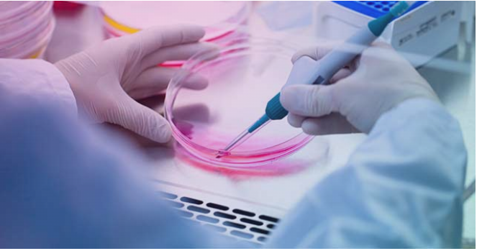
Results

Slide 14
Morphological and
Marker Analysis
The differentiation of hESCs into platelets was achieved using a four-stage, 3D, xeno-free protocol.
Stage I: Mesoderm induction → Stage II: Hemogenic endothelium (HEC) → Stage III: Megakaryocyte–erythroid progenitors (MEPs) → Stage IV: Mature MKs and Platelets.
Hypoxia (5% O₂) was applied in early stages to mimic embryonic conditions, followed by normoxia (21%) for maturation.

Slide 15
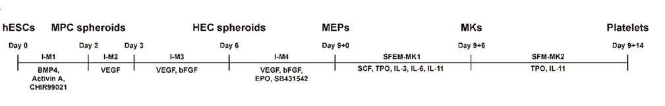
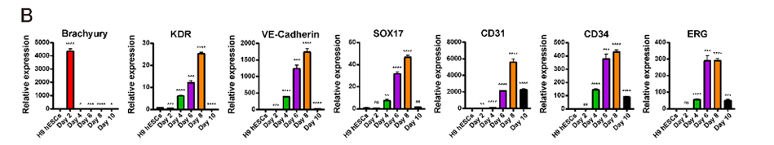
Morphological and
Marker Analysis

Slide 16
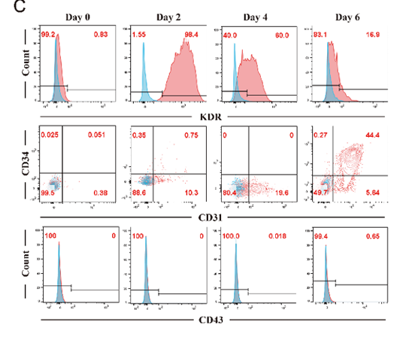
Morphological and
Marker Analysis

Slide 17
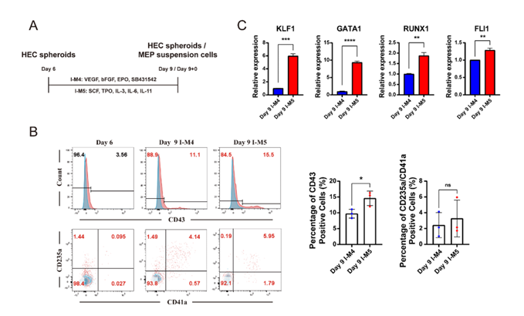
Stepwise Hematopoietic Differentiation Validation
Flow cytometry confirmed the sequential expression of key markers:
CD31⁺, CD34⁺ at Day 6 (HEC stage).
CD41a⁺, CD42b⁺ at Day 9+6 (MK stage).
Gene expression analysis showed upregulation of Brachyury (mesoderm), RUNX1, TAL1 (HEC), and ITGA2B, GP1BA (MK stage).
Immunofluorescence staining demonstrated strong CD31/CD34 in endothelial cells and CD41a/CD42b in MKs

Slide 18
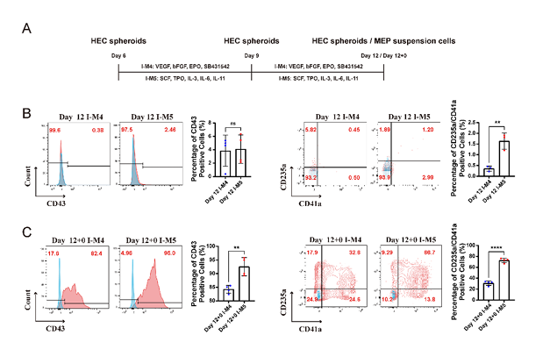
Morphological and Nuclear Maturation of MKs
Bright-field microscopy revealed large, granular MK-like cells after Stage IV.
Immunostaining for α-tubulin (green) and DAPI (blue) showed multinucleated cells and proplatelet extensions, typical of mature MKs.
Flow cytometric ploidy analysis indicated increased DNA content (4N, 8N, 16N), confirming polyploidization.

Slide 19
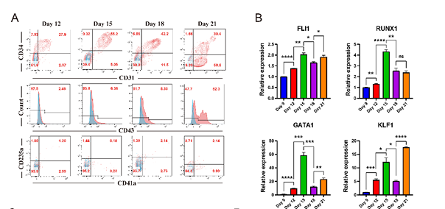
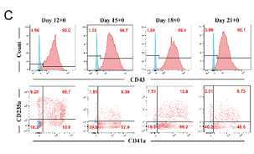
Generation of Platelet-like Particles
Mature MKs released small, spherical platelet-like particles (2–4 µm) into the culture medium.
Flow cytometry confirmed expression of CD41a, CD42b, and CD61, markers identical to natural human platelets.
Forward/side scatter plots and size histograms show that PLPs matched donor platelet size profiles

Slide 20
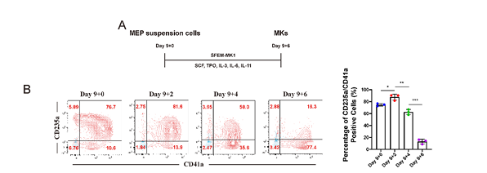
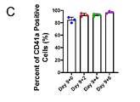
Functional Activation of Generated Platelets (In Vitro)
Platelets were stimulated with ADP and TRAP-6 to test activation.
Flow cytometry detected significant upregulation of CD62P (P-selectin) and PAC-1 binding, confirming fibrinogen receptor activation.
Approximately 50% of generated platelets responded to agonists, demonstrating partial but clear functionality

Slide 21
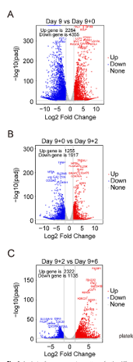
02
In Vivo Hemostatic Function in Thrombocytopenic Mice
A chemotherapy-induced thrombocytopenic mouse model was used to test in vivo efficacy.
Transfusion of hESC-derived platelets increased circulating platelet counts within 4 hours, comparable to human donor platelets.
Bleeding-time assays showed significantly shorter bleeding duration in treated mice.

Slide 22
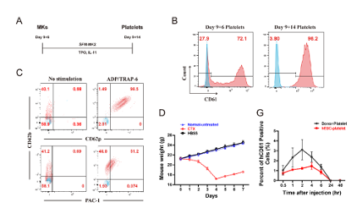
Transcriptomic Profiling of Differentiation Stages
RNA-seq across differentiation stages revealed dynamic transcriptional changes.
Early stages: activation of Wnt and PI3K-Akt pathways.
Mid stages: upregulation of cell-cycle and DNA-replication genes (progenitor expansion).
Late stages: enrichment of platelet activation and cytoskeleton remodeling pathways.
Key hub genes identified: CDK1, MYC, EGFR, JUN, TLR4.

Slide 23
Table of Contents
02
04
01
03
05
method
DISCUSSION
Introduction
RESULTS
Conclusion

Slide 24
Main Findings
Successfully established a stepwise, 3D xeno-free protocol for platelet generation.
Produced MKs with high purity and physiological morphology.
Platelets demonstrated functional activation and in vivo hemostatic efficacy.
Transcriptomic data confirm biological fidelity of the system.
DISCUSSION
Strengths
Fully defined, feeder-free, and xeno-free culture system.
Mimics natural embryonic hematopoiesis.
High MK maturation rate and proven platelet function.
Integration of molecular, cellular, and functional validation.

Slide 25
Limitations
Absolute platelet yield not quantified.
Only ~50% platelets fully activated (PAC-1⁺).
No mechanical shear forces (unlike bioreactor systems).
Initial hESC source — requires ethical consideration and immunogenicity control.
DISCUSSION
Clinical Implications
Demonstrates feasibility of donor-independent platelet biomanufacturing.
Can reduce transfusion dependency in thrombocytopenic patients.
Safer than MSC transplantation; free from animal components.
Potential to integrate with iPSC-derived personalized medicine.

Slide 26
Table of Contents
02
04
01
03
05
method
DISCUSSION
Introduction
RESULTS
Conclusion

Slide 27
conclusion

Slide 28

Conclusion and Future Directions
This study presents a robust, four-stage, xeno-free 3D differentiation system producing functional platelets from hESCs.
Generated platelets resemble natural human platelets morphologically and functionally.
The approach eliminates animal components and demonstrates in vivo hemostatic efficacy.
Though optimization for scalability and activation is needed, the work represents a major step toward synthetic platelet manufacturing for transfusion therapy.
Combine spheroid culture with bioreactor shear systems to boost yield.
Apply single-cell RNA-seq to study MK heterogeneity.
Transition protocol to iPSC lines for patient-specific therapy.
Conduct preclinical and clinical validation studies.

Slide 29
Thanks for your attention

