Slide 1
In the name of God

Slide 2

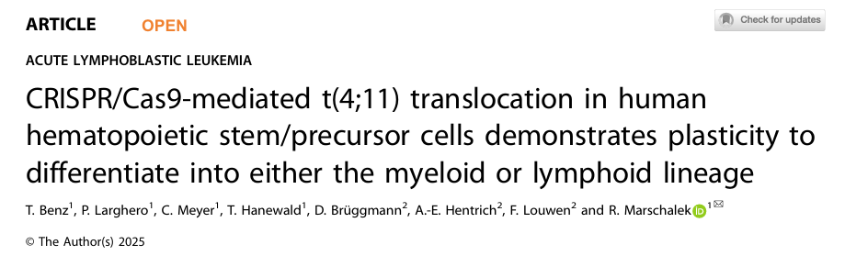
Presented by :
Negin Maherani
Kerman university of medical science

Slide 3
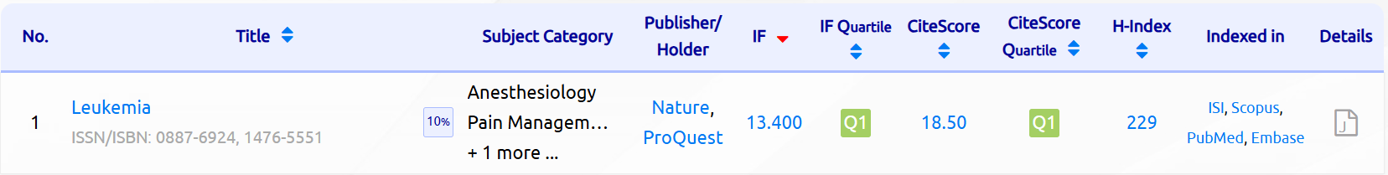

Slide 4
Introduction :
Molecular Function of the KMT2A Protein :
The KMT2A gene is associated with chromosomal translocations in acute leukemia.
KMT2A forms a multi-protein complex.
It is recruited to gene promoters through MEN1/LEDGF.
It activates chromatin by depositing H3K4me3 and other marks.
It prevents transcriptional repression mediated by the HP1/SUV39H1/2 complexes and PRC2/PRC1 complexes

Slide 5
Consequences of KMT2A Genetic Rearrangements :
The direct fusion (KMT2A::X) is the primary driver of transcriptional changes.
The reciprocal fusion (X::KMT2A) is essential for chromatin opening and for enabling the oncogenic activity of the direct fusion.
Gene expression patterns associated with KMT2A include:
Upregulation of HOXA genes
Upregulation of MEIS1 and PBX family members
Upregulation of IRX1/IRX2

Slide 6
In the past, stem cells were isolated from mice and artificial fusion retrovirus vectors were used to introduce them into the cells to see if leukemia would develop
Limitations :
We don't have a real translocation
We don't have reverse fusion
The early stages of leukemia were not visible
The transformation of HSC into leukemia occurs in vivo in mice

Slide 7
CRISPR/Cas9 Approach :
Creates a true chromosomal translocation t(4;11) in human CD34 cells. Creates both forward and reverse fusions. Allows for investigation of the early stages of the transition from a normal cell to a pre-leukemic state. Provides a human model
•Early leukemia-like features appeared within 4–5 weeks
•Cells retained differentiation plasticity up to days 40–70
•Addition of IL-7 directed the cells toward a lymphoid lineage

Slide 8
Material And Methods :
.1Collection of Umbilical Cord Blood Samples
2. Isolation of CD34+ Hematopoietic Stem/Progenitor Cells (HSPCs)
3. Isolation of Cord Blood Mononuclear Cells (CBMCs)
4. Purification of CD34+ Cells via MACS
5. Cell Culture Conditions for CD34+ HSPCs
6. IL-7 Treatment
7. Optional: Cryopreservation of Cells

Slide 9
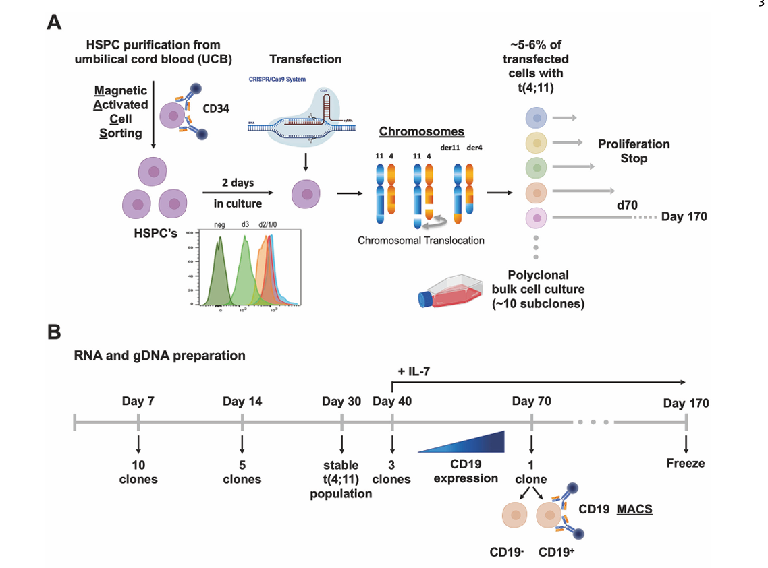

Slide 10
Design of sgRNAs Targeting the KMT2A and AFF1 Genomic Regions
Evaluation of sgRNA Efficiency in In Vitro Assays
Synthesis of Chemically Modified sgRNAs
Preparation of CD34⁺ Umbilical Cord Blood Cells for Genome Editing
Assembly of Cas9–sgRNA Ribonucleoprotein (RNP) Complexes
Electroporation of CD34⁺ Cells with Cas9 RNP Complexes
Post-Editing Cell Culture Conditions with Addition of the Caspase Inhibitor z-vad-fmk

Slide 11
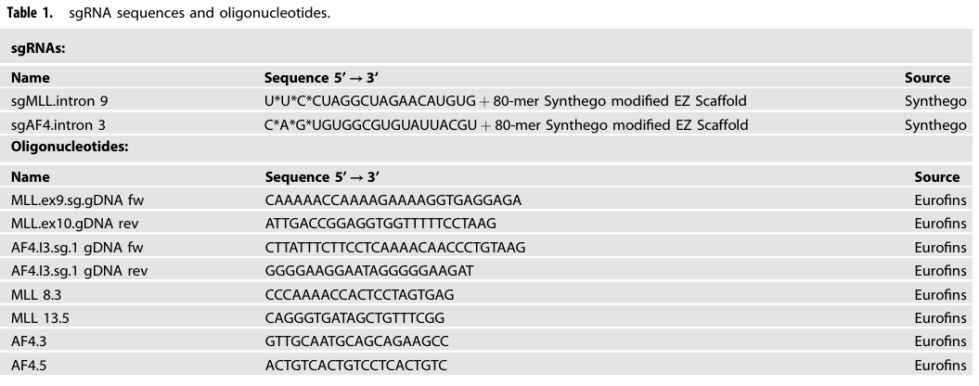

Slide 12
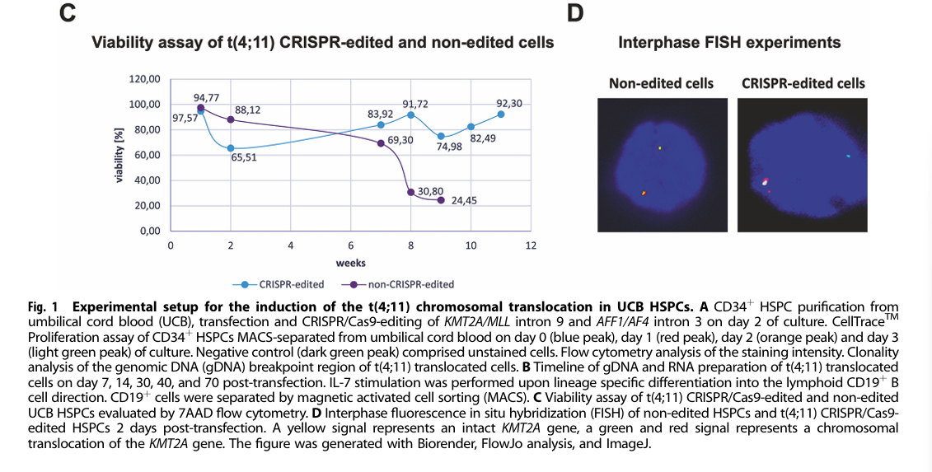

Slide 13
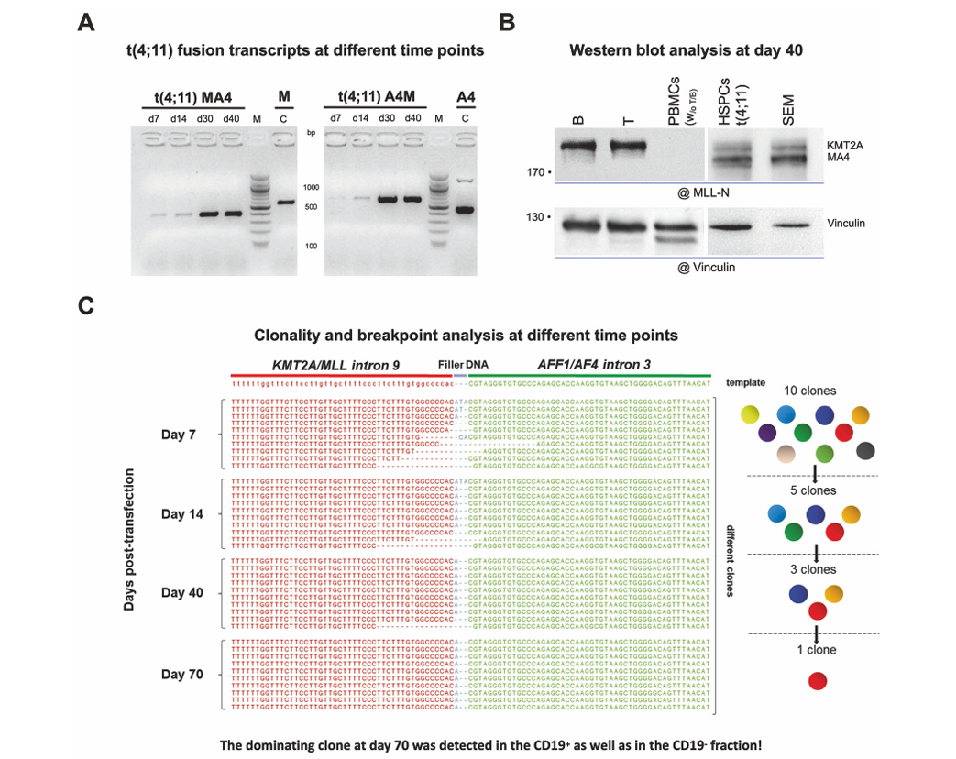

Slide 14
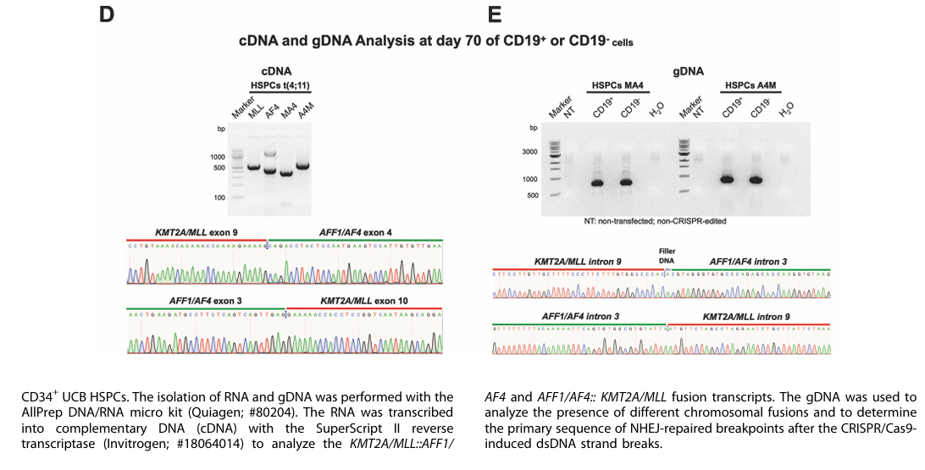

Slide 15
Genomic profiling of subclones :
CRISPR/Cas9-induced double-strand breaks in chromosomes 4 and 11
NHEJ is not accurate
NHEJ repair may introduce nucleotide insertions or deletions
Therefore, multiple fusion variants are generated
How were these subclones separated from each other?
(1 PCR amplification of gDNA at the breakpoint region
(2Performing TOPO TA cloning
(3Performing Sanger sequencing on each individual clone
4) Alignment and comparison of the sequences with CLC Sequence Viewer

Slide 16
Cell trace proliferation assay :
This assay is used to measure the rate of cell proliferation
when the cell divides → the dye is equally split between the two daughter cells.
Therefore, each new generation shows lower fluorescence intensity
Flow cytometry analysis :
1) CellTrace
2) 7-AAD

Slide 17
Gene expression profiling:
RNA was collected at different time points
The RNA samples were sent to GenXPro for gene expression
)analysis using the MACE-seq method(
They calculated the differential gene expression
)log2 Fold Change (
TPM was used to quantify gene expression accurately
They assessed the statistical significance of the change
)Student’s t-test(
The results were visualized using three tools:
(1Heatmap
(2Volcano plot
(3GSEA

Slide 18
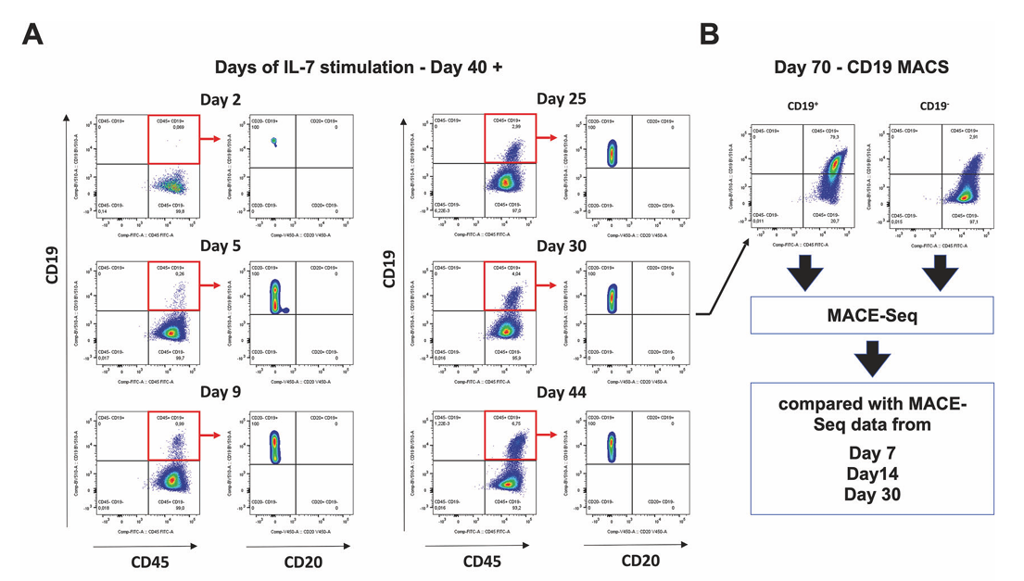
RESULTS :

Slide 19
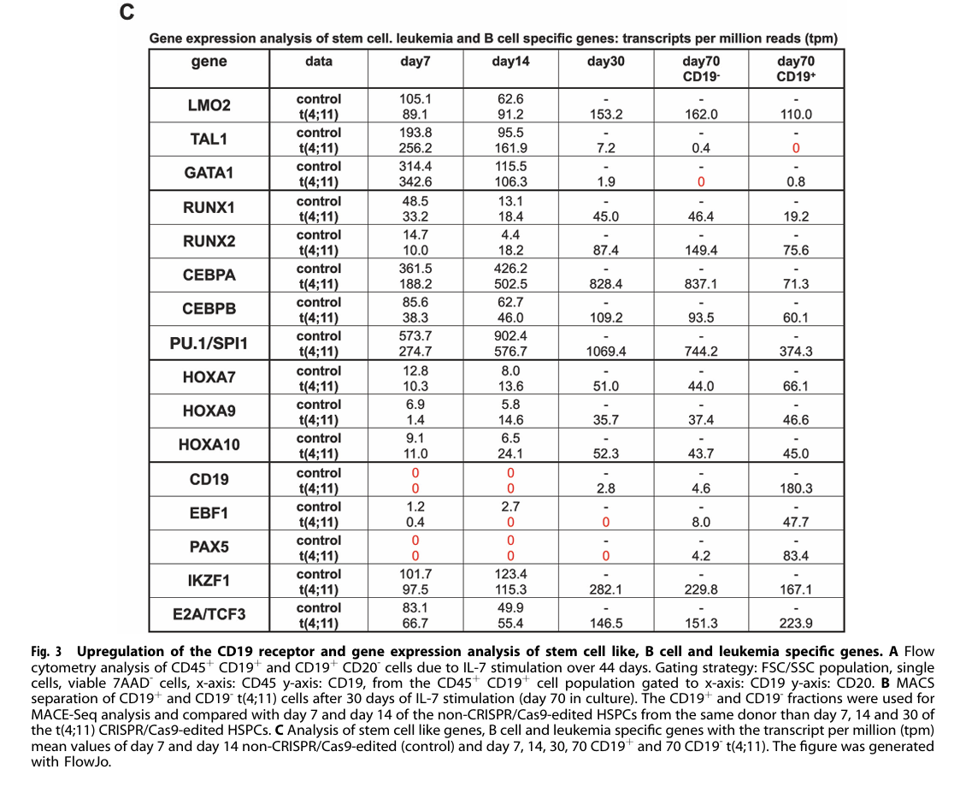

Slide 20
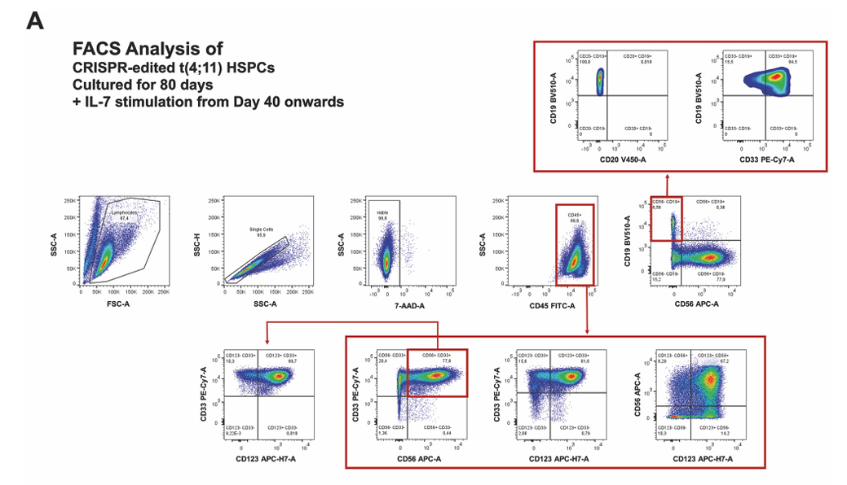

Slide 21
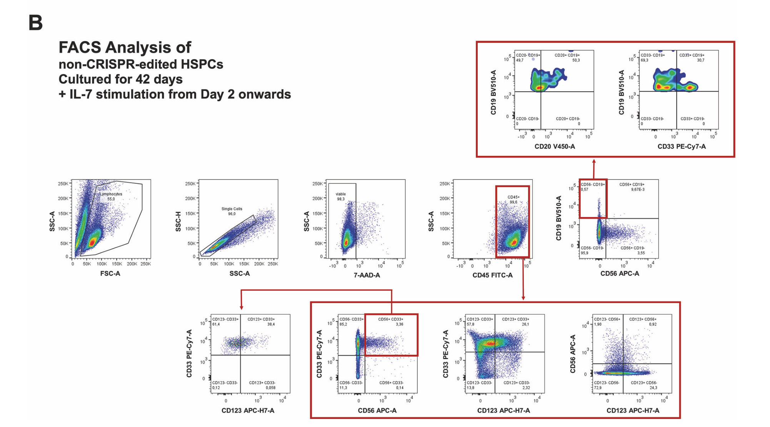

Slide 22
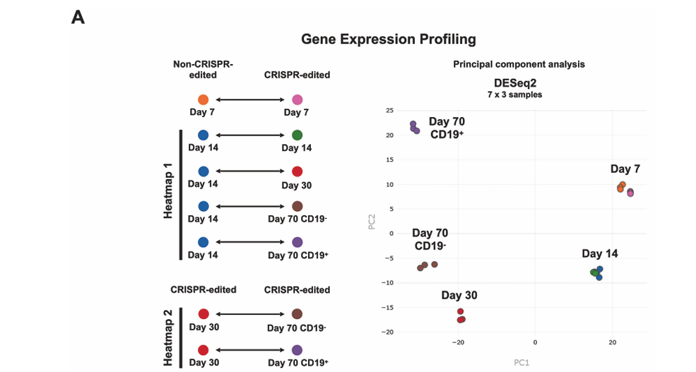

Slide 23
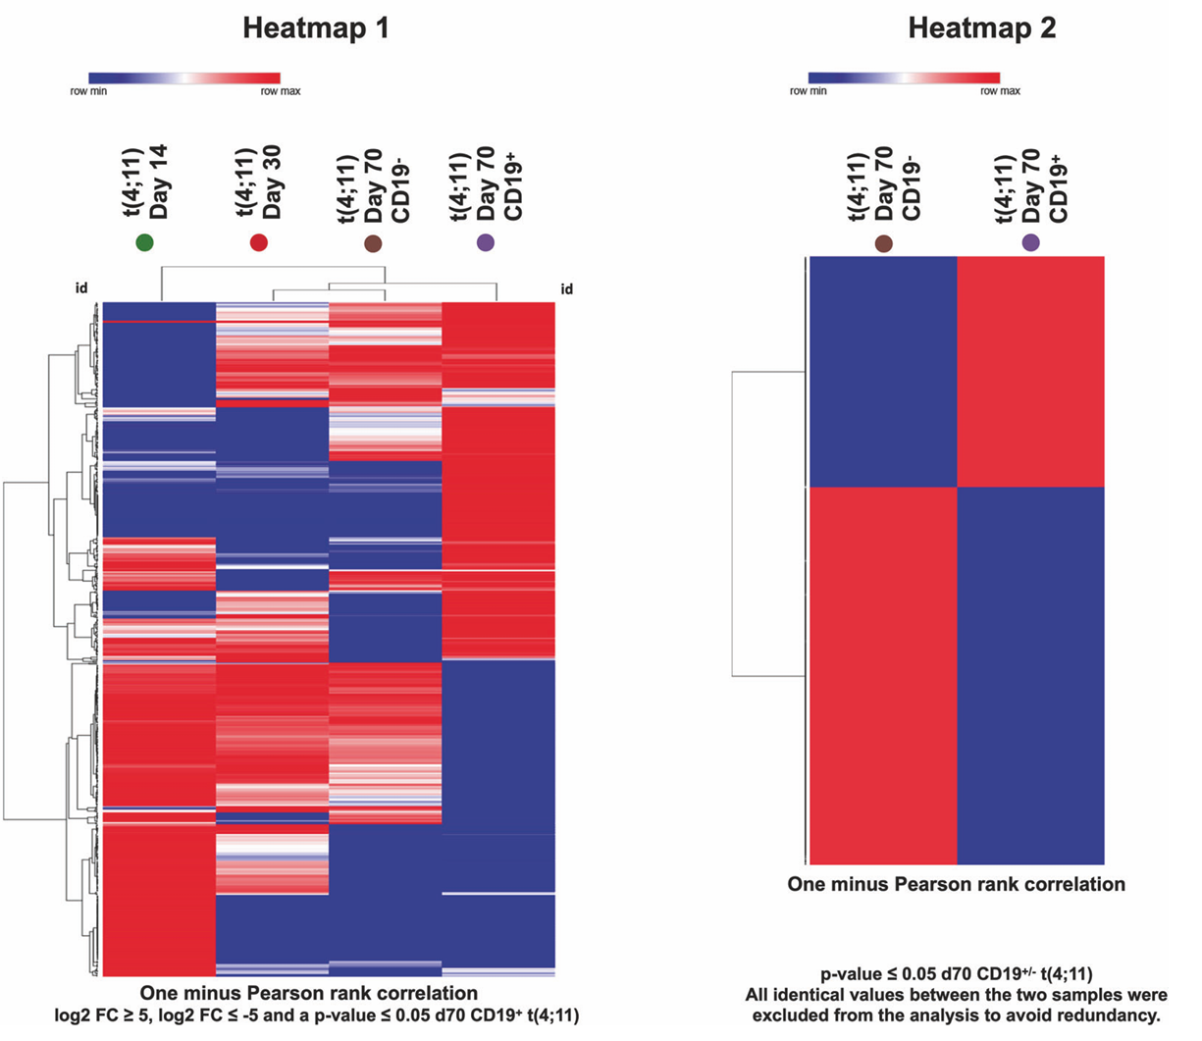

Slide 24
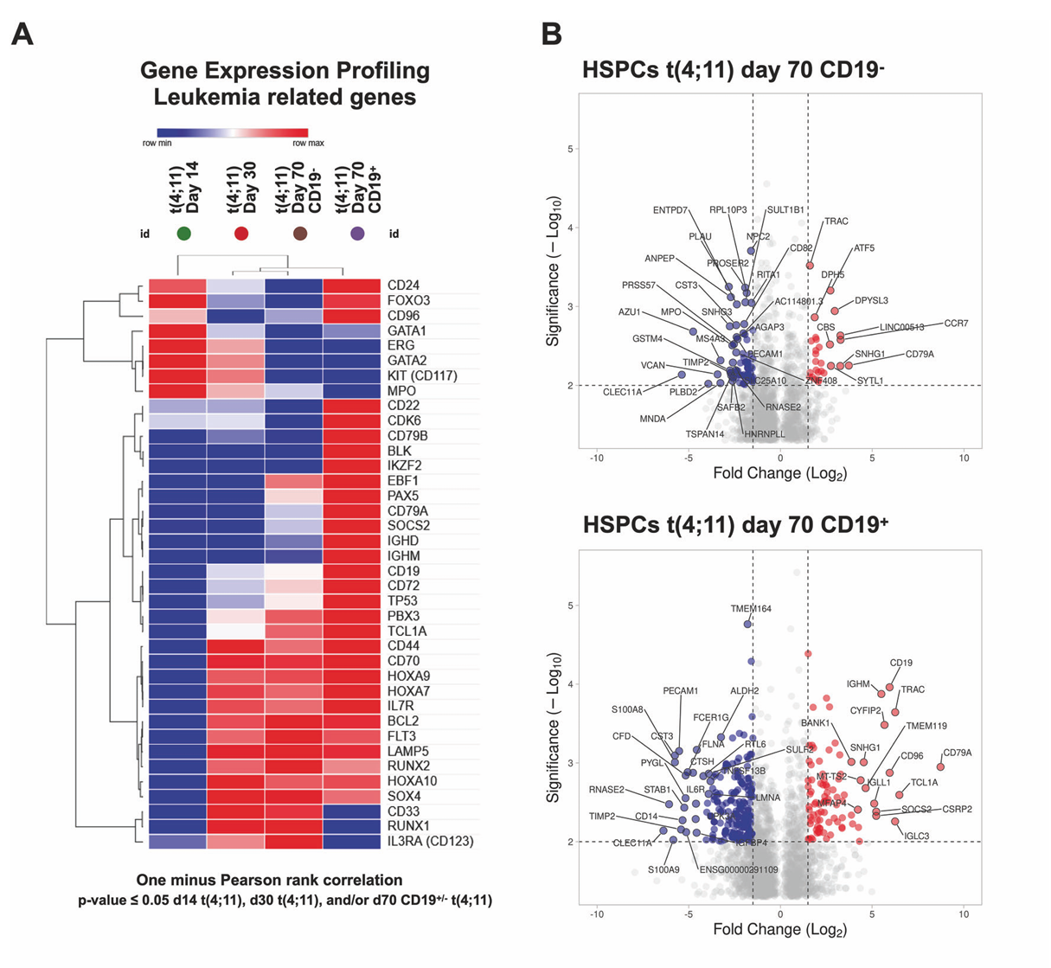

Slide 25
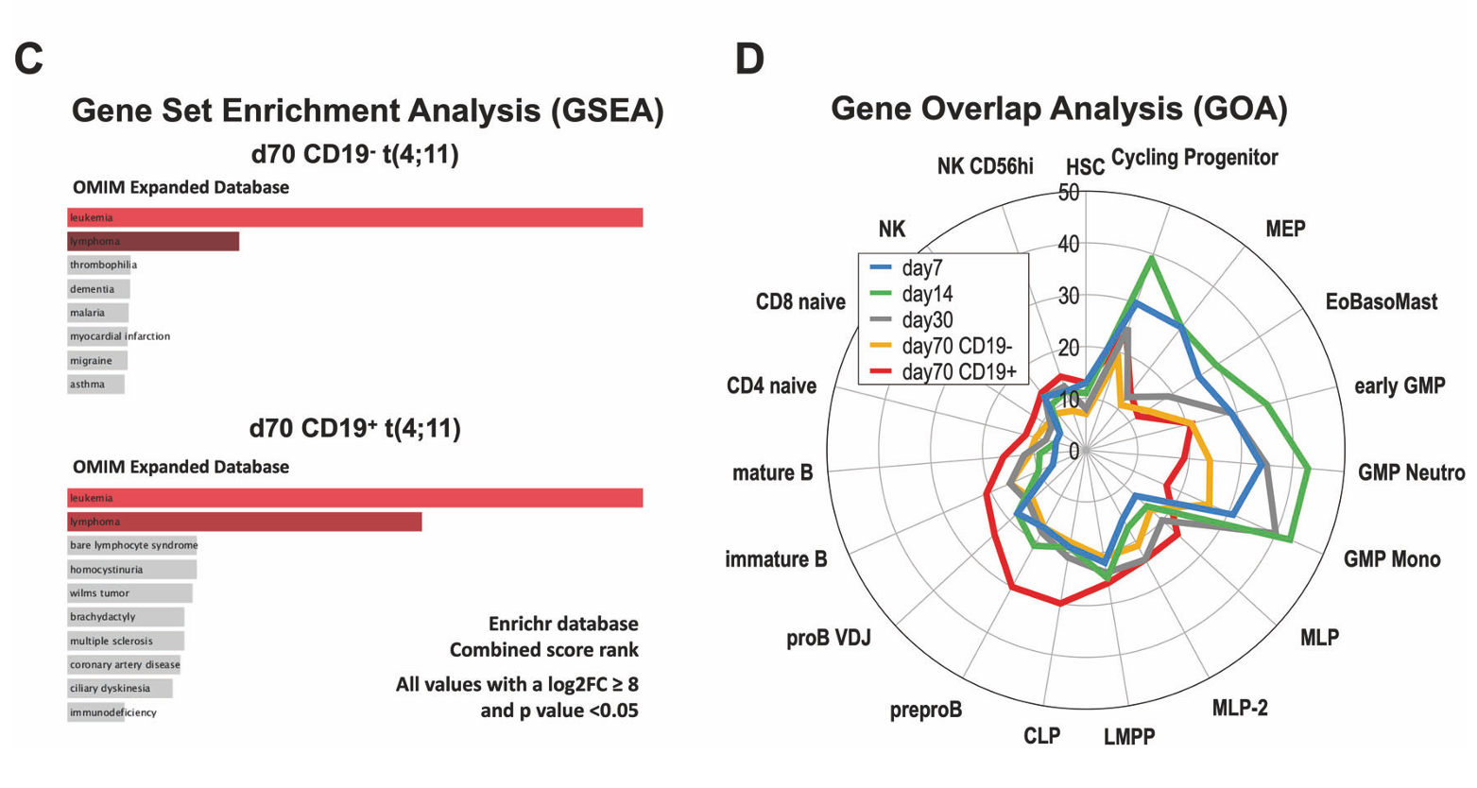

Slide 26
Discussion:
 This study is a realistic model of t(4;11) in umbilical cord hematopoietic stem cells using CRISPR/Cas9
 CRISPR model enables study of very early pre-leukemic events, previously inaccessible
 CD56 increases in the presence of IL-7(seen in aggressive AML)
 CD19 cells resemble leukemia and proliferate more rapidly in response to IL-7
 CD19− cells remain in a myeloid-like / pre-leukemic state

Slide 27
KMT2A-AFF1 fusions result in loss of TAL1/GATA2 and stable expression of LMO2, FLT3, CD133, NG2, CD72
GSEA analysis shows that the generated cells clearly overlap with leukemia and lymphoma
Comparing KMT2A translocations helps us understand leukemia development.

Slide 28
Thank you for your attention

