Slide 1
به نام خداوند جان و خرد کزین برتر اندیشه برنگذرد خداوند نام و خداوند جای خداوند روزی‌دهِ رهنمای خداوند کیوان و گردان سپهر فروزندهٔ ماه و ناهید و مهر

Slide 2
Coagulation and Fibrinolysis Dysregulation in β-Thalassemia Major:
Potential Impact of Splenectomy and Medications on Thrombotic Risk
Provider: Hassan Mirahmadi Hotaki
MSc student of hematology and blood banking

Slide 3
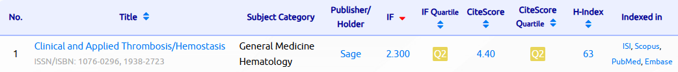

Slide 4
Introduction
Beta-thalassemia major:
_Beta-thalassemia major is a genetic blood disorder in which mutations impair the production of β-globin chains of hemoglobin.
_As a result, the body cannot synthesize normal hemoglobin, leading to chronic anemia and ineffective erythropoiesis.
_Patients must undergo regular blood transfusions to survive.

Slide 5
Iron overload
_Frequent blood transfusions cause accumulation of iron in the body (since
iron cannot be excreted)
_ resulting in iron overload or hemosiderosis.
_Excess iron damages various organs such as the heart, liver, and endocrine
glands.

Slide 6
Global economic burden:
_Thalassemia represents a significant global economic burden because of the lifelong need for costly treatments such as blood transfusions and iron chelation therapy.
_Moreover, patients develop complications like thrombosis (blood clot formation) and organ failure
Increased life expectancy and new complications:
_Although modern treatment (regular transfusion and iron-chelation therapy) has greatly improved patients’ life expectancy, it has also led to the emergence of serious complications such as thromboembolic events

Slide 7
Pathophysiological mechanisms of thrombosis in thalassemia:
Several mechanisms contribute to the increased thrombotic risk in thalassemia, including:
Endothelial activation The endothelial cells lining blood vessels become damaged in thalassemia.
Alterations in natural anticoagulants, such as:
-Protein C (PC) -Protein S (PS) -Anti thrombin
Red blood cell membrane damage, which promotes activation of the coagulation cascade.
Excessive platelet activation, common in these patients.

Slide 8
Role of chronic hemolysis and oxidative stress:
In thalassemia, chronic hemolysis releases large amounts of free hemoglobin and arginase into plasma. These substances deplete nitric oxide (NO), leading to:
_Impaired vasodilation
_Increased oxidative stress: Excess iron from repeated transfusions promotes the generation of reactive oxygen species (ROS), which further aggravate endothelial damage and disrupt normal vascular function
_Endothelial dysfunction and injury

Slide 9
Changes in natural anticoagulants (PC, PS, Anti thrombin):
In healthy individuals:
_Activated protein C (APC) inhibits coagulation by inactivating factors Va and VIIIa.
_Protein S acts as a cofactor for APC.
However, in β-thalassemia patients:
_Studies have reported conflicting results.
_Most found a significant decrease in PC and PS levels,
_while others reported no change

Slide 10
Liver damage caused by transfusions:
Repeated transfusions may cause:
_Viral hepatitis, and/or
_Hemosiderosis of the liver (iron overload in hepatic tissue).
Both conditions impair the liver’s ability to synthesize coagulation and anticoagulation factors, disrupting hemostatic balance
Chronic consumption of anticoagulants:
In thalassemia, chronic, asymptomatic activation of the coagulation system may occur
leading to consumption of natural anticoagulants such as PC and PS and a consequent reduction in their plasma levels

Slide 11
Role of red blood cell membrane in clotting:
_In thalassemia, the red blood cell membrane becomes abnormal and exposes phosphatidylserine (PS) on its outer surface.
_Phosphatidylserine provides a catalytic surface for assembly of coagulation factors and enhances thrombin generation.
_Additionally, protein C has a high affinity for binding to phosphatidylserine, which reduces its availability in plasma.

Slide 12
Platelet activation:
In thalassemia patients:
_Chronic hemolysis,
_Oxidative stress,
_Exposure to abnormal red cell membranes lead to continuous platelet activation.
This condition is associated with:
_Increased platelet-derived micro particles, and
_Elevated expression of platelet activation markers, resulting in a hypercoagulable state

Slide 13
Splenectomy:
Many β-thalassemia major patients undergo splenectomy to reduce transfusion requirements and control hypersplenism
However, splenectomy leads to several consequences:
Increased risk of severe infections (sepsis)
Increased risk of thrombosis (clot formation)

Slide 14
after splenectomy:
_The filtering function of the spleen is lost
_Abnormal or aged blood cells and platelets are not removed,
_Reactive platelets accumulate,
_ thrombocytosis (high platelet count) often develops.
_In addition, splenectomy allows procoagulant red cells exposing phosphatidylserine to persist in circulation, further promoting a hypercoagulable state.

Slide 15
Plasminogen activator inhibitor-1 (PAI-1):
PAI-1 is a key regulator of fibrinolysis (clot breakdown). It inhibits the fibrinolytic enzymes:
_tPA (tissue plasminogen activator), and
_uPA (urokinase-type plasminogen activator).
When PAI-1 levels are elevated, clot breakdown slows down, producing a prothrombotic state.
In thalassemia, the coexistence of endothelial dysfunction and chronic hemolysis makes PAI-1 overexpression an important contributor to thrombosis.

Slide 16
Materials and Methods
Ethical Approval and Patient Selection Criteria:
In this study, Jordanian patients of both sexes (male and female), aged 7 to 35 years, were included.
These patients were followed up at the Thalassemia and Thrombophilia Clinic at Al-Zarqa Public Hospital, in Al-Zarqa, Jordan.
The control group consisted of healthy, age-matched individuals (aged 10–35 years). A written informed consent was obtained from all adult participants or from the parents/guardians of the children.

Slide 17
Inclusion criteria:
Patients who:
_Had a confirmed diagnosis of β-thalassemia major (based on hemoglobin electrophoresis),
_Received regular blood transfusions (10–15 mL/kg) every month,
_Had been transfused regularly for at least 12 months,
_And underwent periodic ferritin level testing.
The hemoglobin level was ideally maintained above 9 g/dL, although in some patients it ranged between 7.4 and 9 g/dL.
All patients were required to:
Be clinically stable during the preceding 4 weeks, and
Have no splenectomy (spleen removal surgery) within the last 6 months.

Slide 18
Exclusion criteria:
_Presence of other hemoglobinopathies (e.g., sickle cell disease, other thalassemia types),
_History of bone marrow transplantation or gene therapy,
_Significant renal impairment,
_Active infections such as hepatitis B, hepatitis C, or HIV,
_Poor adherence to treatment or follow-up,
_And patients with missing clinical data were excluded.

Slide 19
Blood Sample Collection:
Blood samples were obtained from all participants between 10:00 AM and 12:00 PM, before blood transfusion and four weeks after the previous transfusion.
Sampling procedure:
5 mL of blood was collected in EDTA tubes for platelet count, which was analyzed within 2 hours.
1.8 mL of blood was collected in 3.2% sodium citrate tubes, centrifuged, and analyzed within 8 hours for coagulation profile tests.
The following parameters were assessed: PT , aPTT, D-dimer, Fibrinogen, Factor V, Tissue Factor , tPA, PAI-1, vWF, ADAMTS13, Protein C , and Protein S .

Slide 20
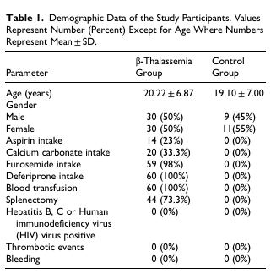

Slide 21
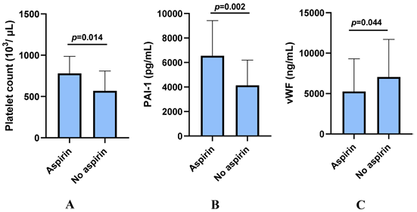

Slide 22
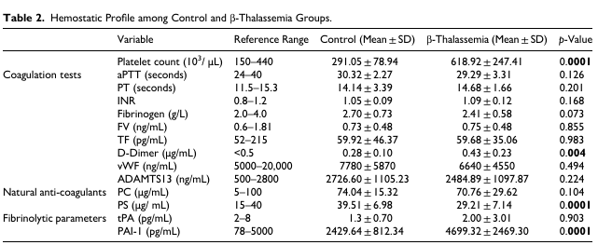
Results

Slide 23
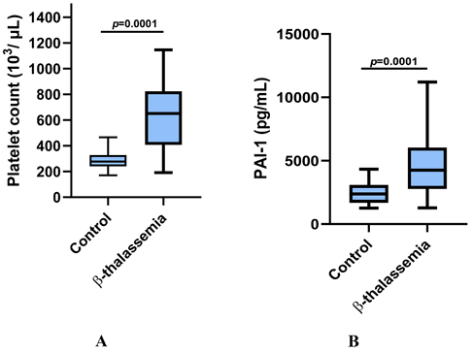
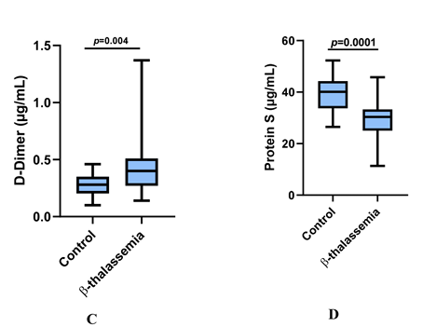

Slide 24
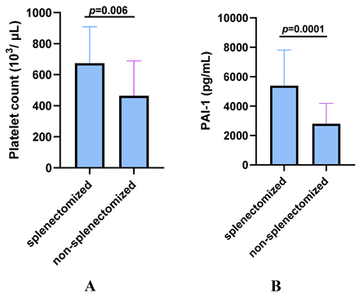
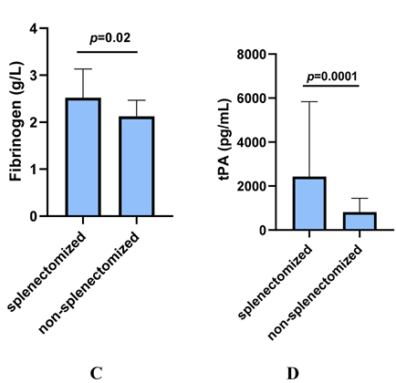

Slide 25
Discussion
Pathophysiological Mechanisms:
Chronic hemolysis releases PS and microparticles from RBCs and platelets → triggers coagulation cascade.
Platelet activation is increased due to oxidative stress and endothelial dysfunction.
Endothelial cells express more adhesion molecules (ICAM, VCAM, E-selectin), leading to enhanced platelet and leukocyte binding.
Nitric oxide (NO) bioavailability is reduced → vasoconstriction and platelet aggregation.
Splenectomy removes a major site of clearance for damaged RBCs and activated platelets → increasing thrombotic risk.
Iron overload causes oxidative stress, damaging endothelium and amplifying prothrombotic signals.
Chronic inflammation (↑ cytokines like TNF-α, IL-6) activates coagulation and inhibits natural anticoagulants.

Slide 26
Clinical Risk Factors:
Splenectomy → one of the strongest predictors of thrombosis.
Older age and non-transfused/intermittently transfused patients have higher risk.
High hemoglobin levels after splenectomy (due to absence of sequestration).
Iron overload and liver dysfunction increase risk.
Elevated platelet count (>600,000/µL) is common after splenectomy and directly related to thrombotic events.

Slide 27
Prevention and Management:
Regular blood transfusion helps reduce hemolysis and circulating procoagulant RBCs.
Antiplatelet therapy (aspirin) may be beneficial, especially after splenectomy.
Anticoagulants should be considered in patients with previous thrombotic events.
Iron chelation to prevent oxidative endothelial damage.
Avoid unnecessary splenectomy when possible.

Slide 28
Limitations
The study was single-centered, which limits the generalizability of its findings to broader populations.
The small sample size reduces the statistical power and robustness of the results.
There was a lack of advanced coagulation and fibrinolysis assays, such as:
Thrombin Generation Assay
Plasma fibrin formation analysis
Whole-blood clot dynamics assessment This limitation restricts the comprehensive evaluation of the hemostatic system.
All patients were receiving iron chelation therapy (Deferiprone) and approximately 98% were on a diuretic (Furosemide), making it impossible to compare users versus non-users of these medications

Slide 29
Future Directions & Recommendations
Larger multicenter studies are required to confirm and validate the current findings.
Future research should incorporate more advanced laboratory techniques to provide a more accurate understanding of coagulation and fibrinolysis balance.
Regular monitoring of thrombotic risk in β-thalassemia major patients—particularly post-splenectomy—is strongly advised.
Key parameters to monitor: PAI-1, D-dimer, platelet count, and Protein S levels.
Lifestyle recommendations:
Maintain adequate hydration
Encourage regular physical activity
Consider low-dose aspirin in high-risk patients
Anticoagulant therapy may be used selectively in specific clinical situations to prevent thrombotic complications

Slide 30
The End…
Thank you for your attention

