Slide 1
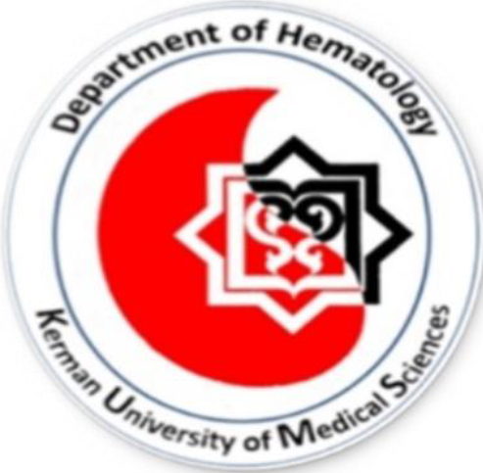
CAR-NK therapy
Presenter: Mohammad Hossein Khazaee
Advisor: Dr. Mirzaee

Slide 2
CAR therapy
short for Chimeric Antigen Receptor therapy, is a type of immunotherapy used in the treatment of certain cancers
It involves the genetic engineering of a patient's own immune cells or Allogeneic immune cell
These CARs enable the modified immune cells to specifically recognize and attack cancer cells

Slide 3
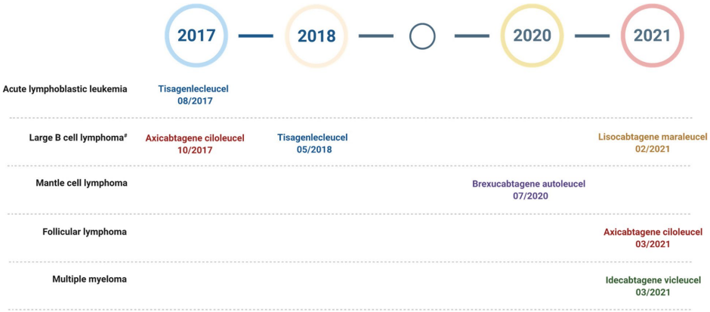
Timeline of CAR-T therapy FDA approvals

Slide 4
Limitations of CAR T
Antigen escape
Insufficient of CAR T expansion and persistence
Cytokine release syndrome (CRS)
Cytopenia
GVHD

Slide 5
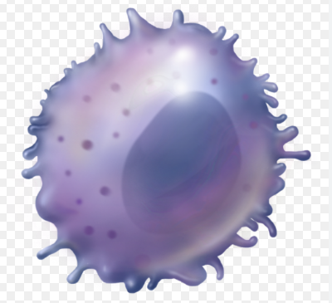
Natural Killer (NK) cells
are a type of white blood cell
a component of the innate immune system
NK cells do not require prior exposure to an antigen to recognize and eliminate abnormal cells
NK cells play a crucial role in the immune system's surveillance and defense against abnormal cells, such as cancer cells and virus-infected cells

Slide 6
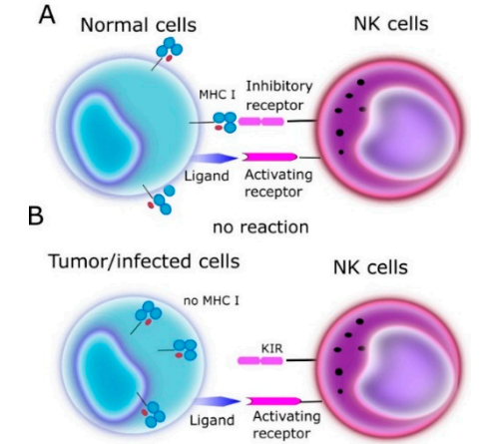
Activation of NK Cell
Lack of Inhibitory Signals
Stress Ligands: HSP
Recognition of Activating Ligands: NKG2D and NKp46
Cytokine-Mediated Activation: IL-12 and IFN-α

Slide 7
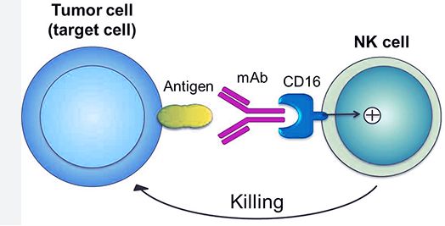
Performance
Release of Cytotoxic Granules: NK cells release cytotoxic granules that contain perforin and granzymes.
Produce Cytokines: IFN-γ, IL1 and IL2
ADCC
Immune Surveillance

Slide 8
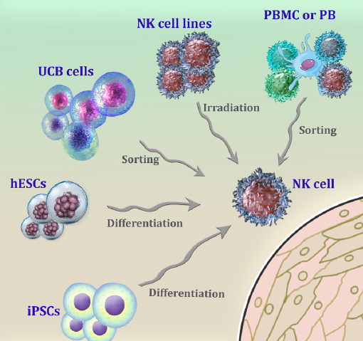
NK cell sources

Slide 9
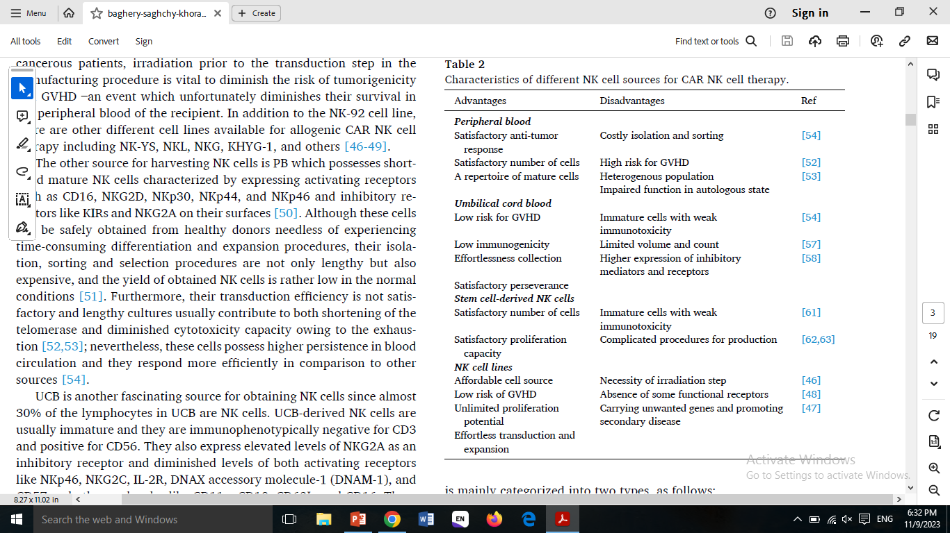

Slide 11
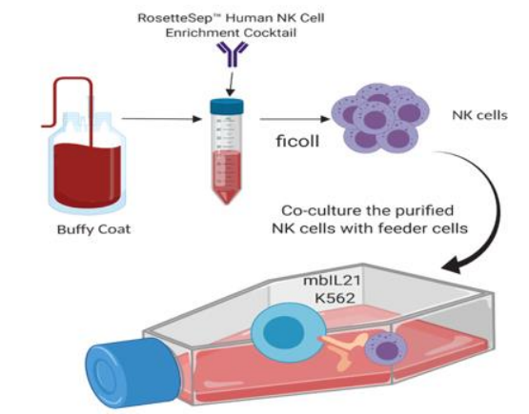
Expansion and activation of NK cells
Feeder-base
Feeder-free
1- EBV lymphoblastoid cell line
2- Jurkat T lymphoblast subline
3- K562 cell line

Slide 12
The feeder-free method is considered more streamlined, reducing the risk of contamination. It's also more defined and controlled.
IL-2
IL-21
IL-15
IL-18
IL-27

Slide 13
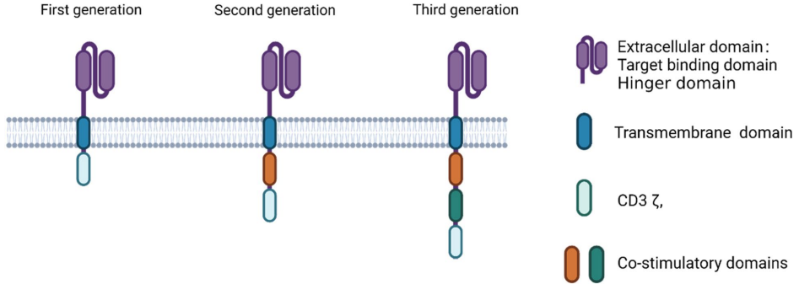
Generation of CAR NK
CD27
CD134
CD278
DAP10
DAP12
CD28
CD137

Slide 14
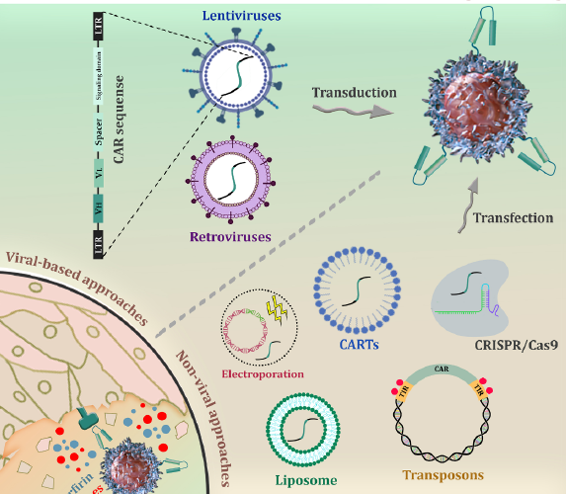
Genetic engineering of NK cells
increased biosafety
rapid and persistent transgene expression
low immunogenicity
cost-effect
capacity for large gene fragment

Slide 15
Limitations of CAR NK
1-Challenges regarding the transduction step
success rate of transducing CARs by the retroviral method was about 43–93%
success rate of lentiviral vectors for transducing the CARs to the NK cells was around 29%
IL-2, IL-12 and IL-15
the source of NK cells, the structure of CAR construct, and the culture media
CRISPR/Cas9
nanochannel-electroporation method

Slide 16
2-Challenges regarding the satisfactory proliferation
utilization of cytokine cocktails composed of IL-2, IL-15, and IL-18 in addition to anti-CD52 and anti-CD3 beads satisfactorily
utilization of genetically modified K562 cells that expressed major histocompatibility complex class I chain-related protein A (MICA) in addition to 4-1BB ligand and IL-15 contributed to improved activation

Slide 17
3-Challenges regarding the preserving and persistence of CAR NK cells
Utilization of DMSO based cryopreservation methods for NK cells
use of poly-l-lysine, dextran, and ectoine as a DMSO-free freezing medium
To provide autocrine support for cytokines, CAR NK cells can be engineered to express cytokine genes such as IL-2, IL-15 and IL-18

Slide 18
4-Fratricide prevention
as a result of the induction of the expression of CAR target antigens on NK cell surfaces
use of knock-out methods

Slide 19
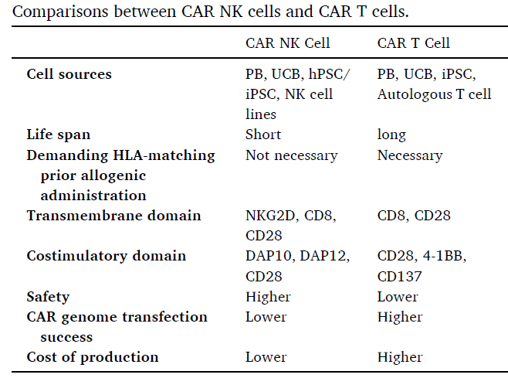

Slide 20
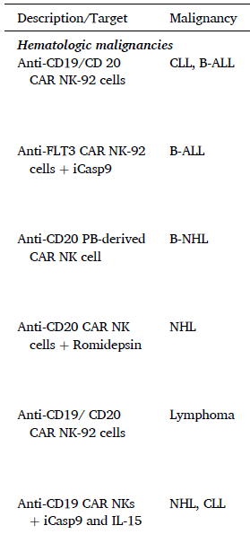
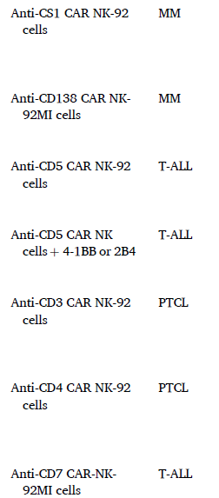

Slide 21
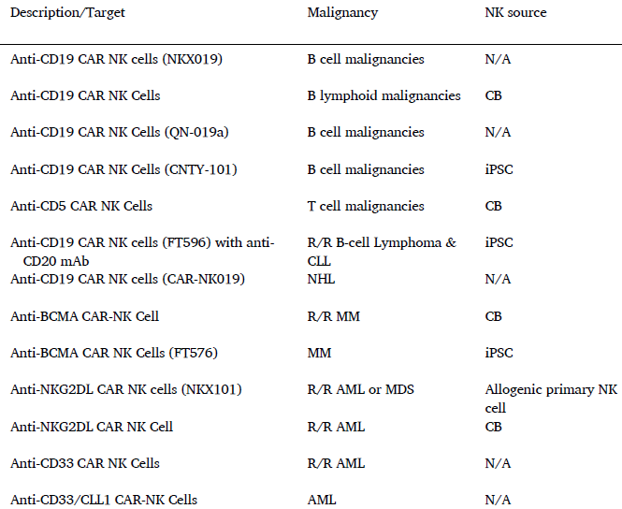

Slide 22
THANK YOU

