Slide 1


Slide 2
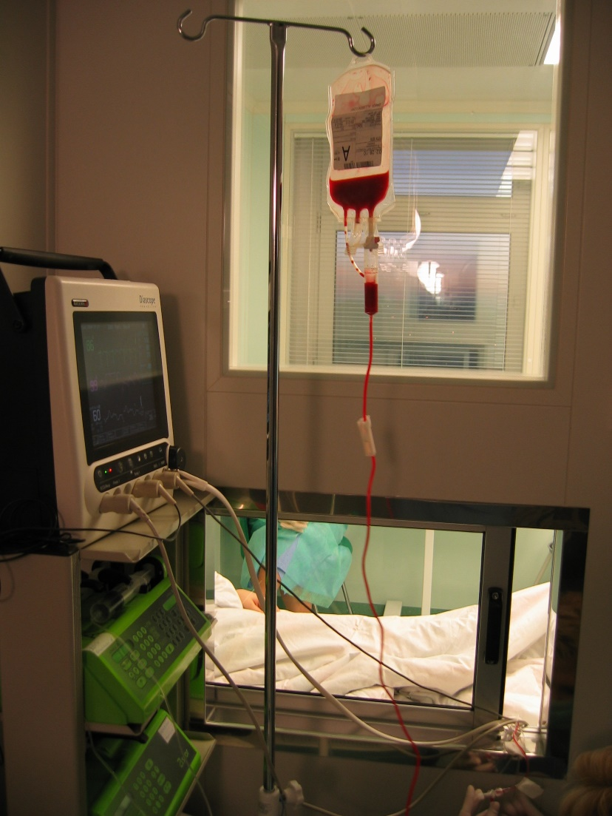

Bone marrow and stem cell transplantation
Kerman university of medical science
Department of hematology
Directed by: Mahsa Rahgoshay

Slide 3
HSCT definition
EBMT defines Hematopoietic Stem Cell Transplant (HSCT) as “transfer of stem cells, defined as progenitor cells with repopulating capacity and the potential to sustain long term hematopoiesis, within one person or from one person to another, in a dose that is sufficient to restitute haematopoiesis in all lineages”

Slide 4
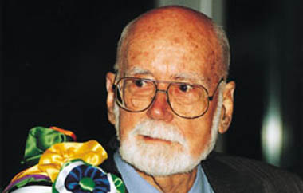
The Nobel Prize, 1990
E. Donnall Thomas
first succsessful HSCT in treatment of acute leukemias
Thomas ED, Lochte HL, Lu WC, Ferrebee JW. Intravenous infusion of bone marrow in patients receiving radiation and chemotherapy. N. Engl. J. Med. 1957; 257: 491

Slide 5
.
Indications for Stem Cell Transplants
Cancer:
  Leukemia
  Myelodysplasia
  Lymphoma
  Breast cancer
  Testicular cancer
  Ovarian cancer
  Brain tumors
  Pediatric tumors
  Multiple myelomas
  Sarcomas
  Kidney cancer
Non Cancers:
  Autoimmune diseases
    Rheumatoid arthritis
      Juvenile and adult
    Multiple Sclerosis
    Scleroderma
    Systemic Lupus
  Immune deficiency
  Sickle cell anemia
  Thalassemia

Slide 6
TYPES OF HSCT
1)Allogeneic stem cell – Minor HLA disparity
Mathed Unrelated donor(MUD) – found using a donor registry
Sibling donor – HLA matched brother or sister
Syngeneic – from an identical twin
Haploidentical – half-matched family member (half matched related)
2)Autologous stem cell transplantion – no immunologic conflict
Transplantation using autologous stem cells which have been corrected by transfer of a normal or therapeutic gene

Slide 7
Elements of Stem Cell Transplants
Selection of donor
Preparative regimen(conditioning therapy)
Harvest of stem cells from donor
Post-transplant supportive care

Slide 8
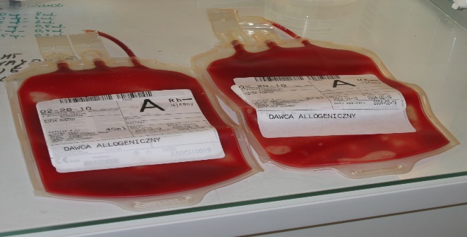
Harvest of stem cells from donor
Sources of stem cells:
Bone marrow harvest
Peripheral blood stem cells (PBSCs)
Umbilical cord blood stem cells

Slide 9
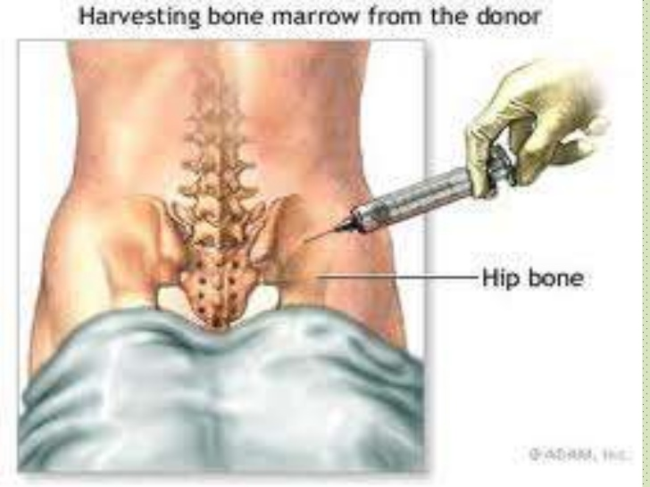
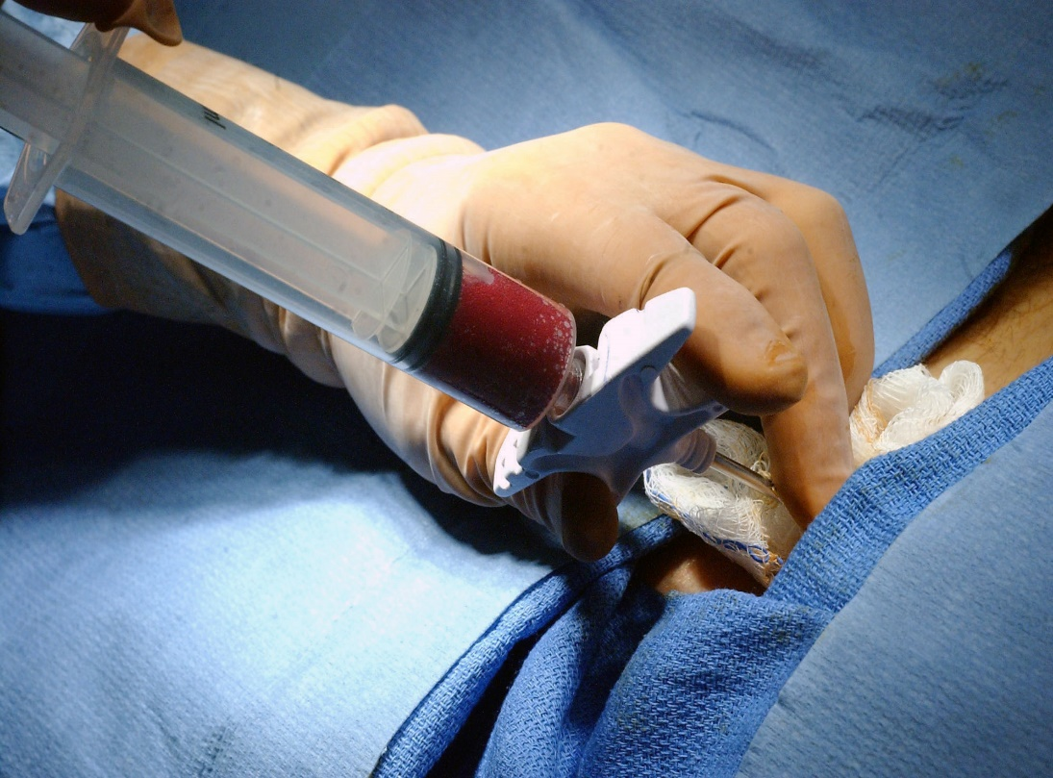
Bone marrow harvest
Bone marrow harvesting involves collecting stem cells with a needle placed into the soft center of the bone, the marrow. Most sites used for bone marrow harvesting are located in the hip bones and the sternum
Benefit
low risk of GVHD for recipients
No G-CSF injections
Drawback
more invasive HSC collection for donor
Side effects of anaesthesia

Slide 10
Peripheral blood stem cells (PBSCs)
PBSC donation is a non-surgical procedure done in an outpatient clinic. The donor receives daily injections of GCSF for five days prior to the harvest. This injection increases the number of stem cells in the bloodstream. The stem cell are then collected by a process called apheresis which takes 4 – 5 hours. During apheresis a donor's blood is removed through a needle in one arm and passed through a machine that separates out the blood-forming cells. The remaining blood is returned to the donor through the other arm
Benefits
No general anesthesia for collection
less discomfort and pain
Faster hematopoietic engraftment and immune reconstitution
Low risk of relapse
enhanced GvL effect due to high number of lymphocyte in PBSC
Drawbacks
Higher risk of cGvHD but no difference in aGVHD

Slide 11
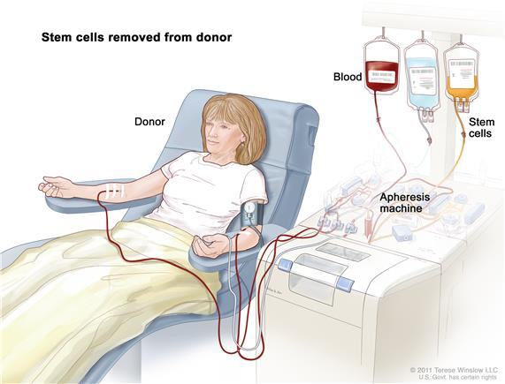
PBHSC mobilization
G-CSF is commonly administered at 10 µg/kg/day for 4 days, and PBHSC collected by cytapheresis from day 5 onwards
Mobilized PBHSC is commonly enumerated by CD34+ cells. Generally, 4–6 × 10⁶ CD34⁺ cells/kg of recipient body weight is sufficient for hematopoietic restoration.
Novel mobilization agents
CXCR4 antagonist AMD3100 (PLERIXAFOR) +G-CSF
VLA-4 antibodies(natalizumab )
Parathyroid hormone (PTH)
Cytokines (EPO)

Slide 12
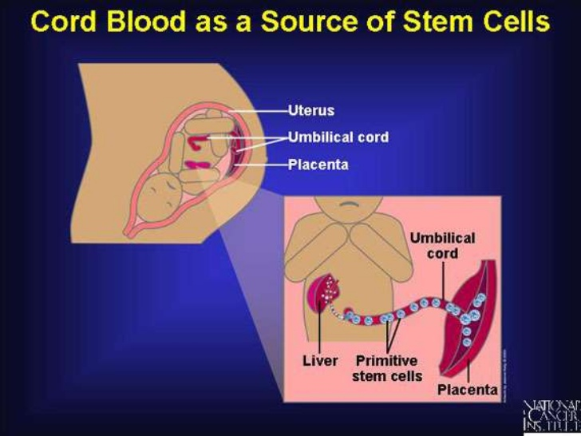
Benefits
Non-invasive
Lower risks of GvHD and relapse
rapid availability
increased level of HLA-disparity tolerated
Low risk of viral infections suh as cytomeegalovirus
Both related and unrelated cord blood transplants have been performed with high rates of success
Drawback
Lower number of HSCs ( a barrier to HSCT in adolescents and adults)
slow hematopoietic engraftment and immune reconstitution (slower neutrophil recovery (26 versus 18 days) and platelet recovery (44 versus 24 days)

Slide 13
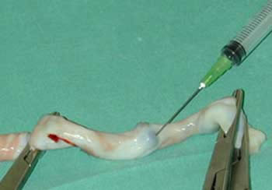
Novel strategies to broaden the applicability of UCB-HSCT
Double-unit UCB-HSCT (better engrafment with higher dose of CD34+ cell in adults.)
Co administration of mesenchymal stromal cells (increase CD34+cell)
Intra bone injection of cells. (better stem cells homing)
ex vivo expansion of CB cells using different cytokine combinations
Enhance homing by inhibiting DPP4 (dipeptidyl peptidase 4)
Notch-mediated Expansion

Slide 14
Conditioning regimens
The chemotherapy or irradiation given immediately prior to a transplant is called the conditioning regimen
Principles:
  Creating room in the bone marrow for the transplanted stem cells
  Suppressing the patients immune system to lessen the chance of graft rejection
  Destroying remaining cancer cells and disease eradication
  Exceptions;
  Infant suffering from SCID
  Patients with SAA with an identical twin donor
  Selection of conditioning regimen is dependent on
  underlying disease,
  type of donor(matched or mismatched, related or unrelated),
  relevant co-morbidities
  recipient age.

Slide 15
Types of Conditioning Regimens:
  1)Myeloablative conditioning
  2)Reduced intensity conditioning ( Non-myeloablative
  conditioning or mini transplant)

Slide 16
  Myeloablative conditioning
  Irreversibly destroys the hemopoietic function of the bone marrow with high doses of chemotherapy +/- TBI
  chemotherapy regimens;
  TBI (12-14 GY) + CY (120mg/kg)
  BU (4mg/kg) + CY (120mg/kg)
Profound and long-lasting pancytopenia
require stem cell support
Younger patients with a good performance status
Quicker hemtopoetic engraftment of donor cell
Increased level of disease control
Higher toxicities associated with higher transplant related mortality (TRM
Higher incidence of aGVHD and cGVHD

Slide 17
Myeloabolative HSCT
High dose chemotherap
High dose radiation
Stem cells
Watch and wait

Slide 18
  Non-Myeloablative conditioning
  ➢ Regimens that have been developed to reduce the morbidity
  and mortality of allogeneic transplant. It aims to use enough
  immunosuppression to allow donor cells to engraft without
  completely eradicating the recipients bone marrow.
  Minimal cytopenia
  Do not require stem cell support
  Can be given to older patients
  Rely mainly on the GVL effect for the eradication of underlying diseadse
  Reduction in morbidity and transplant related mortality (TRM)
  Minor anti tumor effect and high risk of relapse
  Less toxicities

Slide 19
Some of the most common side effects include
Infection
recipients of mismatched family or URD grafts were more prone to develop cytomegalovirus
Mucositis and diarrhea
Nusea and vomiting
Infertility
bleeding
Loss of hair
secondary malignancy
organ toxicity
relapse (HLA cw and DP1 are related to low risk of relapse)
aGVHD( allelic mismatch in HLA-A,B,C,DRB1)
cGVHD (allelic mismatch in HLA-A,B)
Mortlity (TRM)

Slide 20
graft versus host disease (GVHD)
graft versus host disease (GVHD)
GVHD is the most frequent complication after allogeneic HSCT
GVHD can occur even when the donor is perfectly matched (HLA identical sibling)
It is a consequence of interaction between APC of recipient and mature T cell of donor
Immuno biology of GVHD
 | phase | cell | cytokines
1 | Effect of conditioning | Damaged EP cell | TNF IL-1
2 | T cell activation | Donor Tcell Host APCS | IL-2 IFNy
3 | Cellular and inflammatory phase | CTLs NK | Cytokine storm TNF, IL1

Slide 21
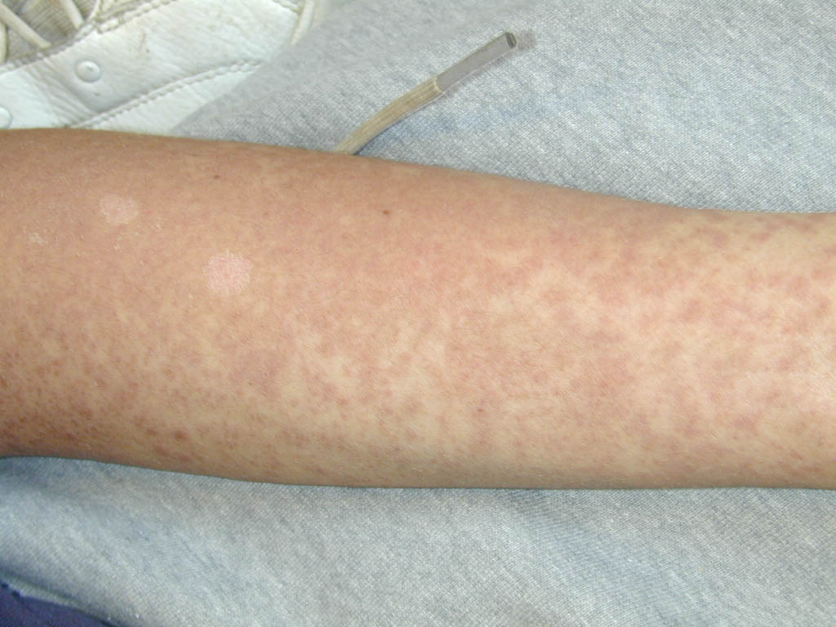
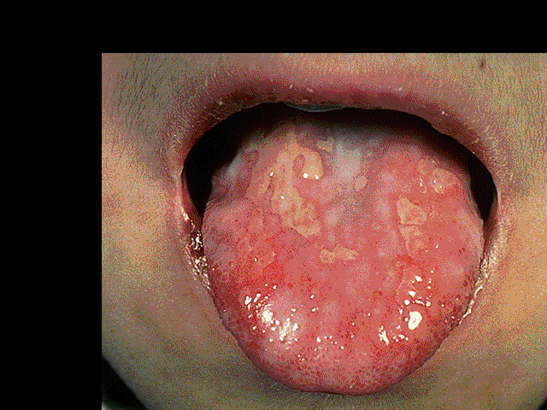
Graft versus host disease (GVHD)
Acute
Usually occurs before D100
Organs affected – skin, gut, liver
Chronic
Usually develops after D100
Can involve skin, gut, liver, eyes, lungs, connective tissues
More prone to opportunistic infections
Risk Factors
Conditioning regimen (MA>NMA)
Mismatched HLA transplants (Related/ unrelated)
High number of T cell in donor
Sex mismatched (F-----M)
Older age of recipient
Source of SC (PBSC > BM > CB)

Slide 22
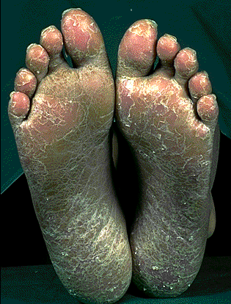
Prevention
HLA matching
Reduced intensity conditioning regimens
door T-cell depletion
Steroids with cyclosporine , methotrexate, Tacrolimus,ATG (Anti-thymocyte globulin)

Slide 23
GVL and GVHD
Allogeneic lymphocytes produce a strong graft-versus-leukemia (GVL) effect, but the beneficial effect is limited by (GVHD)
The challenge of allogeneic HSC is the prevention of GVHD without losing (GVL) effect.
Delayed transfusion of donor T cells after partial T cell–depleted marrow transplantation
Selecting memory T cell (donor T cells with a naive phenotype co expresing CD62L and CCR2 have higher GvHD activity)
Selecting regulatory T cells

Slide 24
Role of KIR Ligand Mismatches
Killer immunoglobulin-like receptors (KIRs) are NK receptors
binding to the HLA class I moleculs
three known KIR ligand mismatches which are present in donor/missing in recipient
HLA-C1
HLA-C2
HLA-BW4
KIR ligand mismatches are important for the success of HSCT with a haploidentical donor in patients with AML

Slide 25
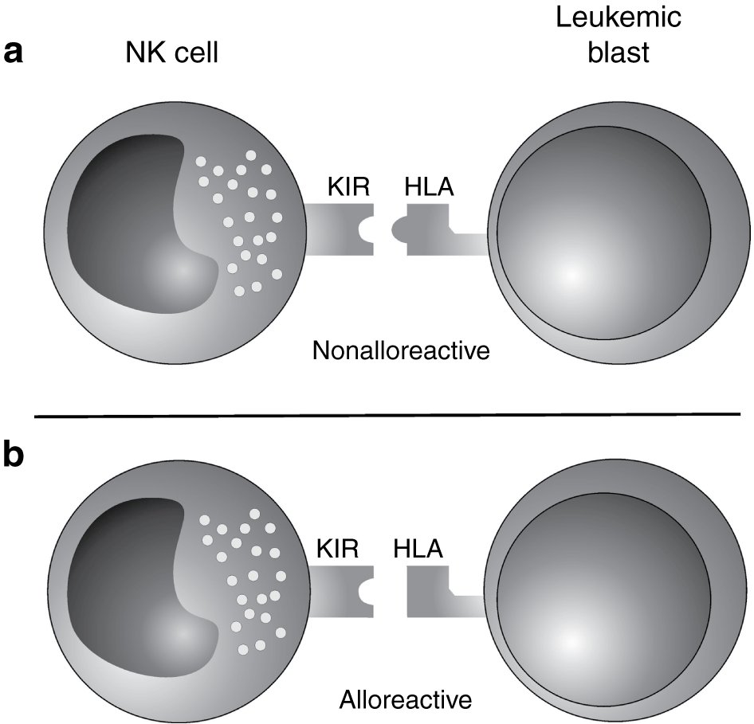
NK alloreactivity:
improved survival favored engraftment
eradication of AML
and reduced GvHD
Mechaism;
clearance of residual leukemia cells resulting in lower relapse rate
clearance of host dendritic cells reducing GvHD incidence

Slide 26


