Slide 1

In the name of god

Slide 2
Interventional impact of liposomal iron on iron-deficient children developmental outcome: randomized,double-blind, placebo-controlled tria
:presented by
Melina Nikpour

Slide 3
Heterotrimeric plasma protein composed of three subunits: Aα (FGA), Bβ (FGB), γ (FGG)
Encoded by genes located on chromosome 4
Hereditary fibrinogen disorders classified into:
Quantitative defects
Qualitative defects (not discussed here)
Quantitative Fibrinogen Disorders
1) Afibrinogenemia
Definition: Complete absence of fibrinogen
Genetics:
Autosomal recessive inheritance (homozygous or compound heterozygous mutations)
Caused by deletions, nonsense mutations, or frameshift mutations in FGA, FGB, or FGG
Prevalence: ~1 per 1,000,000 (very rare)
2) Hypofibrinogenemia
Definition: Reduced fibrinogen levels (partial deficiency)
Genetics:
Often autosomal recessive (heterozygous form of afibrinogenemia)
Mutations reduce fibrinogen synthesis/production
Fibrinogen level: Low, but detectable
RESULTS
DISCUSSION
METHODS
INTRODUCTION
Points of strength
CONCLUSIONS
Limitations

Slide 4
RESULTS
Qualitative Fibrinogen Disorders
1) Dysfibrinogenemia
Definition: Normal antigenic fibrinogen level but reduced functional activity
Laboratory pattern:
Normal immunologic fibrinogen
Low functional fibrinogen
Genetics:
Most commonly autosomal dominant
Usually caused by point mutations in specific functional domains affecting:
Thrombin cleavage sites (impaired release of fibrinopeptide A or B)
Fibrin polymerization
Factor XIIIa or plasmin binding
2) Hypodysfibrinogenemia
Definition: Combination of reduced fibrinogen level (quantitative) and abnormal function (qualitative defect)
DISCUSSION
METHODS
INTRODUCTION
Points of strength
CONCLUSIONS
Limitations

Slide 5
Clinical Manifestations
RESULTS
Disorder | Predominant Manifestation | Key Features
Afibrinogenemia | Severe bleeding | • Most common neonatal sign: prolonged umbilical stump bleeding • Joint & muscle hemorrhage (hemophilia-like) • GI bleeding, intracranial hemorrhage (life-threatening) • Severe bleeding after trauma/surgery • Paradoxical thrombosis may occur (rare, but reported)
Hypofibrinogenemia | Mild to moderate bleeding | • Bleeding severity correlates with fibrinogen level • Mucocutaneous bleeding more common
Dysfibrinogenemia | Highly variable: bleeding or thrombosis | • Bleeding phenotype: often due to impaired fibrin polymerization • Thrombotic phenotype (most common): - Hypercoagulability due to impaired thrombin inhibition or fibrinolysis - Risk of VTE and pulmonary embolism • Asymptomatic patients are common
DISCUSSION
METHODS
INTRODUCTION
Points of strength
CONCLUSIONS
Limitations

Slide 6
Laboratory Diagnosis
RESULTS
DISCUSSION
METHODS
Afibrinogenemia
PT, aPTT, TT: Markedly prolonged
Functional fibrinogen (Clauss): Very low or undetectable (~0)
Antigenic fibrinogen: Very low/absent
Hypofibrinogenemia
PT, aPTT, TT: Prolonged
Fibrinogen level: Low (both functional and antigenic)
Dysfibrinogenemia
Functional fibrinogen (Clauss): Low
Antigenic fibrinogen: Normal or near-normal
Functional/Antigenic ratio < 0.7 (key diagnostic marker)
INTRODUCTION
Points of strength
CONCLUSIONS
Limitations

Slide 7
Fibrinogen Replacement Products
RESULTS
Fibrinogen Concentrate (First-line)
Preferred product
Virus-inactivated, highly purified, fixed dosing
Lower risk of infectious disease transmission
Cryoprecipitate
Used when concentrate is unavailable
Contains high levels of fibrinogen, Factor VIII, vWF, and Factor XIII
Higher pathogen-transmission risk than concentrate
Fresh Frozen Plasma (FFP)
Emergency use only
When neither concentrate nor cryoprecipitate is available
Thrombosis Management (in Dysfibrinogenemia)
Patients with a history of thrombosis may require prophylactic anticoagulation
Example: LMWH (Low-Molecular-Weight Heparin)
This may be needed even during fibrinogen replacement therapy
To prevent thrombotic events in bleeding-risk situations
DISCUSSION
METHODS
INTRODUCTION
Points of strength
CONCLUSIONS
Limitations

Slide 8
RESULTS
Study Design
DISCUSSION
INTRODUCTION
• Study Type: Double-blind, placebo-controlled, randomized trial (DBPCT)
Duration:
For 4 months
January 2022 to March 2023
METHODS
Points of strength
CONCLUSIONS
Limitations

Slide 9
RESULTS
Sampling Technique: Multistage random sampling to select 10 nurseries from a stratified list of available nurseries at study design time
Initial Screening: 674 apparently healthy children screened for eligibility
Consent Process: All parents/guardians attended a meeting; study procedures/purposes explained; written consent obtained
Dietary Guidance: Provided by specialized dietitian on high-iron foods and those reducing iron absorption
Baseline Assessments:
Detailed history
Thorough physical examination
Socioeconomic status (SES) evaluated using Fahmy et al. scale
DISCUSSION
INTRODUCTION
METHODS
Study Population
Points of strength
CONCLUSIONS
Inclusion Criteria:
Age: 6 to 59 months
No iron supplements in past 4 months
No history of blood transfusion
No apparent signs of acute infections
Exclusion Criteria:
Any chronic disease
Family history of hematological diseases
Premature birth or low birth weight (<2500 grams)
Evident neurological disabilities (e.g., cerebral palsy, developmental delay, fits)
Final Recruitment: 433 children met all criteria and were enrolled
Limitations

Slide 10
Tool Used:
Ages and Stages Questionnaires-3 (ASQ-3), age-appropriate questionnaire for all participants
Importance of Screening: Crucial for optimal development and early delay detection
Standard Tool Features:
Cost-effective, simple, accurate, valid, reliable, culturally appropriate
Easy to administer, quick to use
Questionnaire Structure:
30 items total; 6 items per domain across 5 areas
Domains: Communication, gross motor, fine motor, problem-solving, personal-social
RESULTS
DISCUSSION
INTRODUCTION
METHODS
Developmental Assessment
Points of strength
CONCLUSIONS
Scoring Process:
Parent responses: Yes (10 points), Sometimes (5 points), Not Yet (0 points)
Total score: Sum of 5 domains (maximum 300)
Interpretation:
Compare to cutoff points on scoring sheet
White area: Typical development
Gray zone: Refer for additional testing and close monitoring
Black region: 2 SD below age-appropriate mean → Suggests potential developmental delay susceptibility
Limitations

Slide 11
Anthropometric Measurements
RESULTS
DISCUSSION
INTRODUCTION
Measurements Taken: Child's weight, length, and height
Age-Specific Calculations:
For children <2 years: Weight-for-length ratio
For children >2 years: Body Mass Index (BMI) using formula: BMI = weight / (length)²
Interpretation: Plot each measurement on the latest Egyptian Z-score growth curves
METHODS
Points of strength
CONCLUSIONS
Limitations

Slide 12
Laboratory Investigations
RESULTS
DISCUSSION
INTRODUCTION
Blood Collection:
5 mL from each participant, divided into 2 tubes
CBC (Complete Blood Count):
2 mL in EDTA tube
Hemoglobin reference range: 12–15 g/dL
1
2
METHODS
Points of strength
CONCLUSIONS
3
4
Inflammation Control: Ferritin as positive acute-phase protein; complicates ID diagnosis with concurrent inflammation
Exclusion: Children with CRP >5 mg/L classified as positive and excluded
Limitations
Serum Ferritin and CRP (C-Reactive Protein):
3 mL in plain tubes; allowed to clot
Serum isolated via centrifugation (10 min at 2000 × g)
Ferritin reference range: 30–400 µg/L

Slide 13
Study Groups and Intervention
RESULTS
Group Definitions (WHO Criteria for <5 years):
Iron Sufficient: Hb >11 g/dL + ferritin >12 µg/L (n=185; control group)
IDA: Hb <11 g/dL + serum ferritin <12 µg/L (n=146; all received LI)
NAID: Normal Hb + ferritin <12 µg/L )n=102)(randomized 1:1 to placebo n=51 or interventional LI n=51)
Blinding & Anonymity:
Unique personal codes assigned at baseline; confidential via impartial monitoring board until analysis complete
Double-blind: Participants, families, and outcome assessors unaware of allocation until database unlock
Preparation: Independent pharmacist pre-labeled packs matching trial codes
Intervention Details:
LI Groups (NAID interventional + IDA): sachets (19.2 mg elemental iron pyrophosphate)
Dosage: 1x/day, 6 days/week; reconstitute in 19.2 mL water → 1 mg/mL suspension
Individualized: 1.4 mg/kg/day, adjusted monthly by weight
Placebo (NAID): Identical sachet (taste, color, volume) without active ingredients
Supervision & Monitoring:
Trained field worker per nursery directly supervises consumption and records compliance
Adverse Effects: Questionnaire to parents on expected iron therapy side effects
Compliance Calculation: Proportion of medicated days out of maximum 105 days
DISCUSSION
INTRODUCTION
METHODS
Points of strength
CONCLUSIONS
Limitations

Slide 14
1
2
ورود به سایت
Prv.mosharekath.ir
انتخاب گزینه استان ها
3
4
5
انتخاب استان
میز خدمات الکترونیکی
شروع ثبت نام
Study Groups and Intervention
RESULTS
Completion Rate: 403 children completed the 4-month study; 30 dropouts
Effect Evaluation:
Intra-group: Mean difference from baseline for lab, developmental (ASQ-3), and growth outcomes
Inter-group: Pre- vs. post-intervention differences to assess if early NAID treatment > IDA treatment
Focus: Quantitative impact of liposomal iron (LI) on outcomes
DISCUSSION
INTRODUCTION
METHODS
Sample Size Calculation
Points of strength
CONCLUSIONS
Software: SPSS, based on prior studies on iron therapy efficacy and developmental score changes (baseline to 4 months)
Parameters: 95% confidence level; 80% statistical power
Minimum Required: 45 children per group
Adjustment: Targeted 51 per comparative group (accounting for 10% dropout rate)
Limitations

Slide 15
Statistical Analysis
RESULTS
1
2
DISCUSSION
INTRODUCTION
Software: IBM SPSS package version 20.0 (Armonk, NY: IBM Corp)
Qualitative Data Description: Numbers and percentages
Normality Test: Kolmogorov-Smirnov test
Quantitative Data Description:
Normal distribution: Mean ± standard deviation (SD)
Abnormal distribution: Median and interquartile range (IQR)
METHODS
Points of strength
CONCLUSIONS
3
4
5
Limitations
Group Comparisons:
Categorical variables: Chi-square test
Chi-square correction (>20% cells with expected count <5): Monte Carlo correction
Time Comparisons (Pre- vs. Post):
Normal quantitative: Paired t-test
Abnormal quantitative: Mann-Whitney test
Multi-Group Comparisons (Abnormal Quantitative):
Kruskal-Wallis test (for >2 groups)
Post-hoc pairwise: Dunn’s multiple comparisons test
Other Tests:
Significance between stages: McNemar test
Correlation (ferritin changes vs. development scores): Spearman coefficient
Contingency tables: Fisher Exact test
Significance Threshold: P-value ≤ 0.05

Slide 16
METHODS
Participant Demographics:
Mean age: 28.49 ± 16.15 months
Male participants: 50.4%
Prevalence of Iron Deficiency :
Overall ID: 57.2%
IDA: 33.7%
NAID: 23.5%
Developmental Scores (ASQ-3):
Significantly higher in iron sufficient group vs. NAID and IDA groups
Worst scores: IDA group
Anthropometric Measurements (Z-Scores):
Lower in NAID and IDA vs. iron sufficient group:
Weight-for-age
Length/height-for-age
Weight-for-length
BMI
DISCUSSION
INTRODUCTION
RESULTS
Points of strength
CONCLUSIONS
Limitations

Slide 17
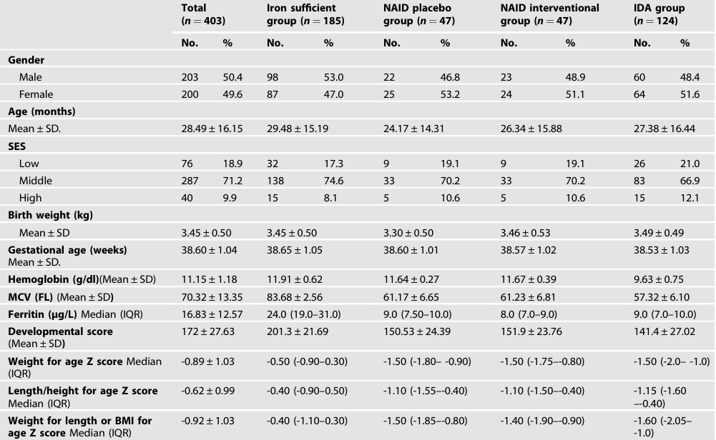

Slide 18
Laboratory Parameters
METHODS
DISCUSSION
Post-Therapy Hemoglobin Comparison:
Higher in NAID Interventional vs. IDA group (p<0.001)
Hemoglobin Changes (Intervention Effect):
NAID Interventional: +1.25 g/dL (95% CI: 1.07–1.43) → Significant increase with LI
NAID Placebo: -0.18 g/dL → Slight decline (natural without intervention)
INTRODUCTION
2
1
RESULTS
Points of strength
CONCLUSIONS
3
4
Limitations
Inter-Group Ferritin Significance:
NAID Interventional vs. Placebo: p<0.001
NAID Interventional vs. IDA: 43.0 µg/L vs. 34.0 µg/L (p=0.013)
Serum Ferritin Changes:
NAID Placebo: No significant difference from baseline after 4 months
Substantial rise in both NAID Interventional and IDA groups

Slide 19
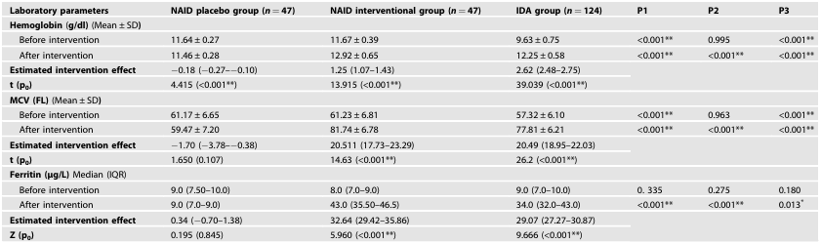

Slide 20
Developmental Scores
METHODS
DISCUSSION
INTRODUCTION
Black Zone Reduction (High-Risk Delay):
NAID Interventional: From 34% pre- to 4.3% post-4 months LI
IDA: From 38.7% pre- to 11.3% post-LI
Placebo Effect: NAID Placebo – Increased from 29.8% to 34% (further deterioration over time
Intervention Effect on Total Scores
Mean Difference in Total Scores:
NAID Interventional: +29.57 (superior vs. placebo; P<0.001)
NAID Placebo: +0.96 only
IDA: +33.63 improvement
Final Scores Comparison:
NAID Interventional: 181.5 (notably superior to IDA; P<0.001)
IDA: 175.0 (Table 3)
Correlation Analysis
Spearman Coefficient: Positive correlation between serum ferritin levels and developmental score changes post-intervention (rs=0.751; P<0.001.
RESULTS
Points of strength
CONCLUSIONS
Limitations

Slide 21
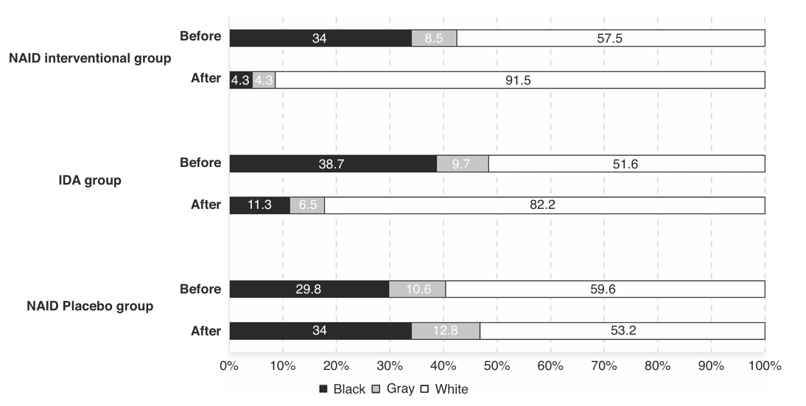
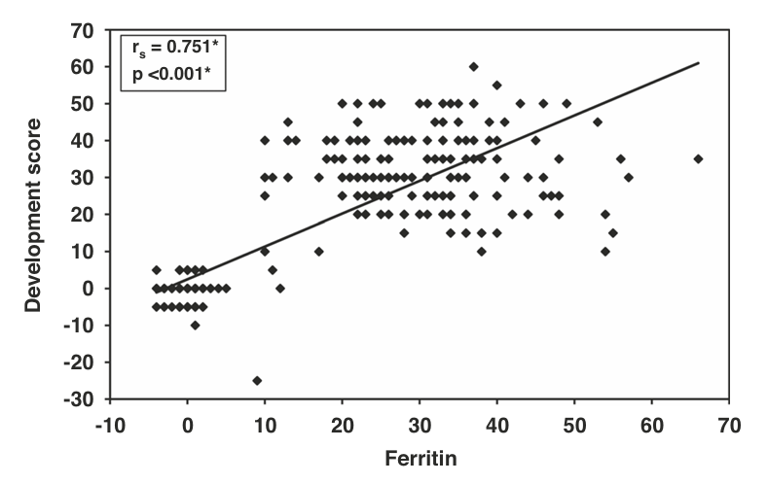
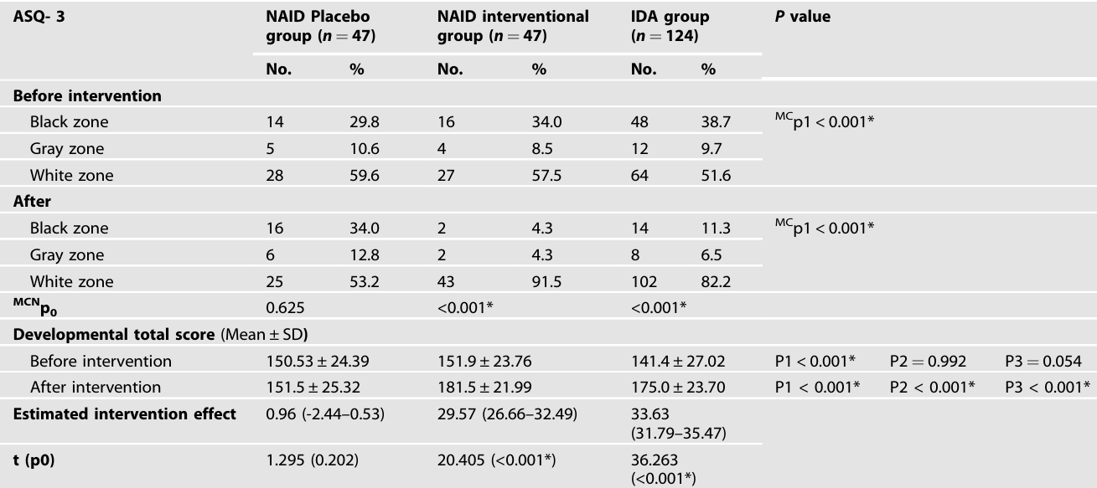

Slide 22
Growth
METHODS
Improvement in LI Groups:
Both NAID Interventional and IDA groups: Significant gains in all Z-scores (weight-for-age, length/height-for-age, weight-for-length/BMI-for-age; p<0.001)
Superiority of Early Intervention:
NAID Interventional: Greater improvement in weight and weight-for-length/BMI Z-scores vs. IDA (p<0.001)
Placebo Effect:
NAID Placebo: No significant improvement; markedly lower Z-scores vs. NAID Interventional (p<0.001)
DISCUSSION
INTRODUCTION
RESULTS
Points of strength
CONCLUSIONS
Compliance and Adverse Effects
Limitations
Compliance Rates (Similar Across Groups):
NAID Placebo: 93.9% ± 1.674 days
NAID Interventional: 93.2% ± 2.206 days
IDA: 93.3% ± 1.9 days
Adverse Effects:
No serious effects in any group
Common (similar percentages): Constipation, loose stools, stool darkening

Slide 23
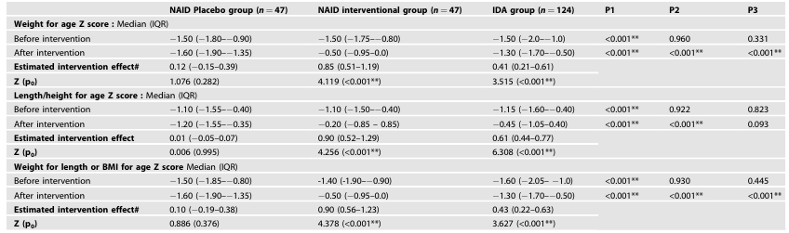
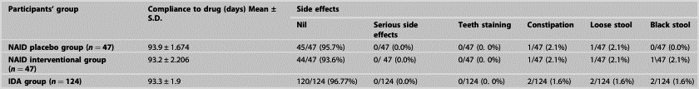

Slide 24
Prevalenceof iron deficiency anemia and non-anemic iron deficiency
METHODS
RESULTS
INTRODUCTION
IDA Prevalence in Study: 33.7%, aligning with global IDA rate of 30% as the most common nutritional deficiency
Previous Egyptian Study: IDA prevalence in children 6-59 months ranged from 27% to 43% (2014-2021)
WHO Classification: Moderate risk level for IDA based on public health grading criteria across communities
NAID Prevalence in Study: 23.5%, consistent with global pooled prevalence of 17.95% in children under 5 years
Global Variation in NAID (WHO Stats): Africa 62.3%, Southeast Asia 53.8%, North America 2.9%
Reasons for Variation: Inadequate diagnosis/screening guidelines; NAID not viewed as clinically suspicious, leading to oversight by physicians
DISCUSSION
Points of strength
CONCLUSIONS
Limitations

Slide 25
Iron Deficiency and Development
• Study Findings: NAID and IDA groups reported significantly lower developmental test scores compared to iron-sufficient peers
Recent Studies: Infants with ID (including non-anemic) exhibit inferior performance on neurobehavioral assessments, gross/fine motor skills, and adaptability vs. peers with better iron levels
• Parkin et al. Research: Higher serum ferritin correlates with superior cognitive functions in early childhood
• Mechanistic Link: ID impairs iron-dependent enzymes essential for neurotransmitter metabolism, DNA synthesis, and lipid synthesis in oligodendrocytes
• Consequences: Slowed brain myelination, abnormal neuro-synaptic structure, reduced nerve growth factor expression
METHODS
RESULTS
INTRODUCTION
DISCUSSION
Points of strength
CONCLUSIONS
Iron Deficiency and Growth
Mechanisms of Impact:
ID hampers cellular replication via iron-dependent enzyme ribonucleotide reductase, essential for DNA synthesis
Extends to growth pathways: Disrupts IGF-1 and IGF-binding protein-1, inhibiting cell proliferation and negatively affecting growth
Study Findings:
Children with ID (NAID or IDA) showed significantly lower mean Z-scores in all growth parameters (weight, length/height, BMI) vs. iron-sufficient group
Supporting Evidence:
Observational studies link ID to hindered physical growth in children
Malnourished children (low Z-scores) have 2x higher risk of ID vs. normal Z-score peers
Limitations

Slide 26
Efficacy of Liposomal Iron (LI) Intervention
METHODS
Conventional Iron Drawbacks: 30% GI side effects reduce adherence/compliance, leading to dose reduction/discontinuation
• LI Advantages: Concealed iron improves absorption, avoids bad taste; Enhances adherence with low side effects (3.1% in prior trial); Promising safe alternative
• Evidence from Other Contexts:
Effective/safe substitute for IV iron gluconate in CKD anemia patients
Beneficial for non-ID cancer patients on epoetin alpha
• Gaps in Pediatric Data: Prior studies small-scale, limited to mild IDA; Lack effects on iron stores/Hb stability → Unclear therapeutic efficacy in children
RESULTS
INTRODUCTION
DISCUSSION
Points of strength
CONCLUSIONS
Limitations

Slide 27
METHODS
Interventional Effect of Liposomal Iron on Development
RESULTS
INTRODUCTION
• ASQ-3 Improvements: Significant score gains in LI groups; Strong correlation between ferritin rise and developmental score changes post-intervention
• Reversibility Debate: Conflicting studies on reversing deficits
Idjradinata et al.: 4-month oral iron benefits young ID infants' scores
Lozoff et al.: Post-anemia iron fails to reverse neurological effects, even extensively
Pasricha meta-analysis: Most studies show no cognitive gains from supplementation
• Reasons for Disparities: Screening ferritin levels, protocol adherence, use of conventional iron (with drawbacks)
• Study Choices: ASQ-3 over Bayley scale (criticized for underestimating delays); First RCT using LI (vs. prior conventional iron studies)
• Group Differences: Both LI groups improved, but NAID > IDA (means: 181.5 ±21.99 vs. 175.0 ±23.70; P<0.001)
Implications: Early ID detection/treatment maximizes cognitive development; Pre-anemia intervention key
• Placebo Contrast: Deterioration in NAID placebo disproves diet-alone sufficiency; Stresses monitoring at-risk kids and early intervention
DISCUSSION
Points of strength
CONCLUSIONS
Limitations

Slide 28
Interventional Effect of Liposomal Iron on Growth
METHODS
• Overall Impact: LI led to significant positive changes in all growth parameters, alongside hematological and developmental improvements
• Supporting Studies: Oral iron linked to greater weight/height velocity gains vs. placebo
• Correlation Evidence: Improved serum ferritin correlates with growth velocity and BMI in ID patients; Stronger effect in NAID vs. IDA stage
• Study Alignment: NAID interventional children showed better growth metrics than IDA group
• Controversies: Iron therapy's growth impact debated; Some systematic reviews find no significant positive outcomes
• Reasons for Conflict: Variations in age groups, therapy duration; Nutritional shortages in developing countries may limit benefits
RESULTS
INTRODUCTION
DISCUSSION
Points of strength
CONCLUSIONS
Limitations

Slide 29

METHODS
First-of-Its-Kind Trial: Initial evaluation of liposomal iron efficacy on ID via double-blind, placebo-controlled RCT – gold standard for causal inference
1
RESULTS
INTRODUCTION
Points of strength
Comprehensive Design: Included both NAID and IDA groups to compare optimal timing for iron therapy initiation
2
DISCUSSION
CONCLUSIONS
Holistic Assessment: Simultaneously evaluated developmental/growth outcomes alongside biochemical markers to assess reversibility with iron therapy
3
Limitations
Confounding Control: Accounted for key social/demographic factors influencing ID and therapy response
4

Slide 30
METHODS
Heterogeneity Issue: Previous studies vary in developmental assessments, iron therapy type/duration, and inclusion of anemic/non-anemic children → Difficult comparisons
1
RESULTS
INTRODUCTION
Scarce Data on LI: Limited studies on liposomal iron efficacy in children
2
Limitations
Bias in Assessment: Developmental scores parent-reported, potentially introducing inherent bias
DISCUSSION
CONCLUSIONS
3
Short-Term Follow-Up: Need longer monitoring to confirm outcome stability post-therapy discontinuation
Points of strength
4
Recommendations:
Large prospective studies for ID screening in <5-year-olds across diverse populations/conditions
Implement standard guidelines for NAID diagnosis/management
5

Slide 31
METHODS
RESULTS
INTRODUCTION
CONCLUSIONS
Measurement of serum ferritin levels is the best screening method.
🔸 Because it can detect iron deficiency before the onset of anemia and initiate effective treatment.
Particular emphasis must be placed on the early detection of iron deficiency.
DISCUSSION
Limitations
Points of strength

Slide 32



