Slide 1
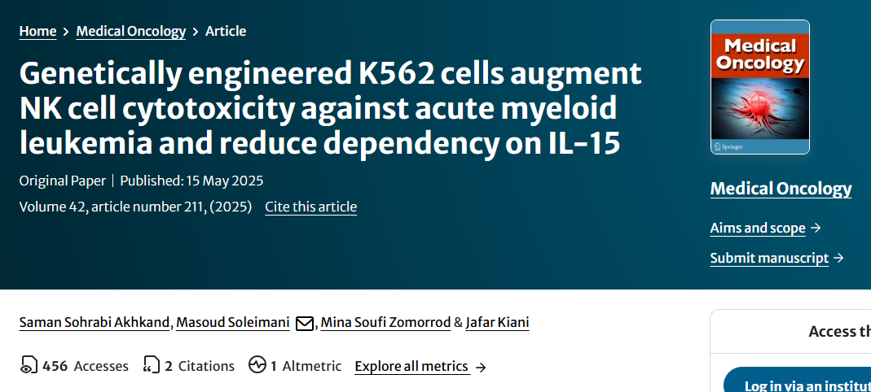






Present by: Fatemeh Peymaninezhad
Home
Introduction
Methods
Results
Discussion
End

Slide 2
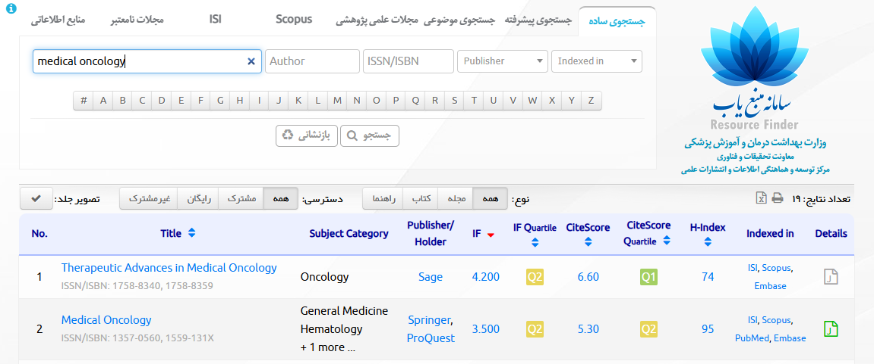
Home
Introduction
Methods
Results
Discussion
End

Slide 3
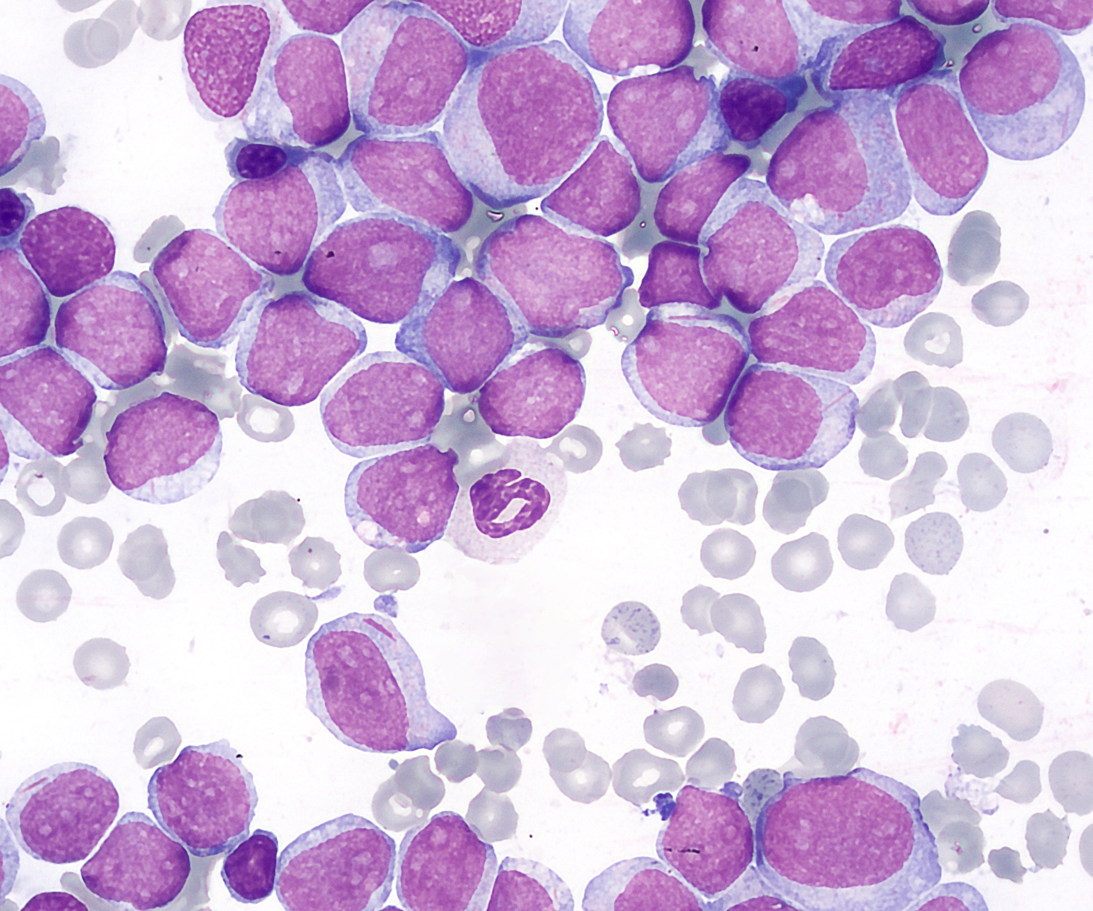
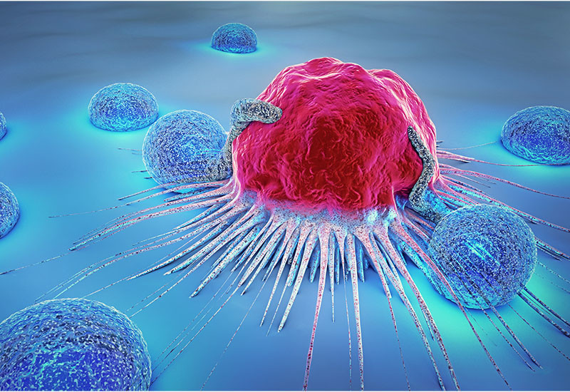
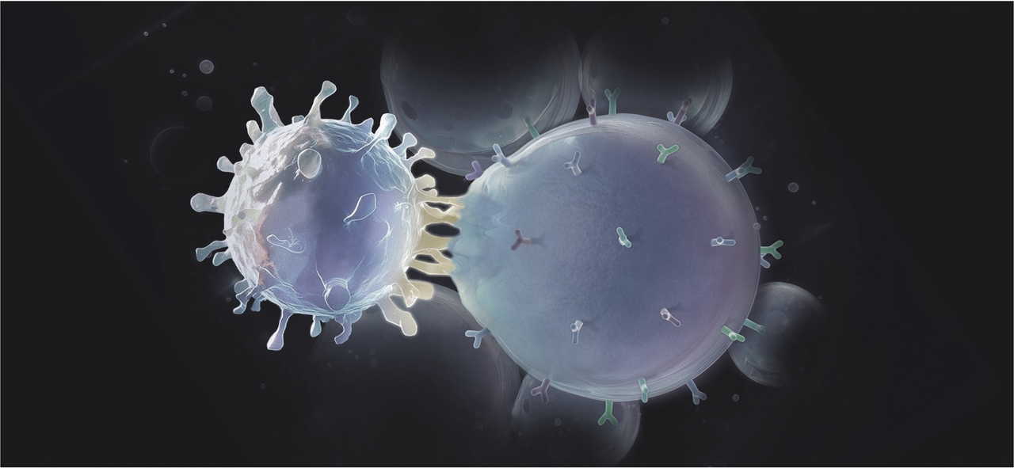


AML:
AML as an aggressive cancer, still faces challenges in treatment.
Even with treatments such as chemotherapy and bone marrow transplantation, many patients experience relapse.
The use of advanced immunotherapy, such as NK cells, has received much attention.
Introduction
Home
Methods
Results
Discussion
End

Slide 4
NK cells:
One of the most important parts of the innate immune system.
These cells face limitations, including their dependence on cytokines such as IL-15 to remain active in vitro.
IL-15 plays a vital role for NK cells, but on the other hand, its use faces challenges.
+
-
?
Introduction
Home
Methods
Results
Discussion
End

Slide 5
aAPCs:
These cells are genetically engineered to express immune-stimulating molecules on their surface, without actually presenting a specific antigen.
They can send signals to NK cells to make them more active and powerful.
Introduction
Home
Methods
Results
Discussion
End

Slide 6
In this Research:
Using K562 cells to make aApc
Genetic engineering to express CD137L and CD86
Overall goals of the study:
  Can K562 cells engineered as aApc enhance the killing power of NK cells against AML cells?
  Can engineered K562 cells reduce the dependence of NK cells on IL-15?
Introduction
Home
Methods
Results
Discussion
End

Slide 7








Plasmid extraction:
Plasmids were extracted using the FavorPrep™ Plasmid DNA Extraction Kit
  psPAX2
  pMD2.G
  pCDH-EF1α−4-1BBL-P2 A-CD86-Puro
Extracted plasmid DNA was then stored at −20°C.
Methods
Home
Introduction
Results
Discussion
End

Slide 8
Lentivirus Production:
Using HEK293 T cells
After reaching a confluence of 70-80%, the cells were starved to increase their permeability to plasmid uptake.
The 3 extracted plasmids were mixed and PEI was added.
The resulting mixture was incubated for 30 minutes at room temperature to form a DNA-PEI complex, after which the resulting mixture was added to starved HEK293 T cells.
After 8 hours, the culture medium was replaced with 10% FBS-DMEM without antibiotics to remove PEI toxins.
After 48 hours and then for 3 consecutive days, the supernatant containing secreted lentiviral particles was collected every 24 hours and stored at 4°C.
The collected viral supernatant was centrifuged at 2000 × g for 10 min and filtered through 0.45 μm syringe filters to remove any cell debris.
To increase the viral concentration, PEG8000 and NaCl were added to precipitate the viral particles.
The mixture was vortexed overnight at 4°C and subsequently centrifuged at 8000 rpm for 20 min to pellet the viral particles.
The pellet was suspended in 3 ml of culture medium and stored at −80°C.
Methods
Home
Introduction
Results
Discussion
End

Slide 9
Transduction of K562 cells to make aAPCs:
K562 cells were cultured with prepared lentivirus containing the CD137 and CD86 transgenes.
Polybrene was used to facilitate virus entry.
After 72 hours, the genes entered the cells.
Methods
Home
Introduction
Results
Discussion
End

Slide 10
Puromycin Selection:
This antibiotic was used to eliminate untransfected cells.
To determine the optimal dose of this antibiotic, K562 cells were plated in appropriate plate wells and treated with different doses of puromycin (0.5, 1, 1.5, 2, 3, and 4 μg/mL).
Finally, a concentration of 2 μg/mL was selected as the optimal dose, which effectively eliminated all untransduced K562 cells by day 6.
Methods
Home
Introduction
Results
Discussion
End

Slide 11
Approval tests for evaluation transduction efficiency:
PCR
RT‑PCR
Flow cytometry
Methods
Home
Introduction
Results
Discussion
End

Slide 12
Cytotoxicity and Viability assays:
1-Can engineered K562 cells make NK cells more active?
Using two sources of NK cells including umbilical cord blood-derived cells and the NK-92 cell line.
Cells were cultured in RPMI medium supplemented with 500 u/ml IL-2 and 50 u/ml IL-15.
Hemocytometry and methylene blue staining were used to count cells and assess cell viability.
K562 cells were rendered non-dividing by gamma irradiation (100 Gy) to to become feeder cells.
The two types of NK cells were cultured with two types of K562 feeder cells (engineered and unengineered) for 2 weeks.
Methods
Home
Introduction
Results
Discussion
End

Slide 13
Cytotoxicity and Viability assays:
2-Are NK cells activated with these aAPCs more potent at killing AML cancer cells?
Both sources of NK cells were co-cultured with target cells of the AML lineage, including HL-60, THP-1, and KG-1, at different E:T ratios of 1:1, 2:1, 5:1, and 10:1 for 4 hours.
Before exposure, target cells were stained with CFSE dye to be detectable by flow cytometry.
7-AAD dye was used to measure cell death.
Methods
Home
Introduction
Results
Discussion
End

Slide 14
Cytotoxicity and Viability assays:
3-Can aAPCs replace interleukin 15?
CB-NK and NK-92 cells were cultured with IL-2 and feeder cells for 14 days.
As a control group, NK cells were cultured with IL-2 and IL-15 in the absence of feeder cells.
Different E:T ratios including 5:1, 8:1, 12:1, 15:1 and 20:1 were investigated after 4 hours of incubation.
Methods
Home
Introduction
Results
Discussion
End

Slide 15
Flow cytometric assessment of cell viability:
7-AAD staining was performed to measure viable cells.
All experiments were performed in triplicate.
Methods
Home
Introduction
Results
Discussion
End

Slide 16
Statistical analysis:
Experimental results are expressed as the mean value with SD using GraphPad PRISM 8 software.
T-test, one-way and two-way ANOVA tests were used to determine statistical significance.
A P-value less than 0.05 was considered statistically significant.
Methods
Home
Introduction
Results
Discussion
End

Slide 17
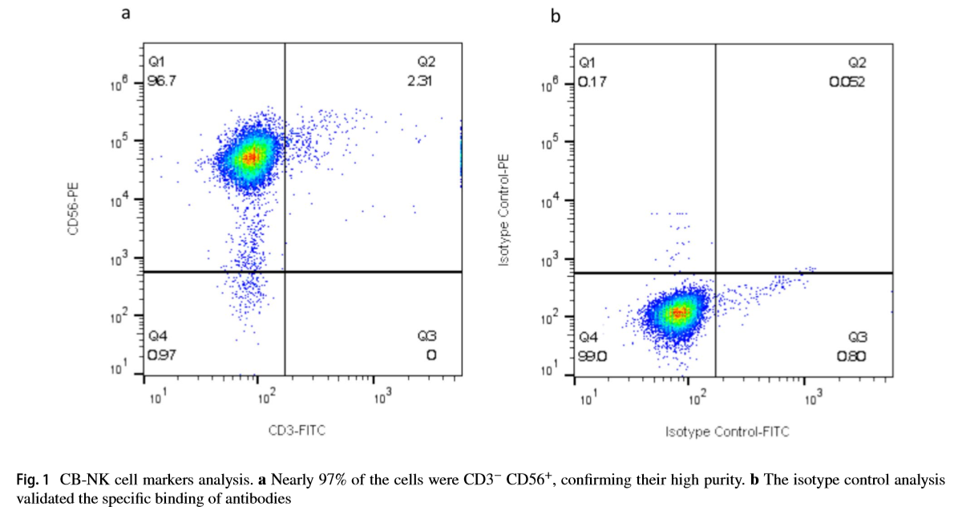
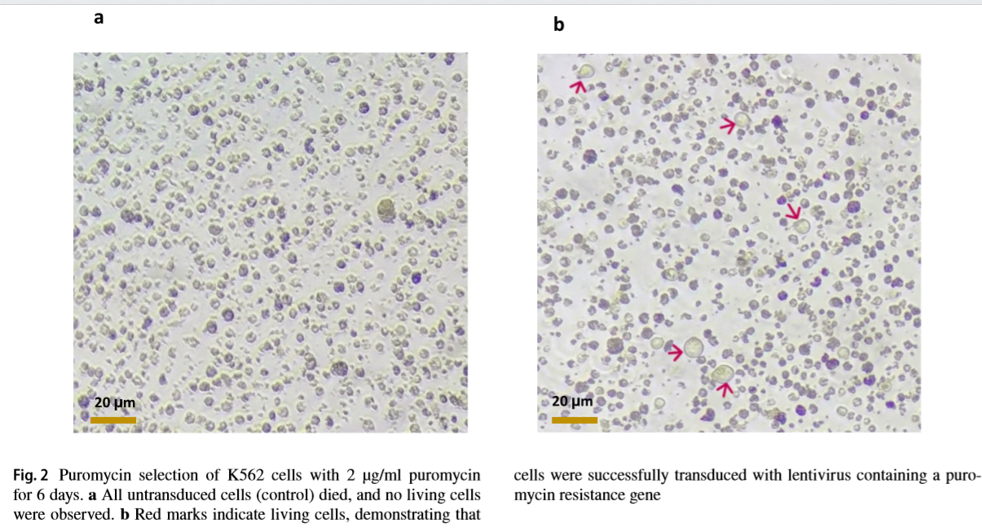
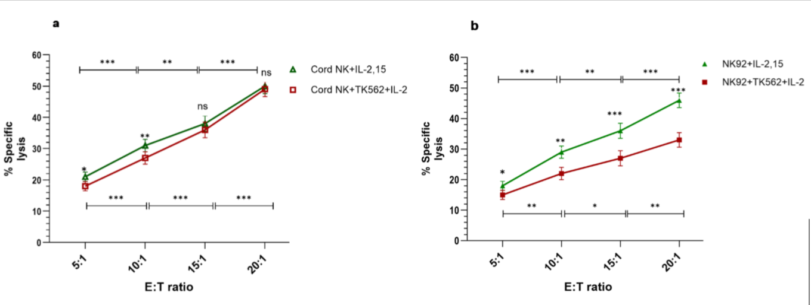
4
1
2
5
Purity of CB‑NK cells
3
Puromycin selection
Transduction of K562 cells
aAPCs as potential substitutes for IL‑15
Cytotoxic activity of CB‑NK and NK‑92 cells against AML cell lines
Results
Home
Introduction
Methods
Discussion
End

Slide 18
4
1
5
2
Purity of CB‑NK cells
3
Puromycin selection
Transduction of K562 cells
aAPCs as potential substitutes for IL‑15
Cytotoxic activity of CB‑NK and NK‑92 cells against AML cell lines
Results
Home
Introduction
Methods
Discussion
End

Slide 19
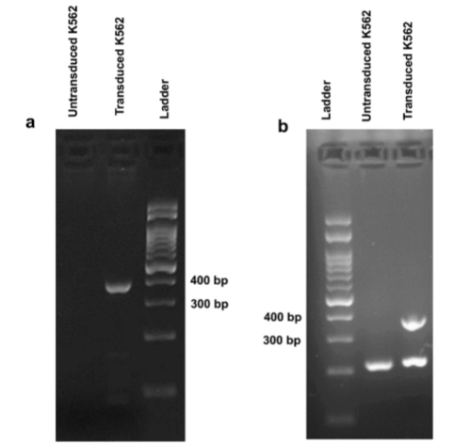
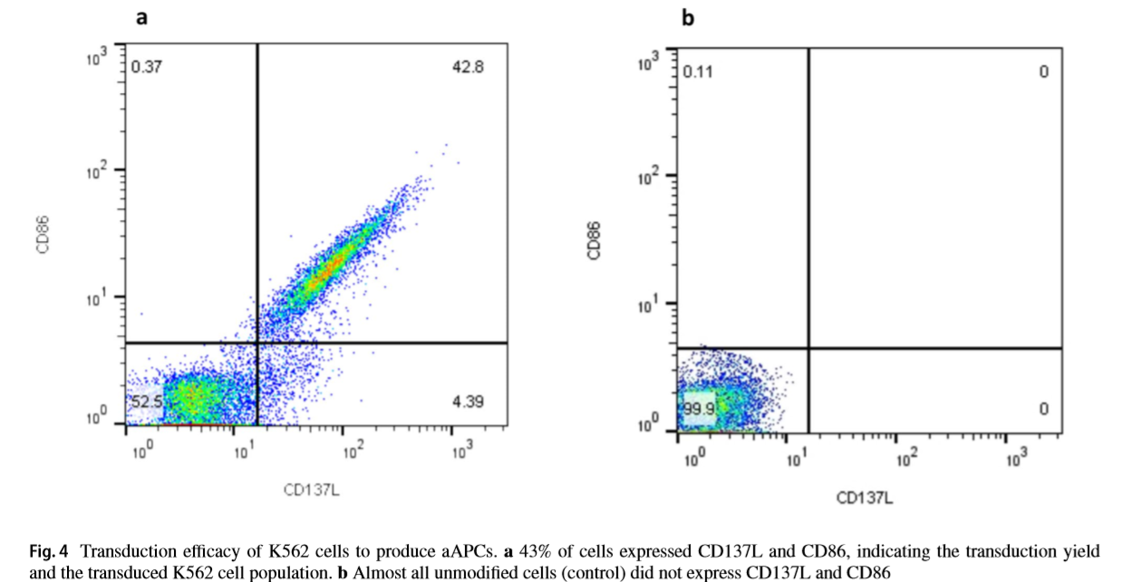
4
1
5
2
3
Purity of CB‑NK cells
Puromycin selection
Transduction of K562 cells
aAPCs as potential substitutes for IL‑15
Cytotoxic activity of CB‑NK and NK‑92 cells against AML cell lines
Results
Home
Introduction
Methods
Discussion
End

Slide 20
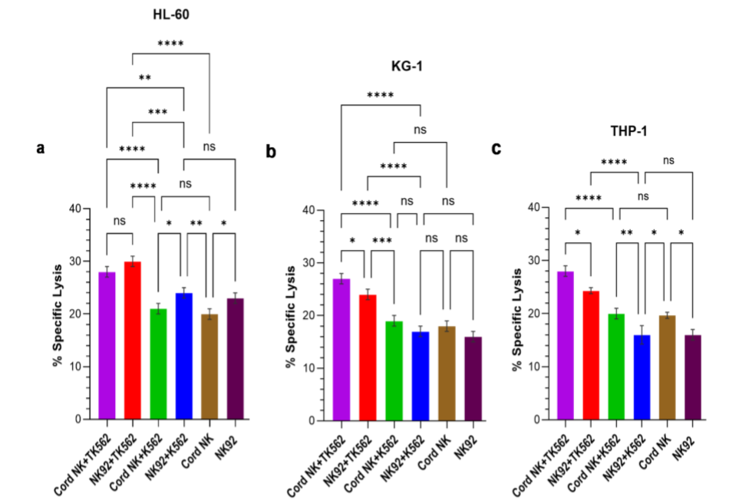
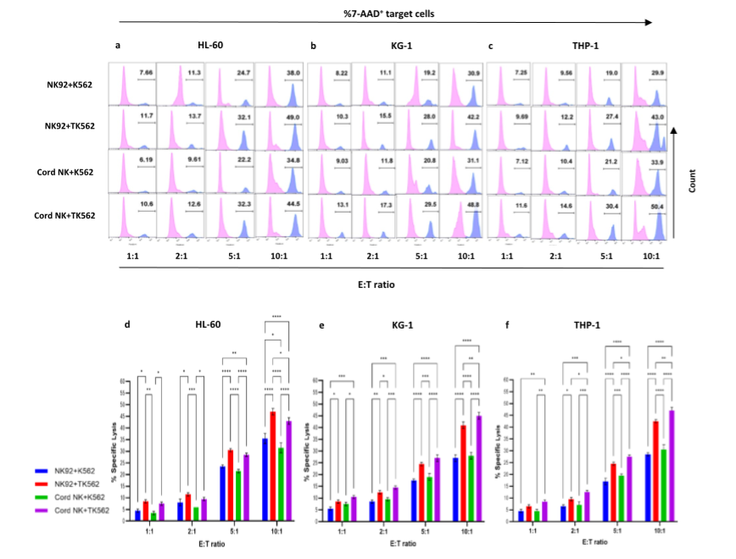
1
4
5
2
3
Purity of CB‑NK cells
Puromycin selection
Transduction of K562 cells
aAPCs as potential substitutes for IL‑15
Cytotoxic activity of CB‑NK and NK‑92 cells against AML cell lines
Results
Home
Introduction
Methods
Discussion
End

Slide 21
4
1
5
2
3
Purity of CB‑NK cells
Puromycin selection
Transduction of K562 cells
aAPCs as potential substitutes for IL‑15
Cytotoxic activity of CB‑NK and NK‑92 cells against AML cell lines
Results
Home
Introduction
Methods
Discussion
End

Slide 22
Conclusion:
The use of genetically modified K562 cells as a support, feeder system or aAPCs can improve the cytotoxicity of NK cells in vitro, leading to their use for immunotherapy.
The cytotoxicity of NK cells varies depending on the target cells tested.
aAPCs may serve as a suitable alternative to IL-15 in enhancing the cytotoxic functions of CB-NK cells under specific conditions and E:T ratios.
Limitations:
Only in-vitro experiments
Limited sampling of primary NK cells
No use of clinical cells
Relatively low transduction efficiency and lack of complete population purification
Short-term study
Discussion
Home
Introduction
Methods
Results
End

Slide 23

End
Home
Introduction
Methods
Results
Discussion

