Slide 1

Platelet concentrate, from whole blood or collected by apheresis?
Zahra shakeri niya
MSc Student Of Hematology

Slide 2
Platelet concentrate (PC)
PRP (Platelet-Rich-Plasma)
Whole blood
BC (buffy coat)
Apheresis

Slide 3
PRP method
Whole blood is centrifuged softly to collect PRP, which in turn is spun hard to sediment and isolate the platelets.
multiple units(5-10) are pooled to make an adult dose .

Slide 4
BC method
Whole blood centrifuged hard, forming of leukocytes and platelets, The BC-layer is isolated, and pools 4-5 BCs are made. Following soft-spin centrifugation, the platelets-rich supernatant is harvested, so that the unit is ready.

Slide 5
Apheresis method
Apheresis is a procedure in which whole blood draw, centrifuged, collect platelets and returns the remainder to the donor
Equivalent of 6-8 random-donor platelets, so decrease donor exposure for a patient.

Slide 6
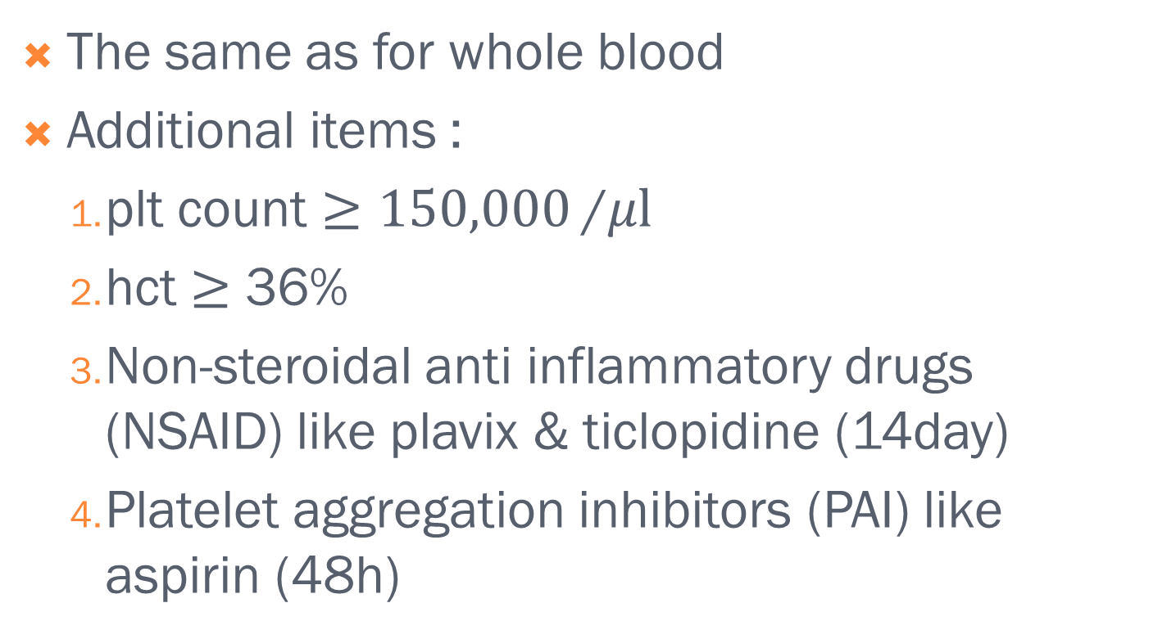
Donor selection criteria
The same as for whole blood
Additional items :
plt count $≥150,000$/$μl$
hct $≥$ 36%
Non-steroidal anti inflammatory drugs (NSAID) like plavix & ticlopidine (14day)
Platelet aggregation inhibitors (PAI) like aspirin (48h)

Slide 7
Donation frequency
Every 2 days
No more than 2 times in 7 days
No more than 24 times in 12 months

Slide 8
Platelets count
20-29%
Notice: It’s not correlate with the yield and plateletpheresis procedure, as more platelets are collected than anticipated due to the mobilization of platelets from the spleen.

Slide 9
Adverse effects of apheresis
Citrate toxicity (Hypocalcemia)
Vascular access complication (hematoma, sepsis, phlebitis, neuropathy)
Vasovagal reactions
Allergic reaction (ethylene oxide)
Air embolus and another things is rare
Notice: long-term plateletpheresis made thrombocytopenia and immune suppression

Slide 10
Compare platelet whole blood and apheresis
whole blood (CPD) anticoagulant
plateletapheresis acid–citrate–dextrose.
Notice : Phosphate is known to stimulate
glycolysis in platelets which may affect storage
characteristics.

Slide 11
hypotonic shock response from the same donor on day 5
32 ± 13% for PRP
57 ± 14% for apheresis platelets
PH on day 5
7.30 ± 0.12 for BC-derived PCs
7.04 ± 0.21 for apheresis PCs

Slide 12
Activation markers CD62P and CD63, and the apoptosis marker phosphatidyl serine exposure, showed minor differences during storage.

Slide 13
Recovery When collected from and reinfused to the same volunteer
35.2 ± 6.7% for PRP-derived platelets
36.8 ± 5.3% for apheresis
Survival at 72 hours
44.1 ± 18.6% for PRP
53.8 ± 10.5% for apheresis

Slide 14
Recovery on day 5
34.8% for BC method
28.1% for apheresis
Survival
6.9 days for BC-derived platelets
5.4 days for apheresis platelets

Slide 15
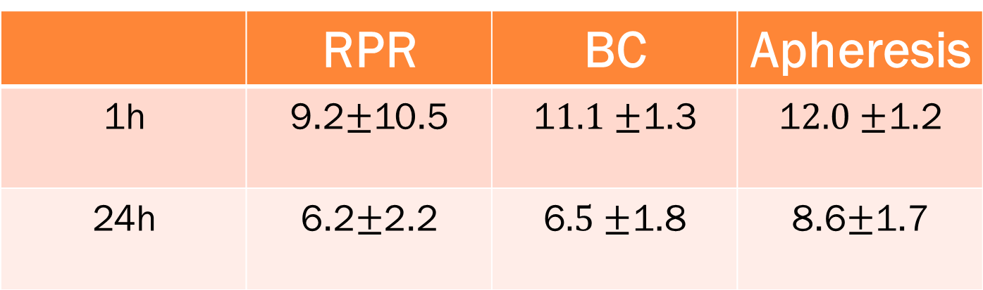
Cci (corrected count increment)
Apheresis | BC | RPR
1$2.0±$1.2 | 1$1.1±$1.3 | 9.2$±$10.5 | 1h
8.6$±$1.7 | 6$.5±$1.8 | 6.2$±$2.2 | 24h
Apheresis | BC
69% | 68% | 1h
46% | 50% | 24h
Meta analysis : CCI for apheresis is better

Slide 16
Safety for pathent
Apheresis : one donor
Whole blood-derived concentrate : multiple donor , exposure (viral transmission)
And bacterial contamination is higher

Slide 17
Safety for donor
Apheresis | Whole blood
0.12% | 0.38% | Moderate reaction
0.03% | 0.09% | Severe reaction

Slide 18
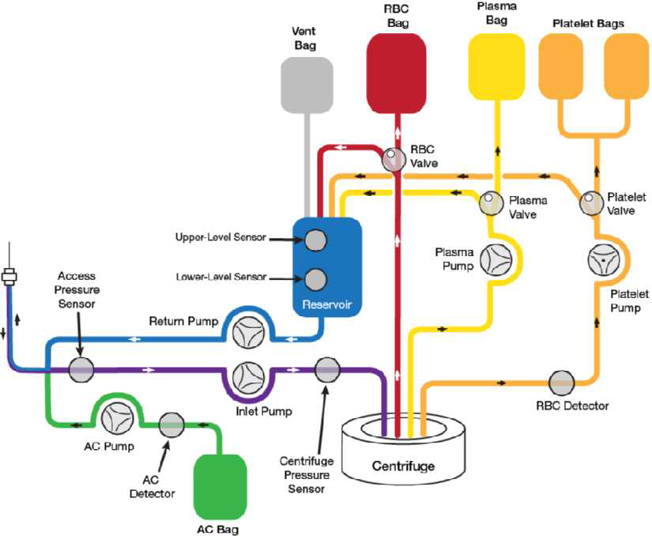
The end

