Slide 1
CT Artifacts

Slide 2
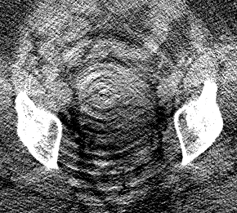
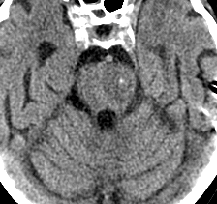
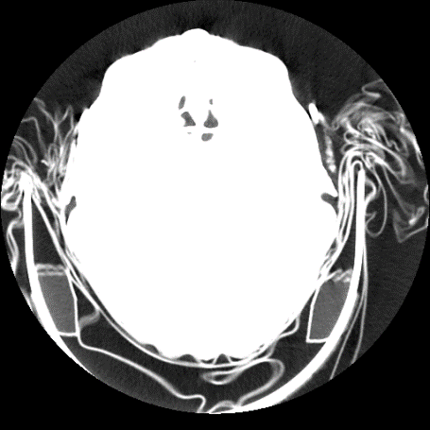
Ring artifact
A B C
Figure 1. Ring artifact. A. Pelvic CT showing severe ring artifact. B. Head CT with subtle ring artifact simulating a pons lesion (arrow). C. Changing the window / level settings shows the circular reconstruction region, which is centered at the center of rotation. The pons pseudolesion (marked with a small circle) is exactly at the center of the circular reconstruction region, and thus consistent with a ringartifact. Follow-up MRI showed a normal pons.

Slide 3
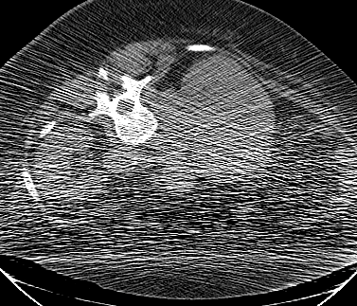
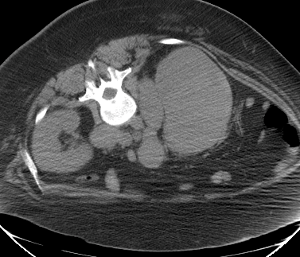
Noise
A. 60 mA, 120 kVp, slice thickness 5 mm B. 440 mA, 120 kVp, slice thickness 5 mm
Figure 2. Effect of mA on Poisson noise. A. Low dose CT image obtained during a CT-guided biopsy shows extensive Poisson noise. These streaks are the same whether or not the abdomen or arms arepartially outside the field of view. B. Post-biopsy image obtained at 7.3 times higher dose has √7.3 􀵌 2.7times less noise. The images show an enlarged retroperitoneal lymph node (arrow) and infiltration of theright kidney in a patient with Hodgkin’s lymphoma.

Slide 4
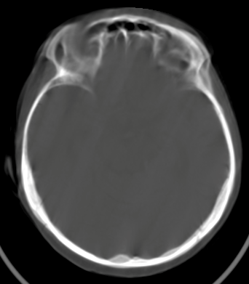
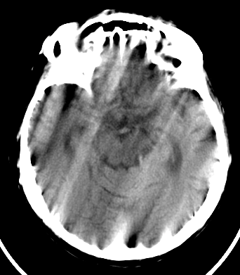
Motion artifact
Figure 5. Motion causes blurring and double images (left), as well as
long range streaks (right).

Slide 5
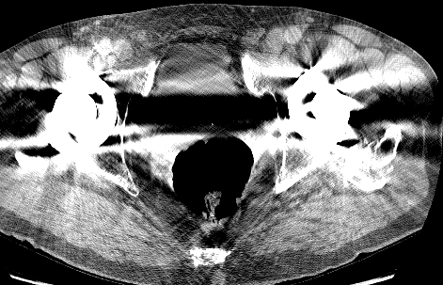
Metal artifact

Slide 6
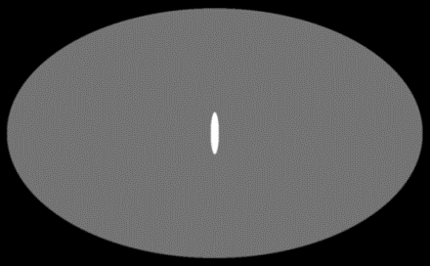
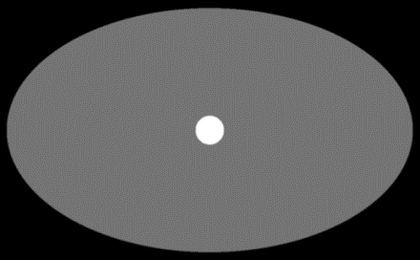
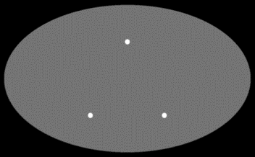
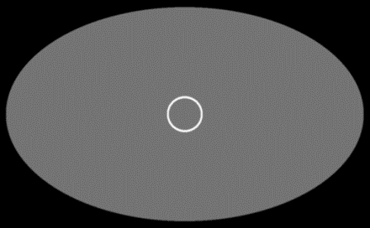
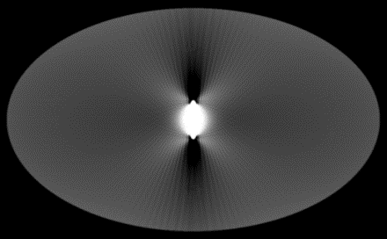
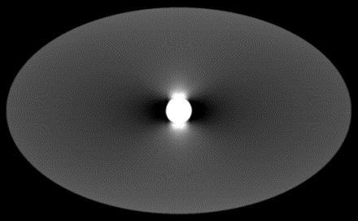
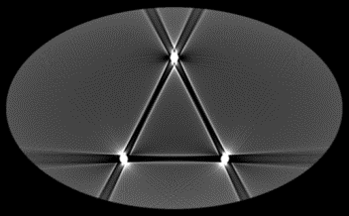
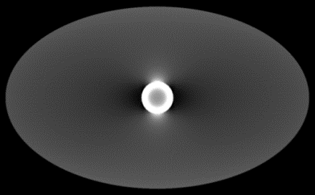
Beam hardening and scatter

Slide 7
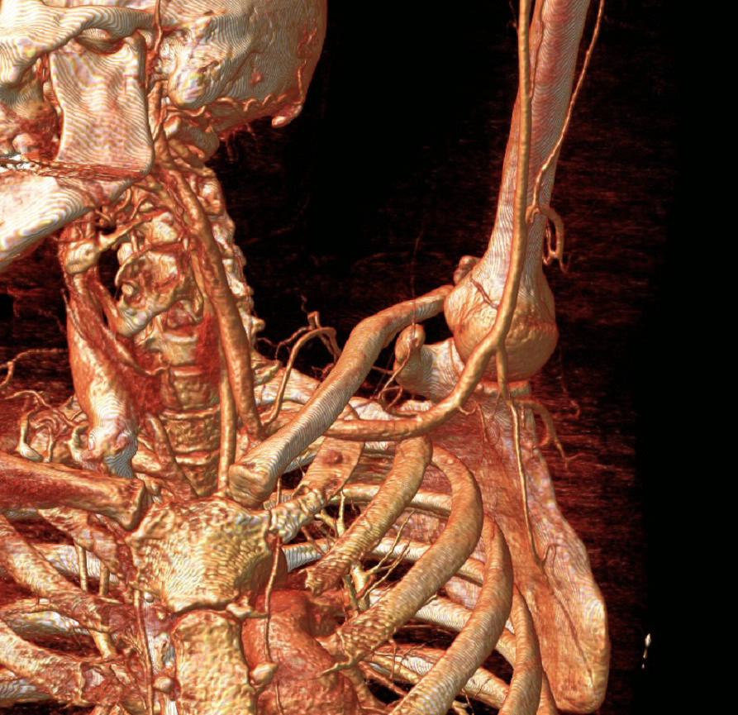
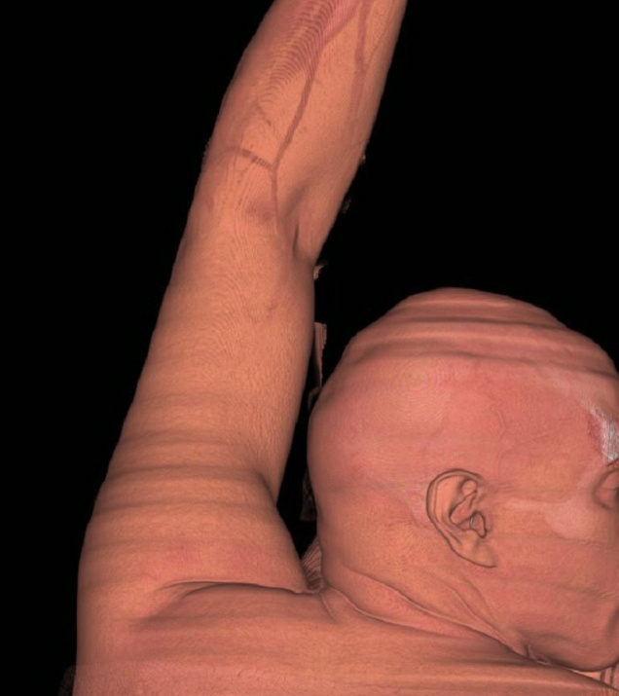
Cone-beam (multidetector row) and windmill (helical) artifacts

