Slide 1

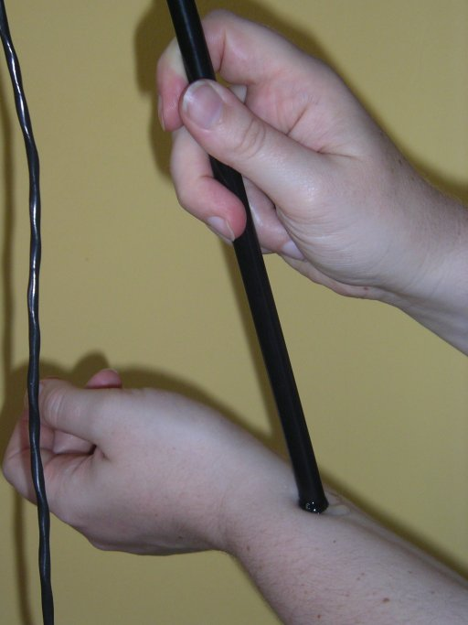
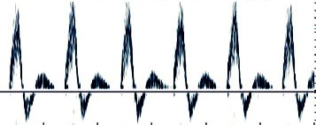

Doppler effect: blood flow in artery
Notes:
Picture and sound from Adam
Radial artery – same one as you measure your pulse from

Slide 2
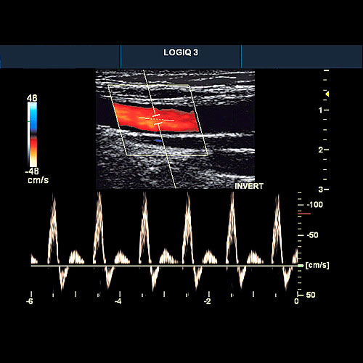
Ultrasound imaging: carotid artery
Doppler imaging looks at artery
Get image and trace of blood flow
This is a healthy artery. The flow is smooth and all in the same direction, like water in a large, slow river
Notes:
Pictures from http://www.gehealthcare.com/uken/

Slide 3
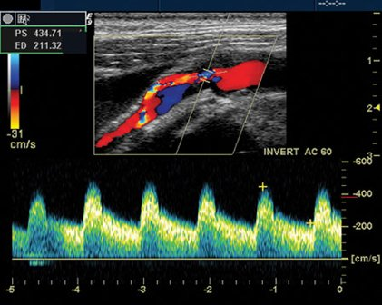
Ultrasound imaging: carotid artery
This is also a carotid artery.
The flow is not all in the same direction. It is turbulent, like rapids in a river.
This is usually due to a build-up of fatty deposits in the artery
Notes:
Pictures from http://www.gehealthcare.com/uken/

Slide 4
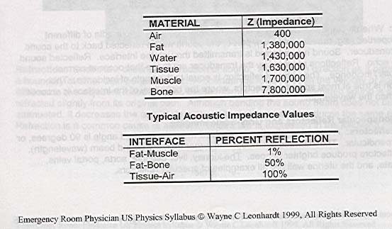

Slide 5
Hyperechoic
Structure reflects most sound waves
Structure appears white on screen

Slide 6
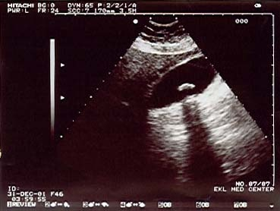

Slide 7
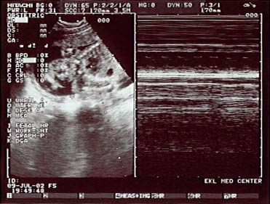

Slide 8
Anechoic
Structure allows most sound waves through
Structure appears black on screen

Slide 9
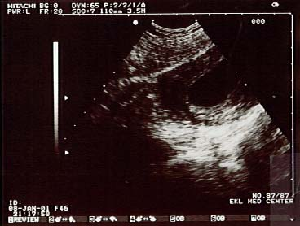

Slide 10
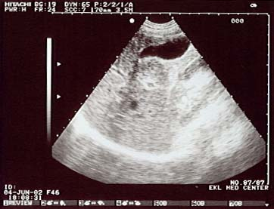

Slide 11
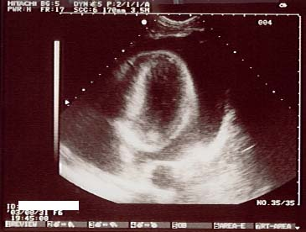

Slide 12
Echogenic
Tissues in between
Allow some sound waves through and reflect others
Structures appear in various shades of gray depending on amount of reflection

Slide 14
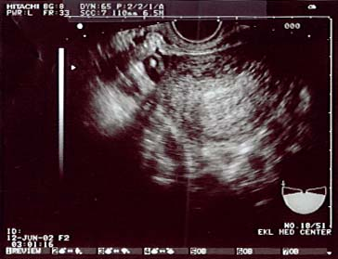

Slide 15
Homogeneous
Tissue has uniform texture

Slide 16
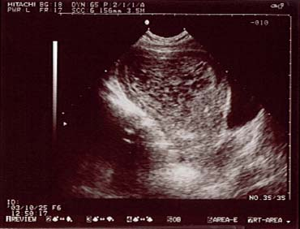
Heterogeneous
Various degrees of echogenicity present

Slide 17
Isoechoic
Two tissues with same of echogenicity

Slide 18
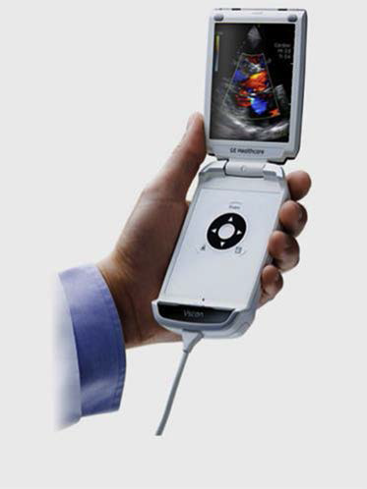

Slide 19
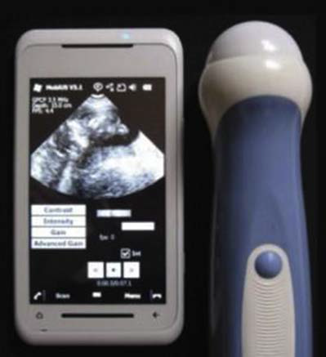

Slide 20
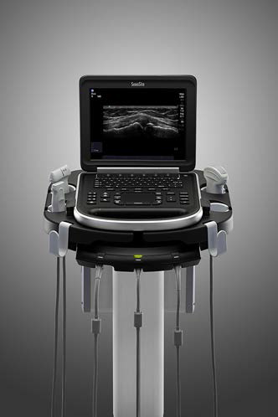

Slide 21
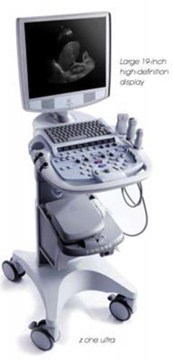

Slide 22
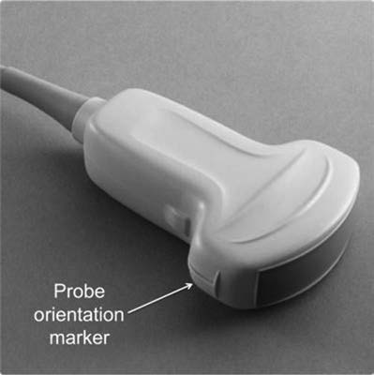

Slide 23
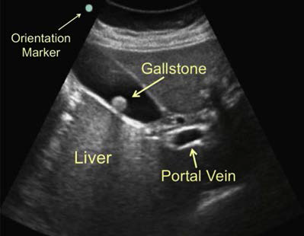

Slide 24
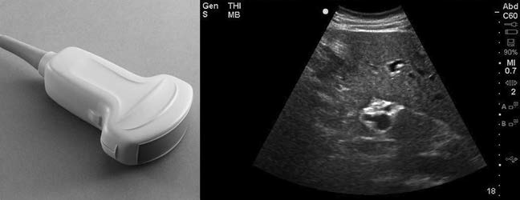
Fig. 16. Curvilinear probe and corresponding ultrasound image.

Slide 25
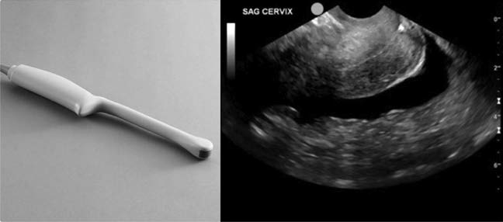
Fig. 17. Intracavitary probe and corresponding ultrasound image.

Slide 26
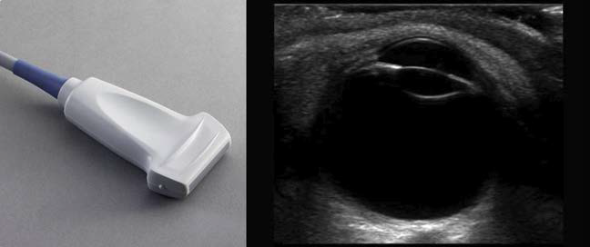
Fig. 18. Linear array transducer and corresponding ultrasound image.

Slide 27
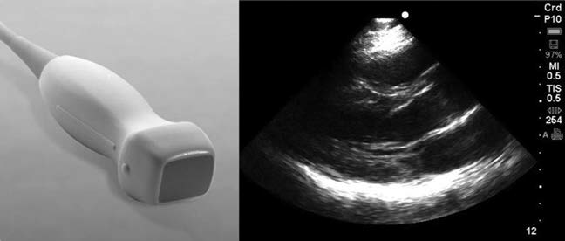
Fig. 19. Phased array transducer and corresponding ultrasound image.

Slide 28
Table 1
Transducer type and clinical use
Probe Type Frequency (MHz) Applications
Curvilinear 2–5 FAST, renal, aorta, IVC, pelvic, bladder, bowel,
appendicitis
Linear 6–15 Ocular, trachea, thyroid, thoracic, vascular
access, DVT, MSK, soft tissue, appendicitis
Intracavitary 8–13 Peritonsillar abscess, pelvic
Phased array/sector 1–5 Cardiac, abdominal, renal, pediatric abdomen,
bladder, bowel, IVC
Abbreviations: DVT, deep venous thrombosis; FAST, focused assessment with sonography in
trauma; IVC, inferior vena cava; MSK, musculoskeletal.

Slide 29
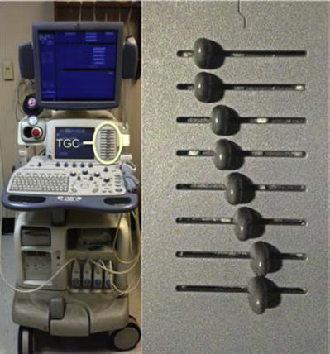
Fig. 23. Time gain compensation (TGC) control.

Slide 30
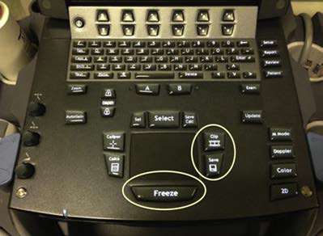
Fig. 24. Freeze, save, and video clip buttons on an ultrasound machine

Slide 31
