Slide 1

The mRNA-LNP vaccines
mohadese baniasadi

Slide 2
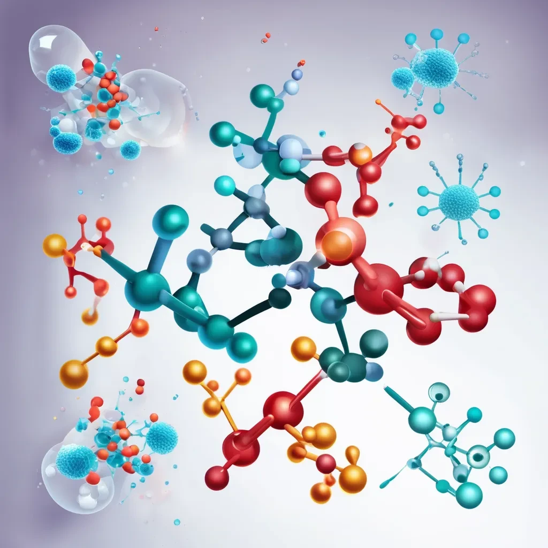
The mRNA-LNP vaccine was widely used as a COVID-19 vaccine in Western countries.
Early clinical trial data suggested these vaccines were safe and effective.But the latest data raise serious concerns about their safety and effectiveness.
It will review the identified safety and efficacy concerns.
It will also discuss the potential mechanism of adverse events and whether they can be mitigated.

Slide 3

non_Standard Components of mRNA
1
DNA Contamination
Recent studies found DNA contamination in Moderna and Pfizer vaccines exceeding
EMA and FDA limits. The health impact of this contamination is still unclear.
2
Double-Stranded RNA (dsRNA)
Low levels of dsRNA can form during production, triggering immune responses and inflammation. Both Pfizer and Moderna vaccines have reported dsRNA presence.
3
Physiological Levels of dsRNA
The Pfizer COVID-19 vaccine contains physiological levels of dsRNA, confirmed experimentally. This dsRNA activates MDA5, a sensor, affecting adaptive immune responses in mice

Slide 4
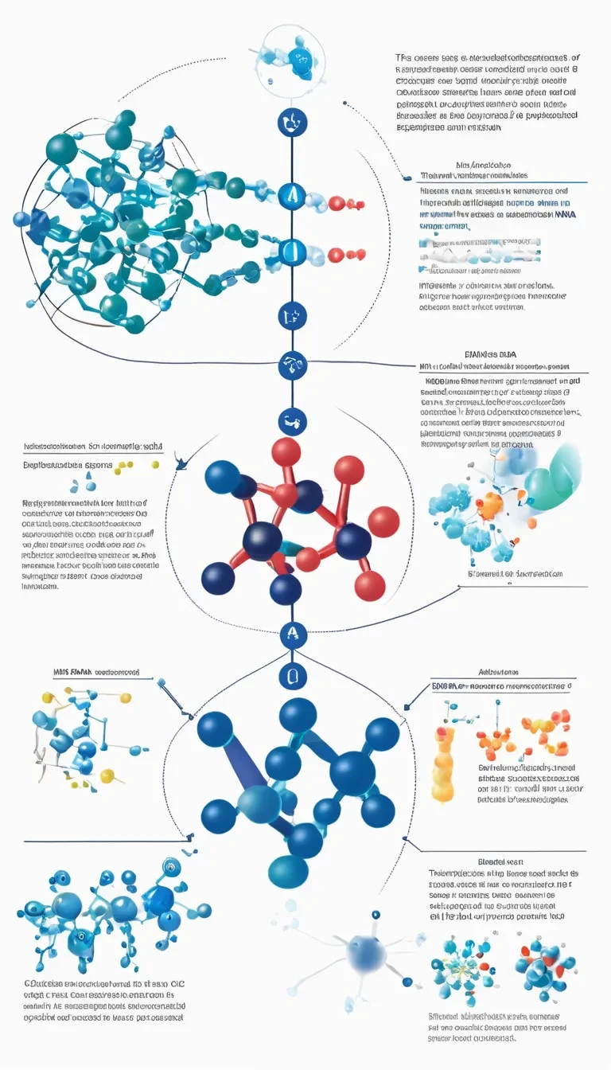



Nucleoside modifications and the removal of double-stranded RNA (dsRNA) using HPLC, introduced by Kariko et al., are crucial for avoiding the activation of innate immune sensors and the production of inflammatory cytokines that would limit protein translation from mRNA
Inflammatory Components
The importance of inflammatory components in the mRNA-LNP platform is highlighted by the inability of highly purified mRNA (with no detectable dsRNA) combined with non-inflammatory LNPs to induce immune responses in vivo.
Contaminants and Variability
Some lots of Pfizer's mRNA vaccines caused minimal side effects, while
others were associated with higher incidences of adverse events.
Purity Assessment
These findings emphasize the need for strict purity criteria and allowable
limits for mRNA vaccines to ensure consistent safety and efficacy.

Slide 5
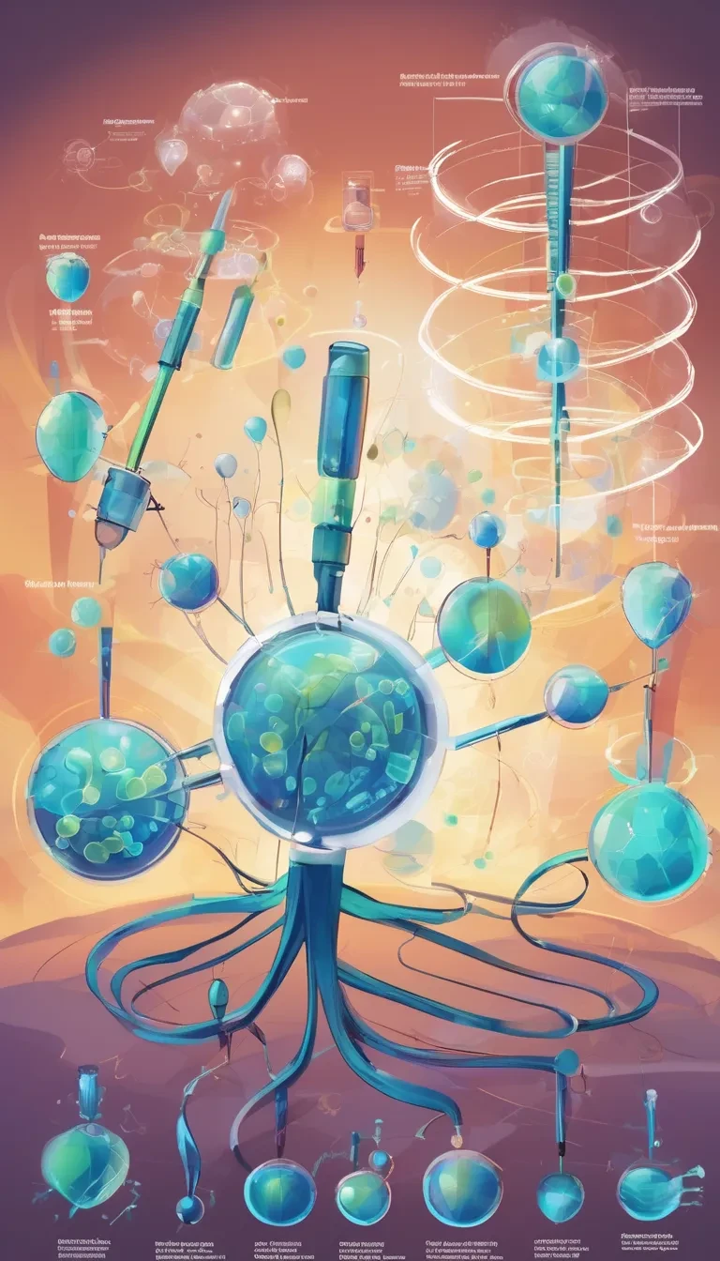
Concerns of mRNA-LNP
Circulating mRNA and Spike Protein:
Vaccine mRNA and spike protein have been detected in plasma for weeks to months post-vaccination. A post-mortem study found vaccine mRNA in lymph nodes and occasionally in heart tissue, but not in liver or spleen.
Modified Nucleotides:
Used in COVID-19 vaccines to decrease innate immune response. N1-methylpseudouridine in mRNA increases immunogenicity.
Spike Protein Translation:
The spike protein of the BNT162c2 vaccine is translated after vaccination. Frame-shift products and adaptive immune responses are specific to this platform.
Extrapolation Risks:
Highlights the danger of applying existing paradigms to new, untested platforms. Issues specific to this platform need to be addressed for future use in humans.

Slide 6
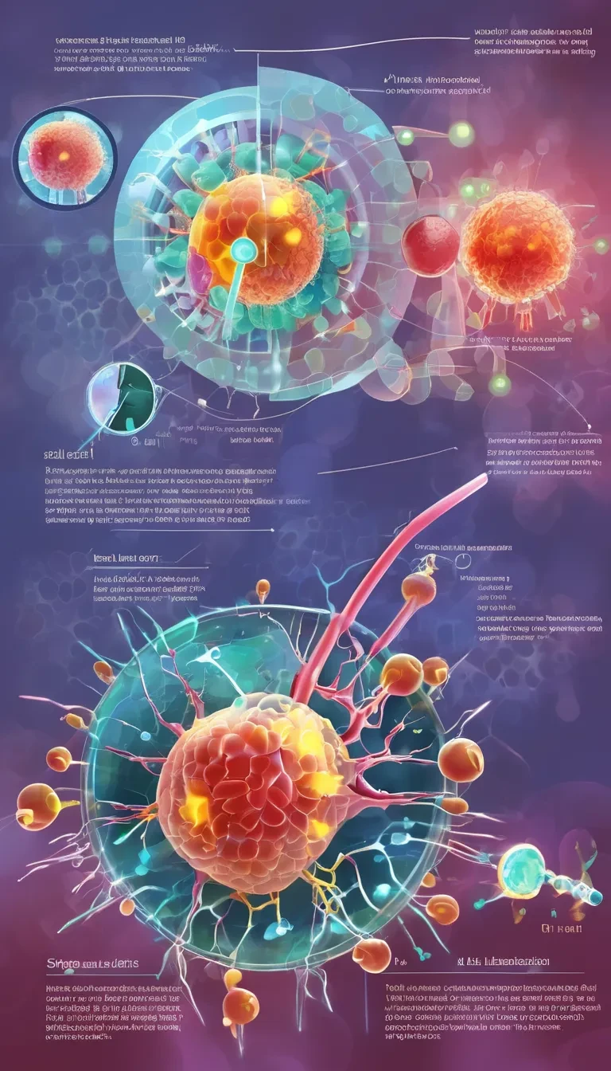
DNA Integration Risks:
Vaccine mRNA reverse-transcribed into DNA poses no risk of insertion into the human genome. However, experimental evidence shows that vaccine mRNA can be reverse-transcribed into DNA in certain cell lines.
LINE-1 Retrotransposon:
Exposure to mRNA-LNP vaccine correlates with increased LINE-1 expression and nuclear localization. This could potentially lead to integration into host DNA.
Spike Protein Localization:
Spike protein has a nuclear localization signal (NLS), allowing its transport to the nucleus. SARS-CoV-2 RNA can be reverse-transcribed and integrated into human cell genomes.
Durability and Degradation:
Vaccine mRNA is degraded within hours to days, limiting its potential to disrupt normal cell biology. Human lymph node biopsies revealed detectable levels of vaccine mRNA and spike proteins up to eight days post-vaccination.

Slide 7

Safety and efficacy
Immune-Tolerant Environment:
Recent studies suggest a correlation between increased doses of mRNA vaccines and higher risk of catching COVID-19. This indicates that the vaccines' efficacy in reducing disease severity and death might be due to their immune suppressive characteristics.
Need for Pre-Clinical Studies:
These findings highlight the necessity of rigorous pre-clinical studies to avoid unexpected consequences for new vaccine platforms.
Efficacy Erosion:
The ability of these therapeutics to prevent infections and limit virus spread has decreased over time. Their current efficacy is mainly in reducing disease severity and death in susceptible individuals.
inflammatory Response:
Excess inflammation (cytokine storm) is a major issue in severe COVID-19 cases. If mRNA-LNP vaccines reduce systemic inflammatory response, this could explain their efficacy in reducing disease severity in delta and omicron variants.

Slide 8
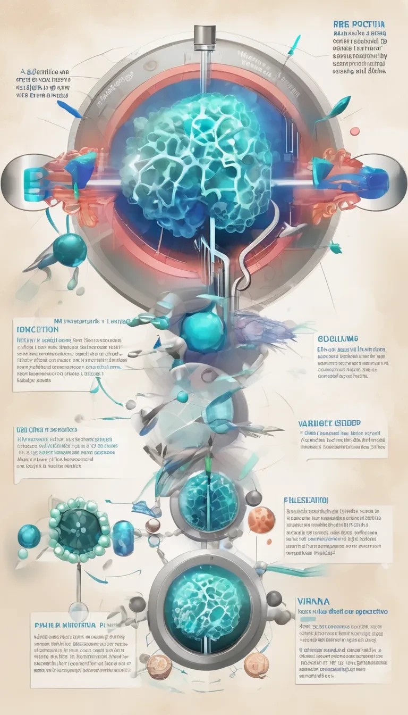
Efficacy Erosion:
The ability of these therapeutics to prevent infections and limit virus spread has decreased over time. Their current efficacy is mainly in reducing disease severity and death in susceptible individuals.
Inflammatory Response:
Excess inflammation (cytokine storm) is a major issue in severe COVID-19 cases. If mRNA-LNP vaccines reduce systemic inflammatory response, this could explain their efficacy in reducing disease severity in delta and omicron variants. Studies have shown dampened immune responses in vaccinated individuals and altered immune fitness in mice.
Adverse Events:
Case reports of severe inflammatory/autoimmune events have been increasing. An analysis of VAERS data reflects diverse adverse effects of the vaccines. The causal relationship between mRNA-LNP vaccines and severe adverse events (SAEs) has primarily been investigated in trials among males.
Risk Factors:
Potential underlying risk factors for myocarditis include prior infection and demographic factors.

Slide 9

Inflammatory responses
Categories of SAEs:
The SAEs can be divided into inflammatory and anergy/hypo-responsiveness categories. Inflammatory side effects include acute reactogenicity (fever, headache, fatigue, myalgia, arthralgia, chills, etc.), autoimmune, and anti-PEG mediated CARPA, along with other events involving activation of the innate immune system. Anorexic side effects (immune suppression) present as serious rare reactions, such as those involving varicella-zoster virus (VZV) and hepatitis C virus (HCV) following COVID-19 mRNA vaccination.
Mechanisms:
The inflammatory nature of this therapeutic is linked to the ionizable lipid component of the LNPs and potentially accentuated by pro-inflammatory contaminants such as dsRNA. The acute reactive responses (fever, headache, fatigue, etc.) are likely triggered by the release of various inflammatory cytokines (IL-1β, IL-6, GM-CSF, type I interferon).

Slide 10

Tolerogenic responses
Infection Protection Waning:
Protection against micron infection waned rapidly after the booster and seven months post-medication, with a higher incidence of infection among those who had a booster compared to those with only the primary series.
Immune Activation and Exhaustion:
The mRNA-LNP platform acts in the presence of sensitized T cells and T cell exhaustion, leading to continuously altered immune response and responsiveness. Exposure to mRNA-LNP leads to a rapid release of inflammatory cytokines associated with type I interferons, inducing out-of-sequence stimulation and exposing adaptive immune cells to an inflammatory environment before mRNA is translated into protein.

Slide 11

Brain bites
Ethical Reflections on Mass Vaccination
Scrutiny of the mRNA-LNP Platform
Questioning the Vaccine Design
The text questions whether the strategy of mass vaccination with a vaccine that provides minimal protection against infection and transmission was sound, and whether it inadvertently accelerated virus mutations
The text calls for scrutiny of the decision to opt for the mRNA-LNP platform over traditional vaccine methods, considering both its advantages and limitations, such as production constraints, affordability, and unknown short- and long-term side effects.
The text questions the focus on a single virus protein with a high mutation rate and whether the vaccine's ease of updating features was critical to fighting against variants.
Concerns about Ignoring Immunology Knowledge
Calls for Open Dialogue and Scrutiny of Data
basic immunology knowledge on how factors like antigen dose, repeated boosters, pre-existing antibodies, and antigenic sin affect the immune system was mostly ignored during the pandemic.
The text emphasizes the importance of fostering open dialogue, considering all perspectives, and employing logic and reasoning for better future preparedness.

Slide 12

Conclusion
Overall, mRNA-LNP technology presents significant benefits in providing effective vaccines that can be rapidly deployed in response to public health threats. However, it is crucial to address safety concerns, improve public understanding, and ensure equitable access to maximize its positive impact. The technology is fundamentally good, but its successful implementation depends on ongoing scrutiny, transparent communication, and equitable distribution.

